Slide 2
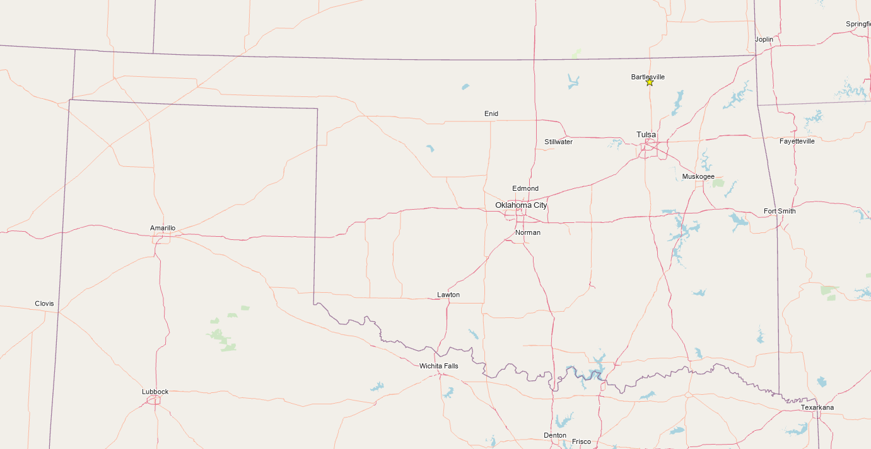
Service area – 36 sq mi
Total Population – 40,000
Bville Population – 37,000
Avg Daily WW – 6.5 MGD
WWM staff – 11
1 Vactor, 1 Rodder
1 Camera Van

Slide 3
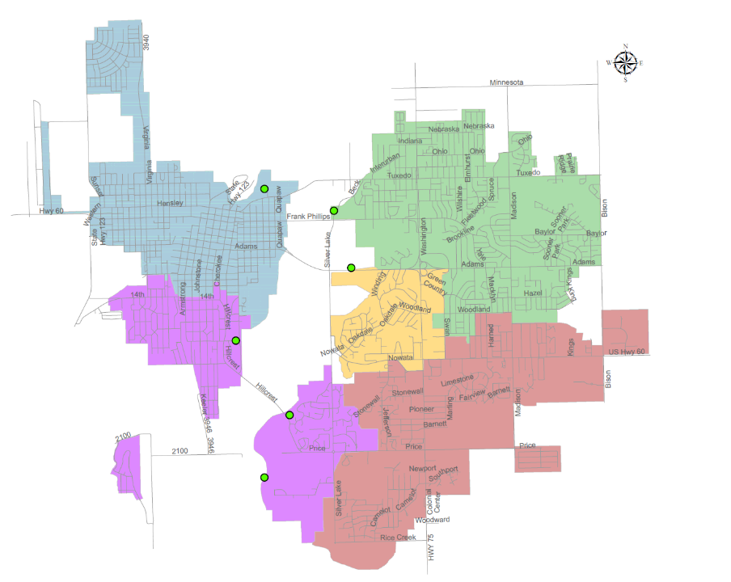
WASTEWATER SYSTEM MAP
Wastewater
Treatment Plant (7 mgd)
Tuxedo
Lift Station
Woodland
Lift Station
Shawnee
Lift Station
Hillcrest
Lift Station
LEGEND
Direction of flow per basin
Lift Station
Force Main
Treatment Plant
Golf Course
Lift Station
Limestone
Lift Station
To Ex. Flow Equalization Basin

Slide 4
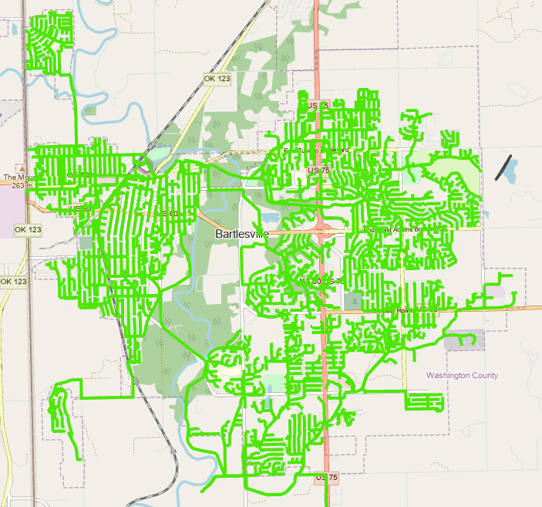
NO BYPASSES
Collection system:
270 miles
9,342 manholes

Slide 5
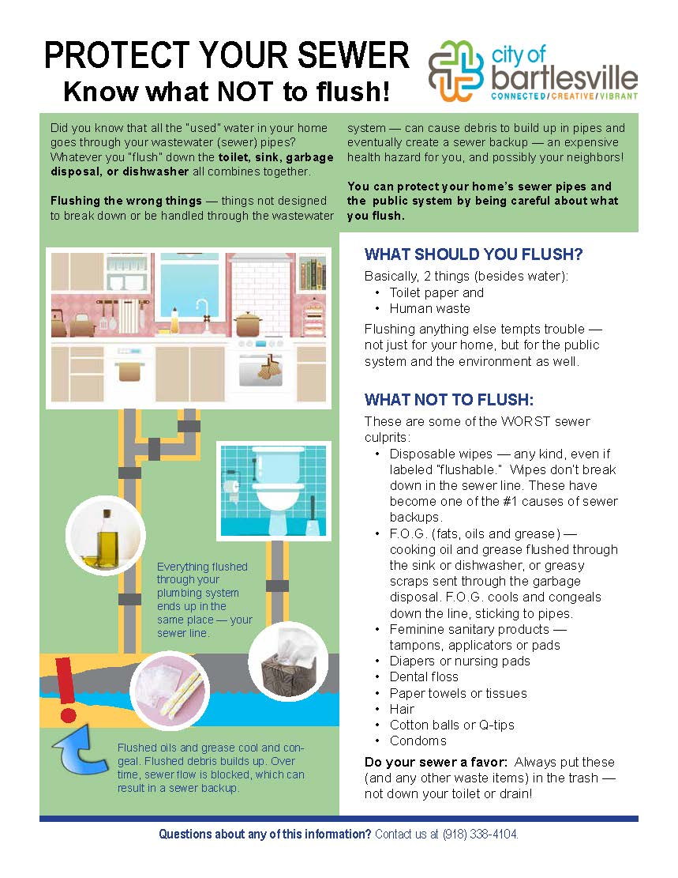
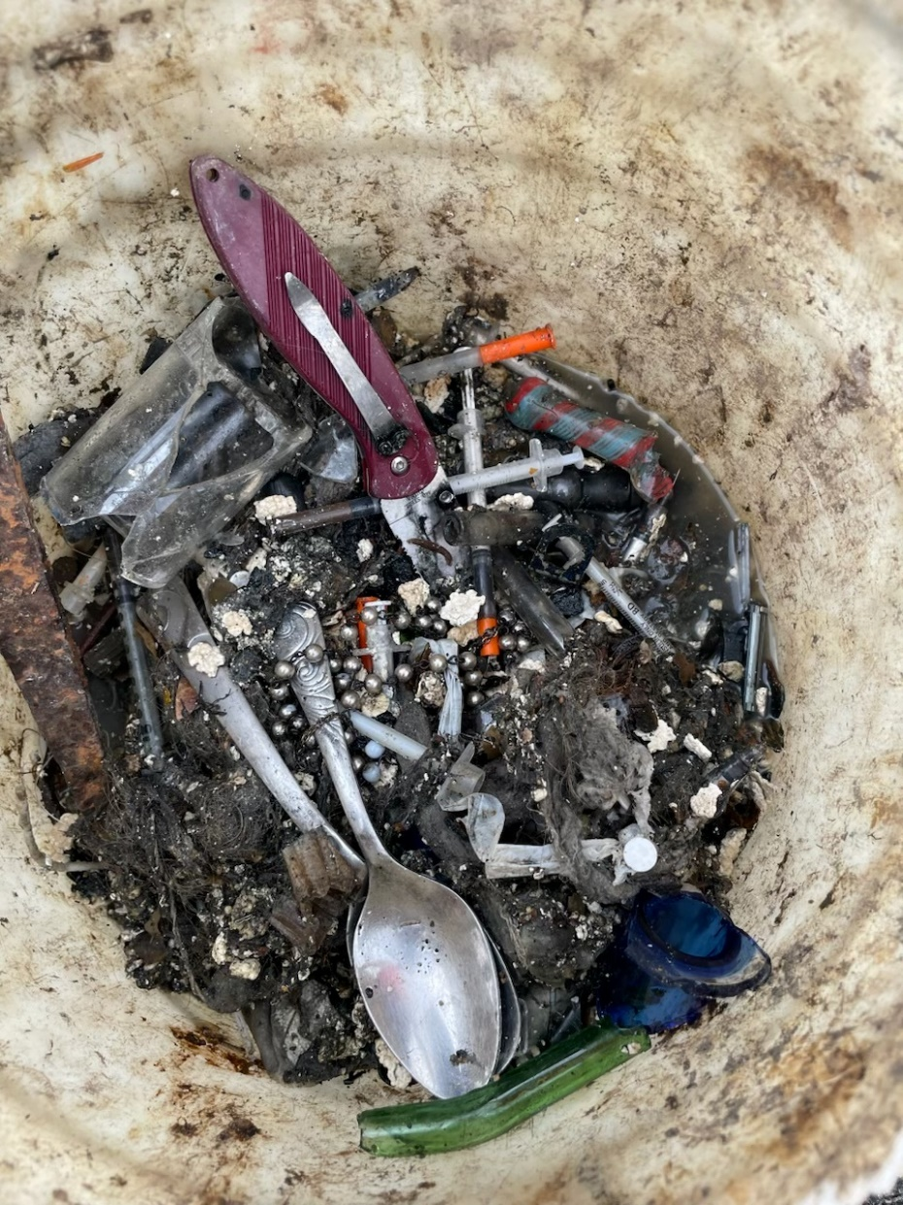
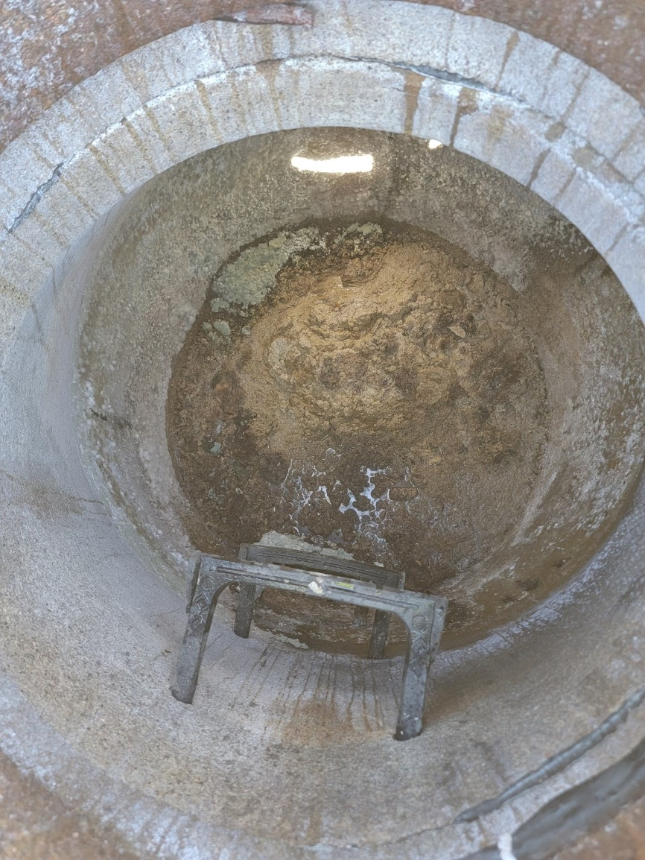
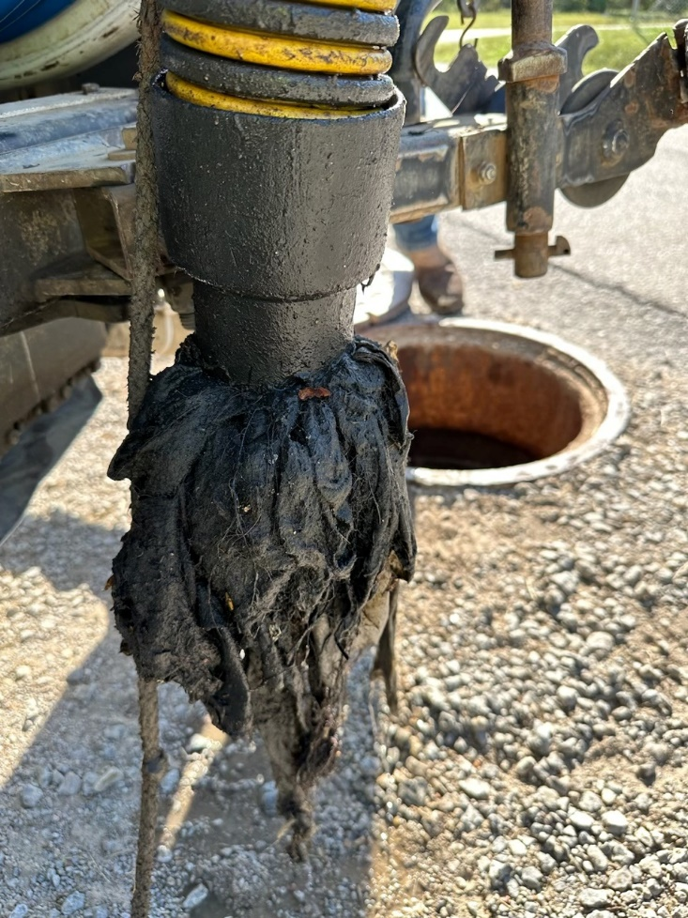
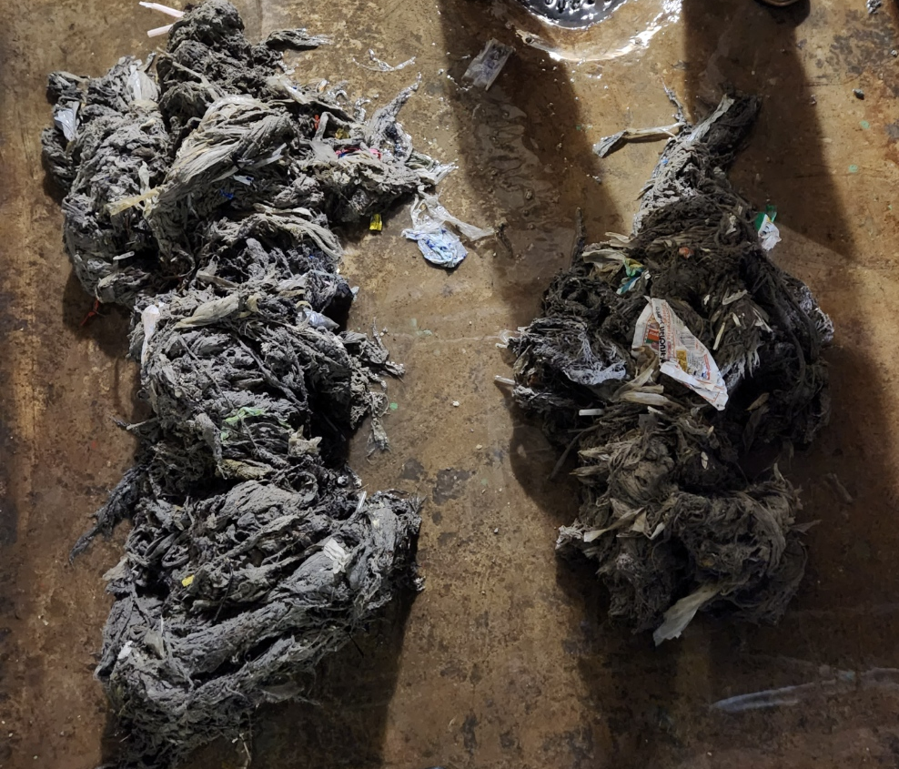
BYPASS/OVERFLOW
AGING INFRASTRUCTURE
INFLOW/INFILTRATION
FOG
RAGS/WIPES
OTHER

Slide 6
NO BYPASSES
UP TO 2.5” RAIN EVENT
Collection system:
270 miles
9,342 manholes

Slide 7
Year | Total # Bypasses | Bypasses caused by rain (I&I) | Rain events over 2.5 inches | Bypasses caused by grease, roots, or debris | Bypasses caused by disinfectant wipes | Bypasses caused by other (line breaks, pump failures, etc)
2014 | 21 | 33% | 100% | 52% | 0% | 14%
2015 | 56 | 77% | 33% | 20% | 0% | 4%
2016 | 36 | 75% | 96% | 22% | 0% | 3%
2017 | 97 | 80% | 29% (58% -2.5 in evnts) | 8% | 5% | 6%
2018 | 11 | 0% | 0% | 82% | 0% | 18%
2019 | 64 | 72% | 74% | 8% | 3% | 17%
2020 | 72 | 69% | 34% | 8% | 4% | 18%
2021 | 110 | 74% | 62% | 9% | 11% | 6%
2022 | 24 | 71% | 47% | 0% | 8% | 21%
2023* | 7 | 0% | 0% | 14% | 71% | 14%
* Through end of Sept.
Year | Total # Bypasses | Bypasses caused by rain (I&I) | Rain events over 2.5 inches
2014 | 21 | 33% | 100%
2015 | 56 | 77% | 33%
2016 | 36 | 75% | 96%
2017 | 97 | 80% | 29% (58% -2.5 in evnts)
2018 | 11 | 0% | 0%
2019 | 64 | 72% | 74%
2020 | 72 | 69% | 34%
2021 | 110 | 74% | 62%
2022 | 24 | 71% | 47%
2023* | 7 | 0% | 0%
* Through end of Sept.
Year | Total # Bypasses | Bypasses caused by rain (I&I)
2014 | 21 | 33%
2015 | 56 | 77%
2016 | 36 | 75%
2017 | 97 | 80%
2018 | 11 | 0%
2019 | 64 | 72%
2020 | 72 | 69%
2021 | 110 | 74%
2022 | 24 | 71%
2023* | 7 | 0%
* Through end of Sept.
Year | Total # Bypasses
2014 | 21
2015 | 56
2016 | 36
2017 | 97
2018 | 11
2019 | 64
2020 | 72
2021 | 110
2022 | 24
2023* | 7
* Through end of Sept.
Collection system:
270 miles
9,342 manholes

Slide 8
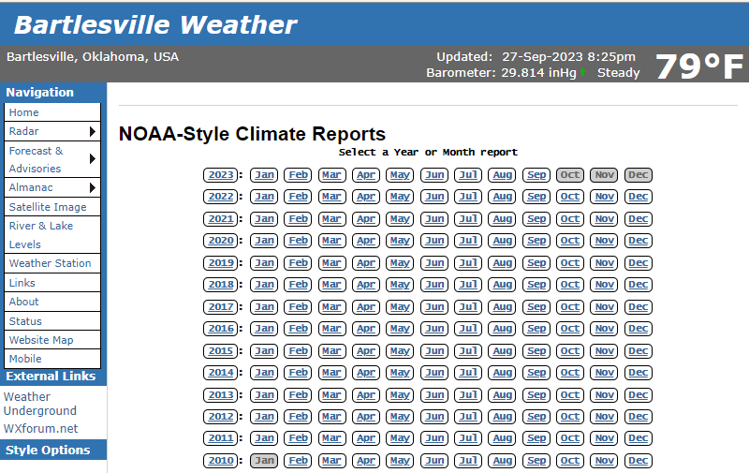
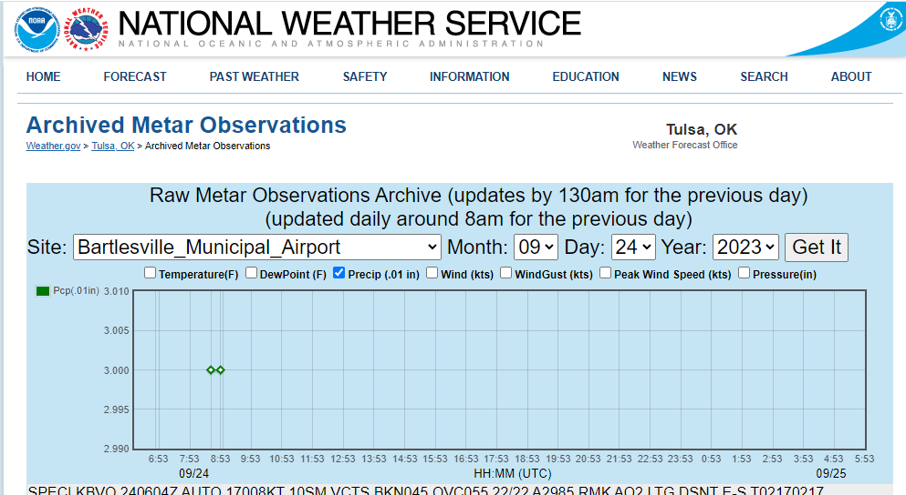
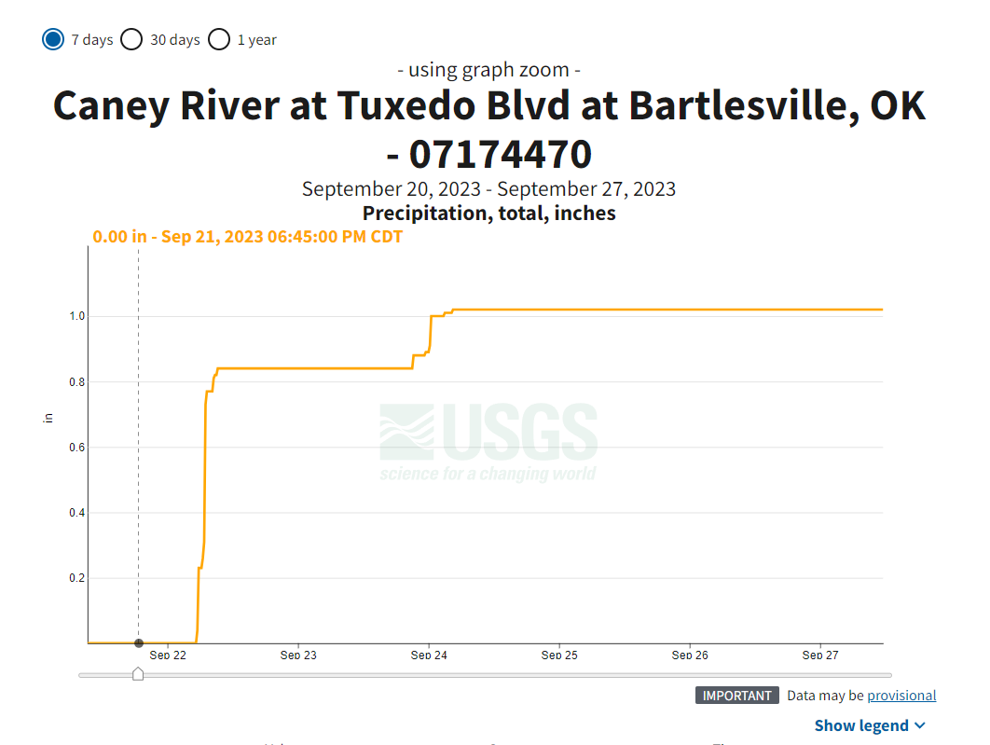
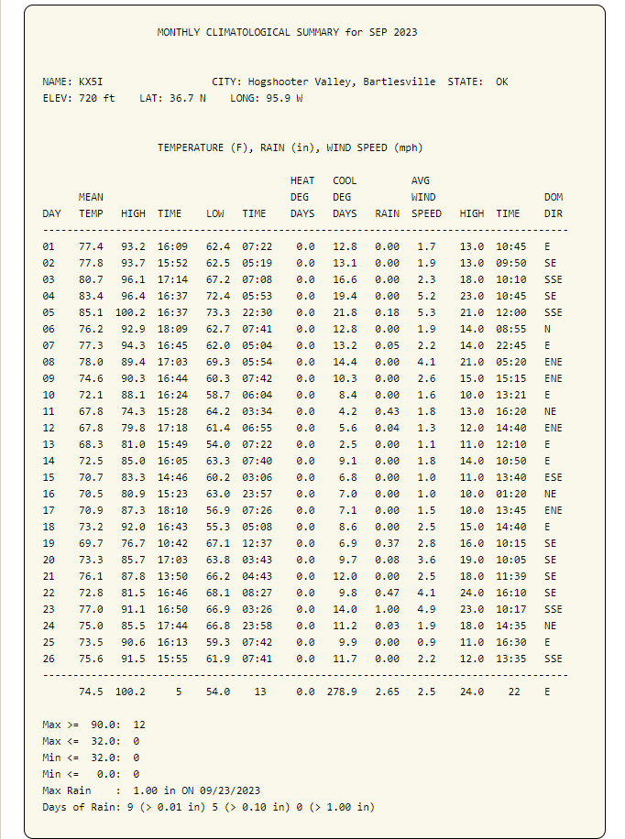
Year | Total # Bypasses | Bypasses caused by rain (I&I) | Rain events over 2.5 inches
2014 | 21 | 33% | 100%
2015 | 56 | 77% | 33%
2016 | 36 | 75% | 96%
2017 | 97 | 80% | 29% (58% -2.5 in evnts)
2018 | 11 | 0% | 0%
2019 | 64 | 72% | 74%
2020 | 72 | 69% | 34%
2021 | 110 | 74% | 62%
2022 | 24 | 71% | 47%
2023* | 7 | 0% | 0%
* Through end of Sept.
Year | Total # Bypasses | Rainfall (in) | Rainfall (in) above/below Annual Avg. | Bypasses caused by rain (I&I) | Rain events over 2.5 inches | Bypasses caused by grease, roots, or debris | Bypasses caused by disinfectant wipes | Bypasses caused by other (line breaks, pump failures, etc)
2014 | 21 | 33.74 | -6.68 | 33% | 100% | 52% | 0% | 14%
2015 | 56 | 44.43 | 4.01 | 77% | 33% | 20% | 0% | 4%
2016 | 36 | 32.03 | -8.39 | 75% | 96% | 22% | 0% | 3%
2017 | 97 | 45.69 | 5.27 | 80% | 29% (58% -2.5 in evnts) | 8% | 5% | 6%
2018 | 11 | 34.03 | -6.39 | 0% | 0% | 82% | 0% | 18%
2019 | 64 | 55.18 | 14.76 | 72% | 74% | 8% | 3% | 17%
2020 | 72 | 40.8 | 0.38 | 69% | 34% | 8% | 4% | 18%
2021 | 110 | 39.44 | -0.98 | 74% | 62% | 9% | 11% | 6%
2022 | 24 | 28.28 | -12.14 | 71% | 47% | 0% | 8% | 21%
2023* | 7 | 20.49 | -19.93 | 0% | 0% | 14% | 71% | 14%
* Through end of Sept.
Collection system:
270 miles
9,342 manholes

Slide 9
Year | Total # Bypasses | Footage Cleaned (ft) | SL-RAT (ft) | Point Repairs (ft) | Rainfall (in) | Rainfall (in) above/below Annual Avg. | Bypasses caused by rain (I&I) | Rain events over 2.5 inches
2014 | 21 | 646,433 | N/A | 411 | 33.74 | -6.68 | 33% | 100%
2015 | 56 | 645,688 | N/A | 1,205 | 44.43 | 4.01 | 77% | 33%
2016 | 36 | 649,200 | N/A | 1,921 | 32.03 | -8.39 | 75% | 96%
2017 | 97 | 1,101,179 | N/A | 1,726 | 45.69 | 5.27 | 80% | 29% (58% -2.5 in evnts)
2018 | 11 | 1,472,471 | N/A | 3,708 | 34.03 | -6.39 | 0% | 0%
2019 | 64 | 687,066 | N/A | 667 | 55.18 | 14.76 | 72% | 74%
2020 | 72 | 110,847 | 148,700 | 387 | 40.8 | 0.38 | 69% | 34%
2021 | 110 | 114,718 | 228,450 | 625 | 39.44 | -0.98 | 74% | 62%
2022 | 24 | 126,332 | 401,450 | 1,032 | 28.28 | -12.14 | 71% | 47%
2023* | 7 | 175,413 | 438,100 | 1,439 | 20.49 | -19.93 | 0% | 0%
* Through end of Sept.
Year | Total # Bypasses | Footage Cleaned (ft) | SL-RAT (ft) | Point Repairs (ft) | Rainfall (in) | Rainfall (in) above/below Annual Avg. | Bypasses caused by rain (I&I) | Rain events over 2.5 inches
2023* | 7 | 175,413 | 438,100 | 1,439 | 20.49 | -19.93 | 0% | 0%
2018 | 11 | 1,472,471 | N/A | 3,708 | 34.03 | -6.39 | 0% | 0%
2014 | 21 | 646,433 | N/A | 411 | 33.74 | -6.68 | 33% | 100%
2022 | 24 | 126,332 | 401,450 | 1,032 | 28.28 | -12.14 | 71% | 47%
2016 | 36 | 649,200 | N/A | 1,921 | 32.03 | -8.39 | 75% | 96%
2015 | 56 | 645,688 | N/A | 1,205 | 44.43 | 4.01 | 77% | 33%
2019 | 64 | 687,066 | N/A | 667 | 55.18 | 14.76 | 72% | 74%
2020 | 72 | 110,847 | 148,700 | 387 | 40.8 | 0.38 | 69% | 34%
2017 | 97 | 1,101,179 | N/A | 1,726 | 45.69 | 5.27 | 80% | 29% (58% -2.5 in evnts)
2021 | 110 | 114,718 | 228,450 | 625 | 39.44 | -0.98 | 74% | 62%
* Through end of Sept.
Collection system:
270 miles
9,342 manholes

Slide 10
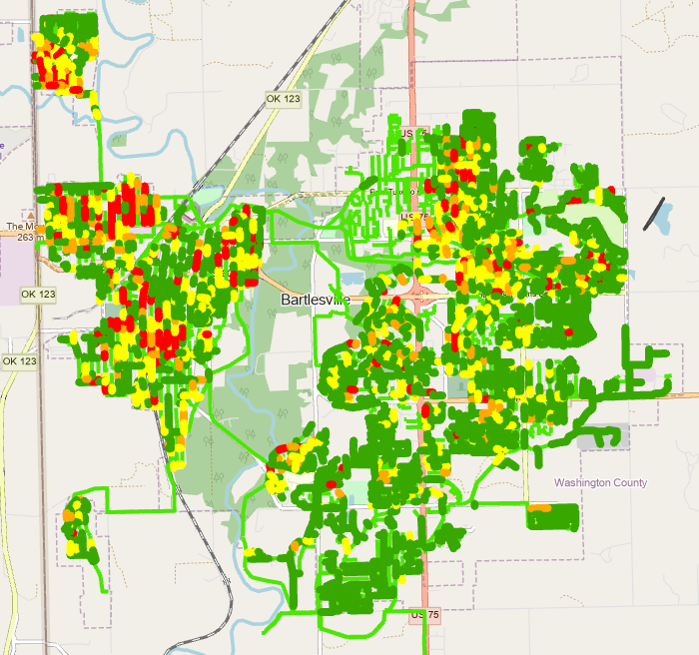
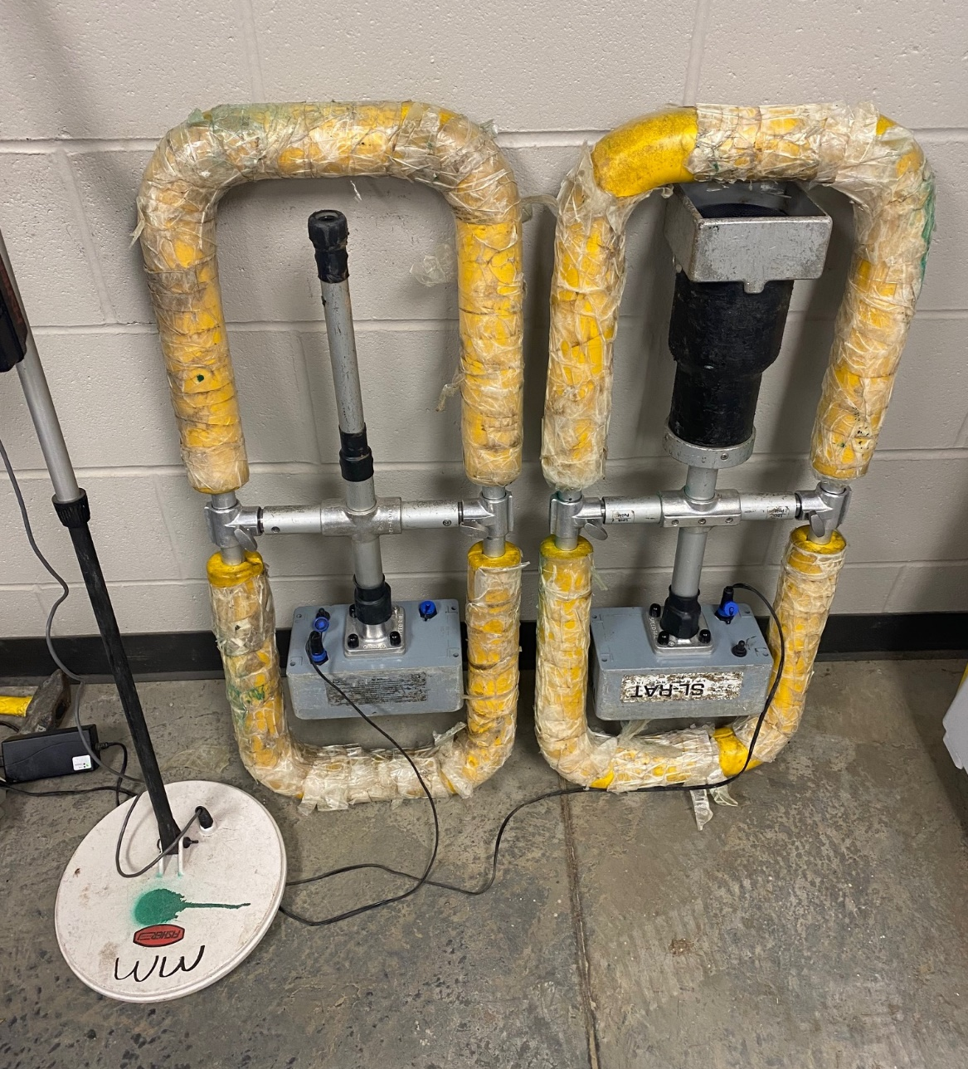
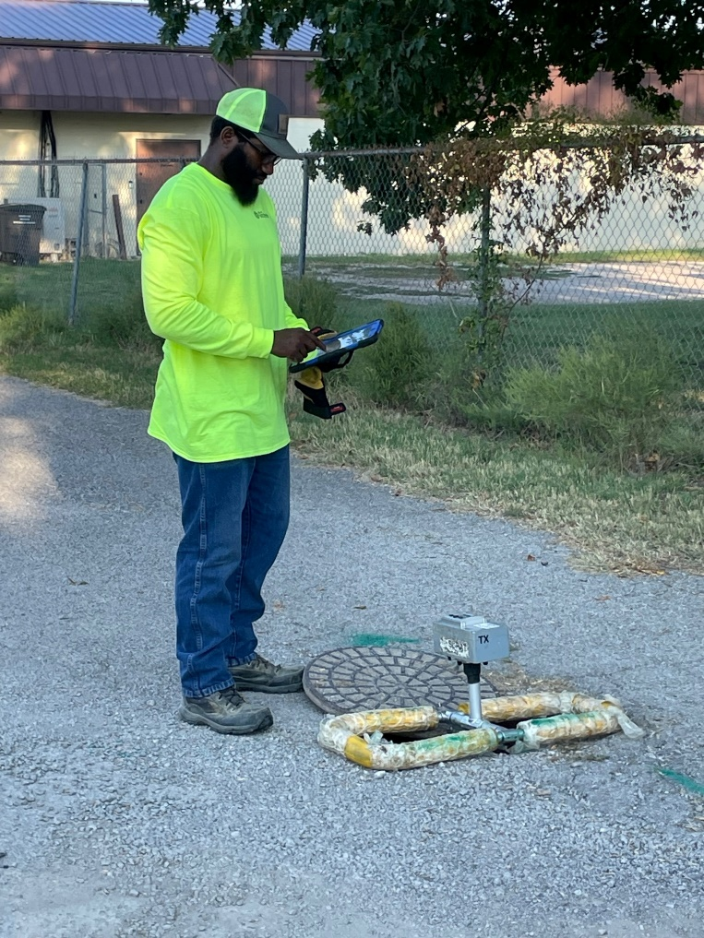
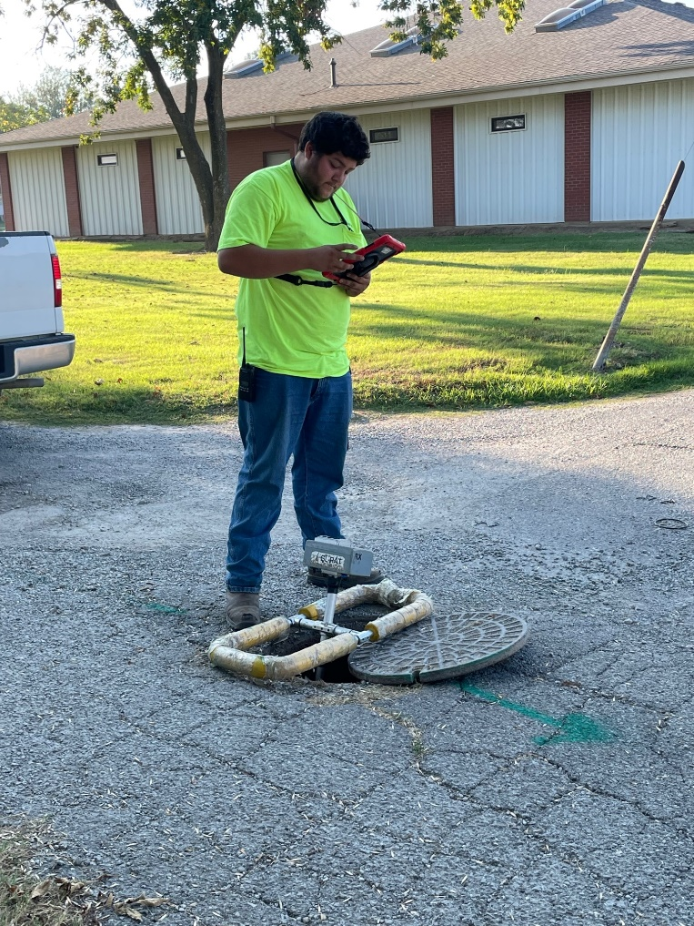
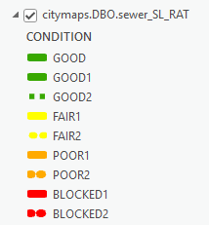
Year | Total # Bypasses | Footage Cleaned (ft) | SL-RAT (ft) | Point Repairs (ft) | Rainfall (in) | Rainfall (in) above/below Annual Avg. | Bypasses caused by rain (I&I) | Rain events over 2.5 inches
2014 | 21 | 646,433 | N/A | 411 | 33.74 | -6.68 | 33% | 100%
2015 | 56 | 645,688 | N/A | 1,205 | 44.43 | 4.01 | 77% | 33%
2016 | 36 | 649,200 | N/A | 1,921 | 32.03 | -8.39 | 75% | 96%
2017 | 97 | 1,101,179 | N/A | 1,726 | 45.69 | 5.27 | 80% | 29% (58% -2.5 in evnts)
2018 | 11 | 1,472,471 | N/A | 3,708 | 34.03 | -6.39 | 0% | 0%
2019 | 64 | 687,066 | N/A | 667 | 55.18 | 14.76 | 72% | 74%
2020 | 72 | 110,847 | 148,700 | 387 | 40.8 | 0.38 | 69% | 34%
2021 | 110 | 114,718 | 228,450 | 625 | 39.44 | -0.98 | 74% | 62%
2022 | 24 | 126,332 | 401,450 | 1,032 | 28.28 | -12.14 | 71% | 47%
2023* | 7 | 175,413 | 438,100 | 1,439 | 20.49 | -19.93 | 0% | 0%
* Through end of Sept.
Collection system:
270 miles
9,342 manholes

Slide 11
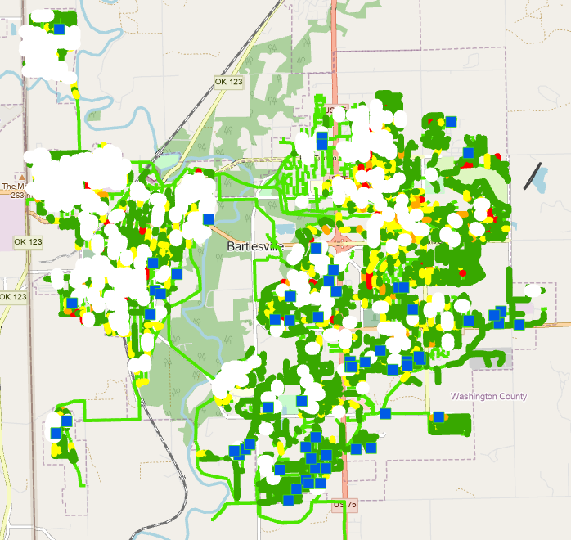
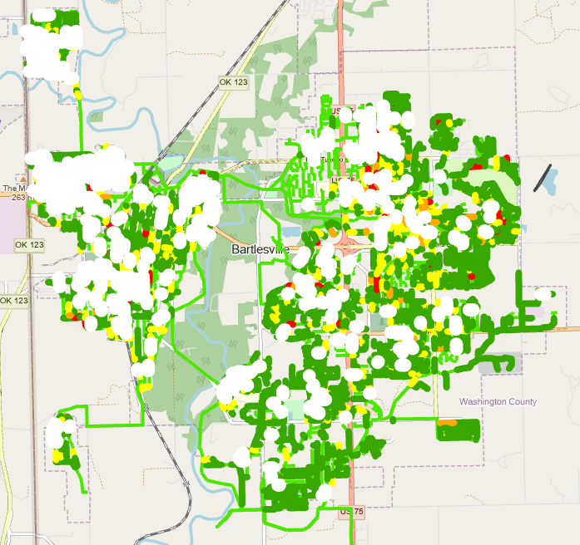
Collection system:
270 miles
9,342 manholes

Slide 12
PILOT PROGRAM
$750k TO UPGRADE PS AND FORCE MAIN
$1.75MM TO UPGRADE PS AND FORCE MAIN
Ex. Pump Stations can handle up to 4.5 times average flow
During rain events, peak flow was 18 times average flow

Slide 13
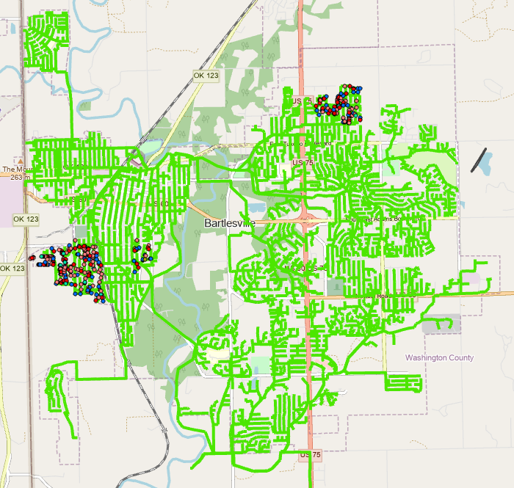
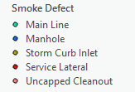
PILOT PROGRAM
$300k – CITY DEFECTS
$250k – PRIVATE SIDE DEFECTS
95 CITY DEFECTS
73 MANHOLE FRAME SEALS
223 PRIVATE SIDE DEFECTS
134 UNCAPPED CLEANOUTS
89 SERVICE LINE DEFECTS

Slide 14
PILOT PROGRAM
PROPERTY OWNER SIGNS AGREEMENT:
ALLOWS ACCESS FOR REPAIR
INDEMNIFY THE CITY
ACKNOWLEDGE SERVICE LINE REMAINS PROPERTY
AND RESPONSIBILITY OF PROPERTY OWNER AFTER
REPAIR IS COMPLETE
CITY HIRES A LICENSE PLUMBER TO PERFORM WORK
PLUMBER PROVIDES A 1-YEAR WARRANTY TO
PROPERTY OWNER
ANY WARRANTY WORK BETWEEN PROPERTY
AND PLUMBER

Slide 15
PILOT PROGRAM
$20k ON CITY DEFECTS
$30k ON PRIVATE SIDE DEFECTS
99% COMPLETE
$10k ON CITY DEFECTS
$10k ON PRIVATE SIDE DEFECTS
5% COMPLETE

Slide 16
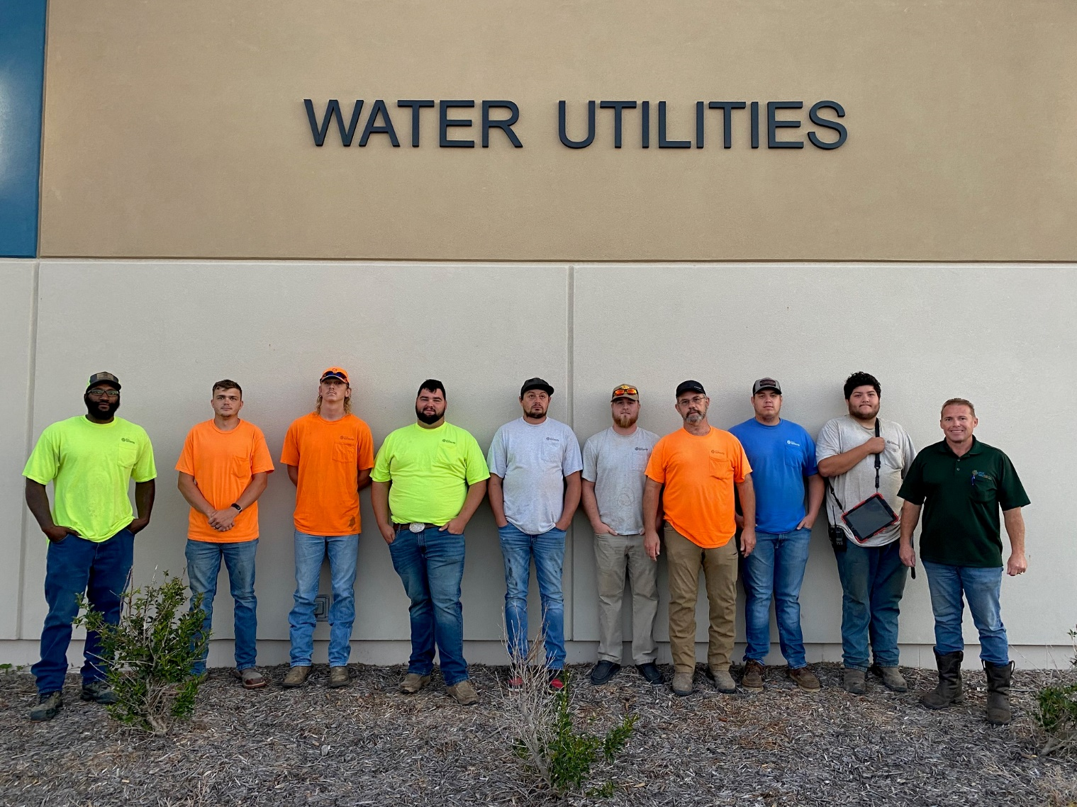
Terry Lauritsen – (918) 338-4107; tllaurit@cityofbartlesville.org

