Slide 1

Sanitary Sewer System Maintenance
Back to Basics, A Pragmatic Approach for Small Communities
October 10, 2023

Slide 2
Agenda
Today we will look at
  Key Drivers
  Why focus on Small Town Oklahoma
  Best Practices
  Standards
  Population Perspective
  Help is Out There
  Play the Long Game

Slide 3
Acknowledgements
Oklahoma Municipal Assurance Group (OMAG) - help cities and towns improve the quality of life of their citizens through not-for-profit risk pool and risk management solutions
Oklahoma Municipal League
Oklahoma Municipal Utility Providers
City of Fairview Staff

Slide 4
Key Drivers
OMAG has seen increased sanitary sewer claims for their covered cities and towns
  Trends are increasing in frequency and severity (costs)
  These judgements divert limited resources to settlements
OMAG with help of an array of organizations and communities is continuing to emphasize this issue with the goal of encouraging discussions and actions to address sanitary sewer key topics
All municipalities are exposed to these increased risks from sanitary sewer backup and overflows
  Age of our underground systems
  Limited budgets and competing priorities
The improvement of our maintenance and operations benefits all cities and towns in the risk pool
  Sanitary sewer systems conditions will gradually improve
  Municipalities not in the risk pool can benefit from this approach

Slide 5
Smaller Community Focus
597 Municipalities in Oklahoma
  75 have a population greater than 5,000 people
  522 have a population less than that
•Predominantly small communities

Slide 6
Smaller Community Focus
An affinity towards our smaller communities
They operate with much more limited budgets and manpower
  Encourage and show there is a path forward
  Our infrastructure degraded over time and if we don’t change our methods, no amount of money will fix the root cause
Backups and overflows settlement costs and emergency repair costs can impact viability
  A single major incident could damage the communities trust
    “… you had one job to do”
Our small towns have been overlooked
  Magnitude of the improvements needed, rate structures, and debit service levels
  Declining populations

Slide 7
Best Practices
There are numerous best practices documents, for example
  OMUP –June 2023 Draft (in-work)
  *Georgia Association of Water Professionals - April 2016
Information Management | Preventive Maintenance
Corrective Maintenance | Planning and Improvements
System mapping | Hydraulic modeling | Flow & rainfall
Fats, oil, and grease | Maintenance program | Assessment & rehab
Contingency & emergency plan
*Note: Edited and Condensed for Simplicity

Slide 8
Best Practices and Standards
There are numerous best practices documents for example (continued)
  *APWA, ASCE, NACWA, and WEF – July 2010
System inventory & IM | Maintenance management system | Safety& Training
Emergency planning | System maintenance | Source control
Condition Assessment | Hydraulic Assessment | Standards
Communication & outreach | Monitoring, measuring, & Modification | Adequate funding
*Note: Shortened Core Attribute Title for Simplicity

Slide 9
Best Practices
It doesn’t matter where you start…..just start
Information Management
Preventive Maintenance
Corrective Maintenance
Planning
Improvements
Corrective Maintenance
Planning
Improvements
Preventive Maintenance
Information Management
Not a one size fits all applications

Slide 10
Best Practices
Information Management
  Keeping records (GIGO)
    Size your actions to fit your needs
      Paper and crayons?
  Inventory your system
    Total line footage, Manhole locations, Establish manhole ID, and Flow data
    Manhole physical inspections
    SL-RAT
    Dye testing
    GPS
    Build a map (Keeping records)
      Electronic mapping
      Wall maps
      Spread sheet?

Slide 11
Best Practices
Information Management
  Sewer Line Rapid Assessment Tool (SL-RAT)
    OMAG sponsored service
    Signal transmitter and receiver used to approximate line integrity between two manholes.
      Signal strength at the receiver is weaken by obstructions or poor line condition
      Quick assessment and allows focus for CCTV follow up
  Allows targeted funding
  Keeping records (GIGO)
    Size your actions to fit your needs
    Schedule inspections periods pragmatically

Slide 12
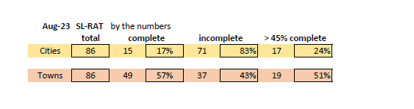
Best Practices
SL-RAT Current Status
Fairview
  75% Initial assessment
  Scheduling some rework due to conflicting data
  Video camera during 1st Q 2024

Slide 13
Best Practices
Utilizing Diamond Maps –Starting at $20/month
  GIS based map of systems
  Record GPS location with smart phones and tablets
  Record maintenance in attribute layer
  Commercial tool; Web based

Slide 14
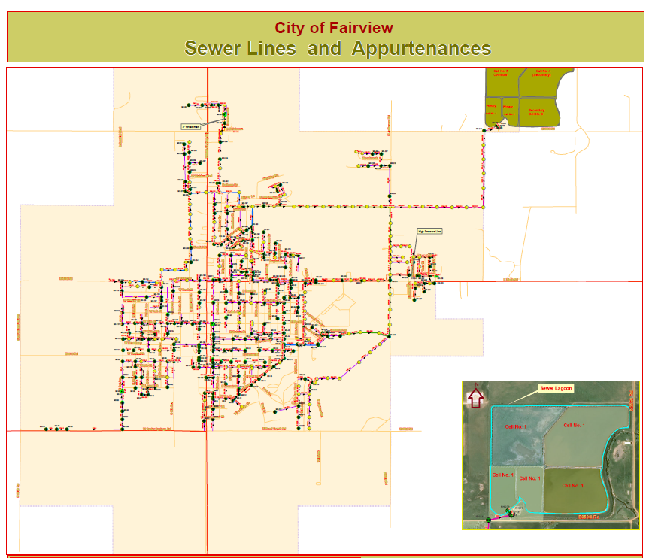
Best Practices

Slide 15
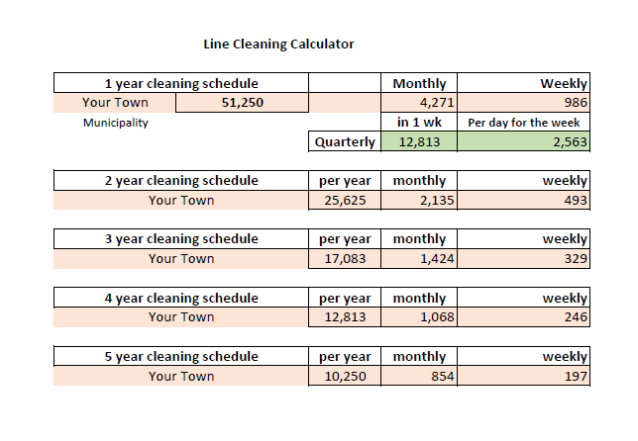
Best Practices
Preventive Maintenance
  Priorities generated through Information Management
  Create an achievable maintenance plan to fit your system and work force
    Set a goal, any goal
      Inspect one block per month
      Tell you community
    Recommend starting down stream
    Use your budgets to establish a commitment
      Encourages reporting
  Keeping records
    Size your actions to fit your needs

Slide 16
Best Practices
Corrective Maintenance
  Point repairs
    Priorities generated through Information Management
    Targets limited funding
  Have an emergency plan
    Keep it simple
    Mutual support agreements
    Identify equipment needs and potential sources
  Work orders
  Keeping records
    Size your actions to fit your needs

Slide 17
Best Practices
Planning and Improvements
  Plans based on knowledge collect through Information Management
    3 to 5 year plan?
  Growth projections
  Flow data
    Water/Sewer flows and Flow directions
  Keeping records
    Size your actions to fit your needs
  Allocate the sanitary sewer fee revenues towards the sanitary sewer system
    It’s what they were intended for….

Slide 18
Standards
Standards for maintenance, corrections, and inspections
  ISO: Standards are the distilled wisdom of people with expertise in their subject matter and who know the needs of the organizations they represent – people such as manufacturers, sellers, buyers, customers, trade associations, users or regulators.
    Think of them as a formula that describes the best way of doing something
  Mirriam-Webster: Something set up and established by authority as a rule for the measure of quantity, weight, extent, value, or quality
  Engineering Standard: A standard is a document that defines the characteristics of a product, process or service, such as dimensions, safety aspects, and performance requirements.

Slide 19
Standards
Standards for maintenance, corrective, & inspections
  Standards allow your maintenance teams to successfully keep the system operable
  Ensures data across any period can be integrated
    Think forms; encourages record keeping
    Develop forms for tablets
  Keeping records
    Size your actions to fit your needs

Slide 20
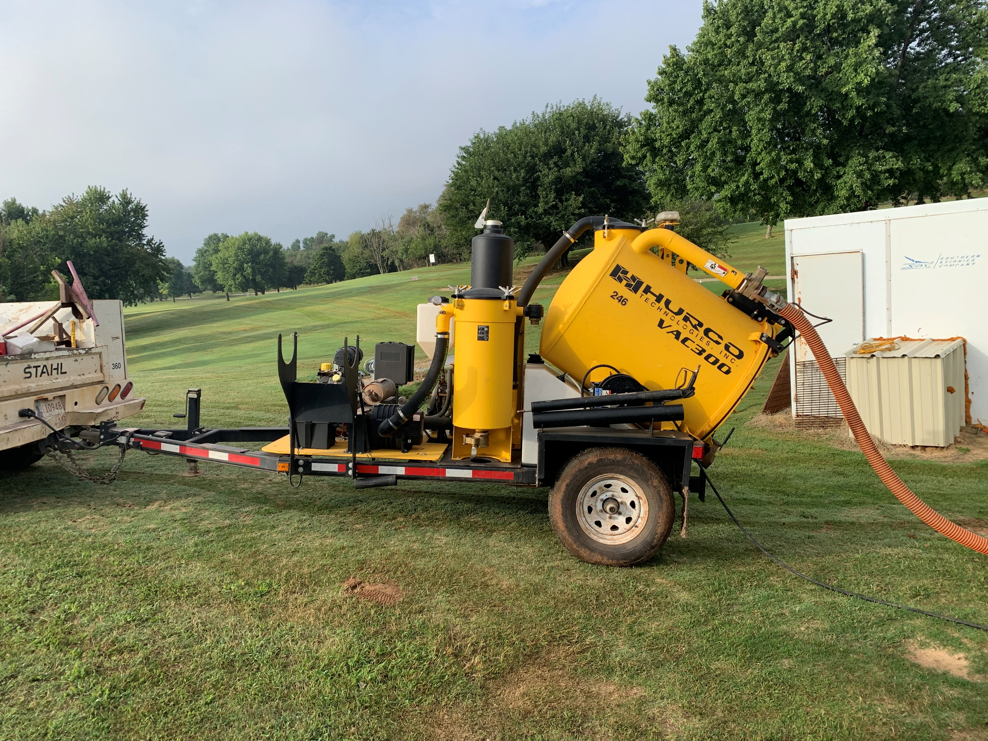
Population Perspective
Any community can establish these practices and plans
  This isn’t rock science
It does require a commitment
Being small means fewer lines, taps, and manholes
  Means a smaller program is needed
  Means smaller less complex record keeping

Slide 21
Help is out there
OMAG Matching Grants
  Sanitary Sewer Equipment Purchase grant
    $10k, maximum of two awards
  Sanitary Sewer Root Control Grant
    $5k, Once per year with maximum of 4 awards
  Public Works Safety Equipment Purchase Grant
    General safety equipment, 2:1
    Confined spaces and fall protection, 3:1
    Excavation safety equipment, 5:1
  CCTV Inspection Grant
    $5K, Camera up to 2,000 linear feet
  https://www.omag.org/grants-and-scholarships

Slide 22
Help is out there
OMUP
  Assist in planning and technical support
Community mutual support agreements
Inter-Local agreements on purchasing equipment
  Shares the cost of critical equipment like Jetter/Hydro-vac
  Allows each participating communities to apply for OMAG Equipment Purchase Grants
  OMAG can assist on developing agreements
  Communities plan together to utilize common equipment

Slide 23
Play the Long Game
Pragmatic planning and action
  Start simple and evolve your plan as needed
  Plan for incremental steps in both the administration and system improvements
  Achievable goals based on current staff and revenues
  A plan, even a simple one, provides a vision and course of action for your peers to follow
Ordinance and Resolutions
  Address revenue (rate structure)
  Priorities can be documented in annual budges
  Resolutions of mutual support
    Simple, clear, and discussed in public form
Restrict sanitary sewer revenue
  By ordinances and budgeting process
  Look to other communities for sample ordinances
    Enid’s ordinances are on-line

Slide 24
Play the Long Game
Leadership
  Principled-based leadership across the work force and across municipalities and jurisdictions
  A champion in the community
  Not limited to the elected body or city manager
Your sphere of influence
Is maintenance and emergency response regionalization in our future?
Sphere of control vs sphere of influence

Slide 25
Play the Long Game
With a plan in place, others can help
These actions are transferable
It took a long time for our underground systems to deteriorate; it will take a long time to revitalize them
Only small town Oklahoma can fix small town Oklahoma

Slide 26

THANK YOU
Christopher Gdanski
C&S Solutions, LLC

