Slide 1
Mission
To provide quality underground damage prevention services.
Value Statement
Delivering excellence through honesty, integrity, and having a highly engaged workforce in a fun and supportive workplace.

Slide 2
Oklahoma Underground Facilities Damage Prevention Act (OUFDPA)
All operators of underground facilities shall participate in the state-wide one-call notification center and shall have on file with the notification center a notice that such operators has underground facilities….
All excavators must give no less than forty-eight (48) hours, excluding the date of notification, Saturdays, Sundays and legal holidays before excavation.
Service is FREE and easy to use.

Slide 3
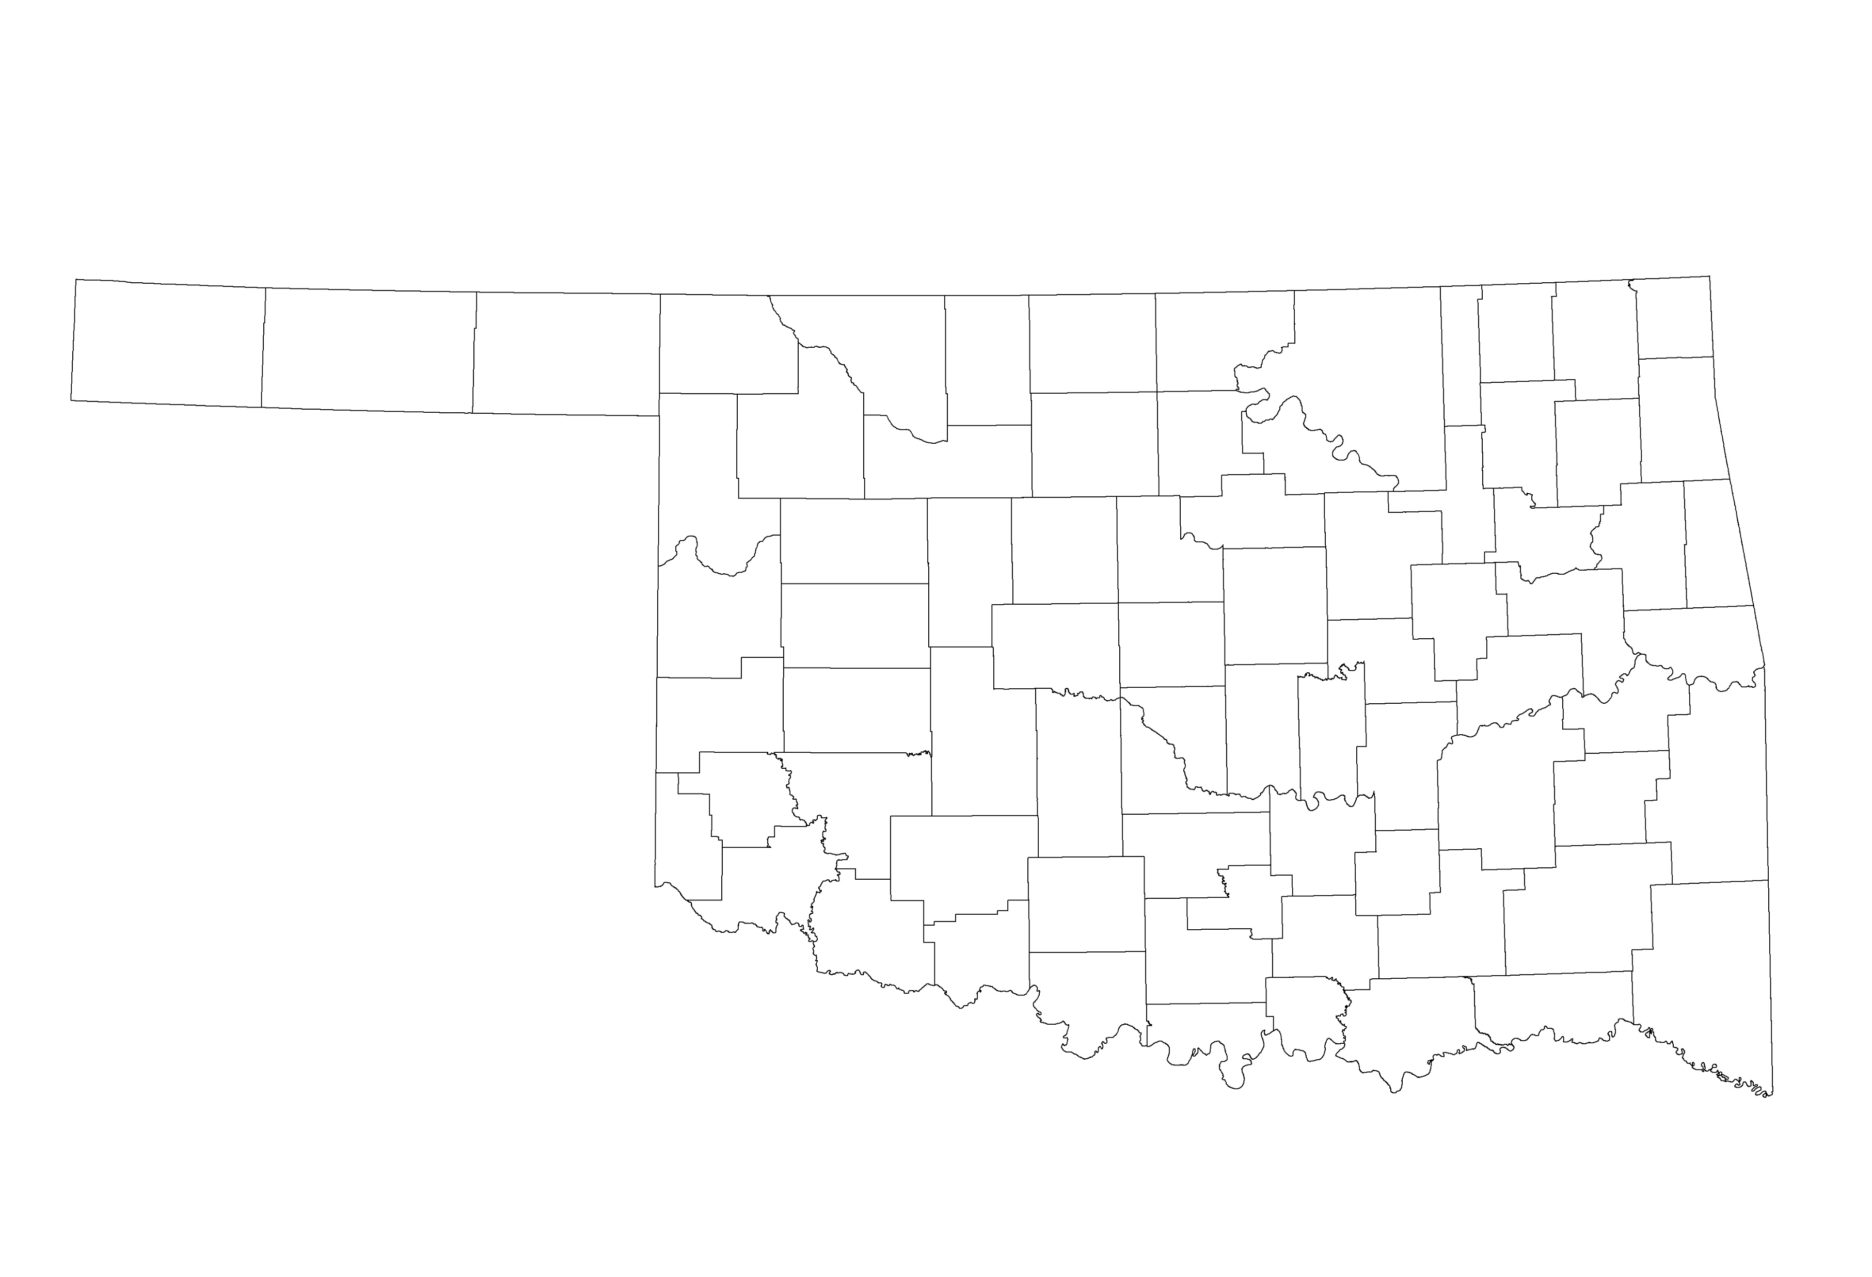
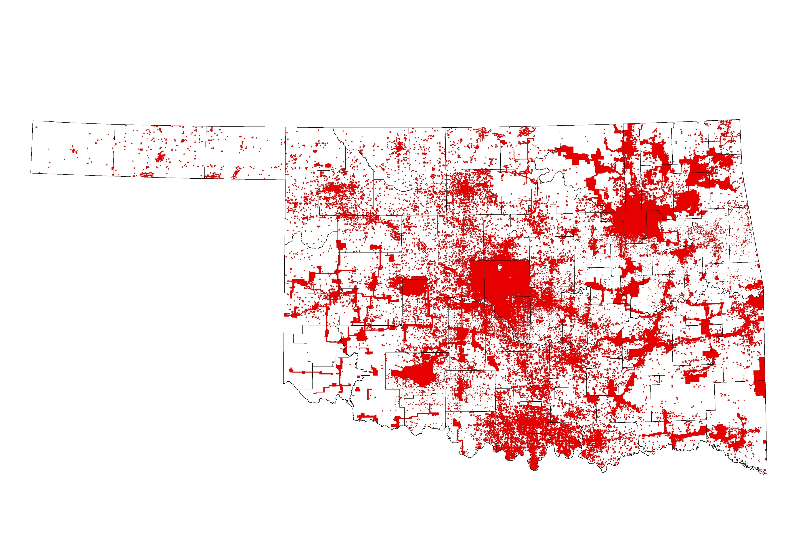
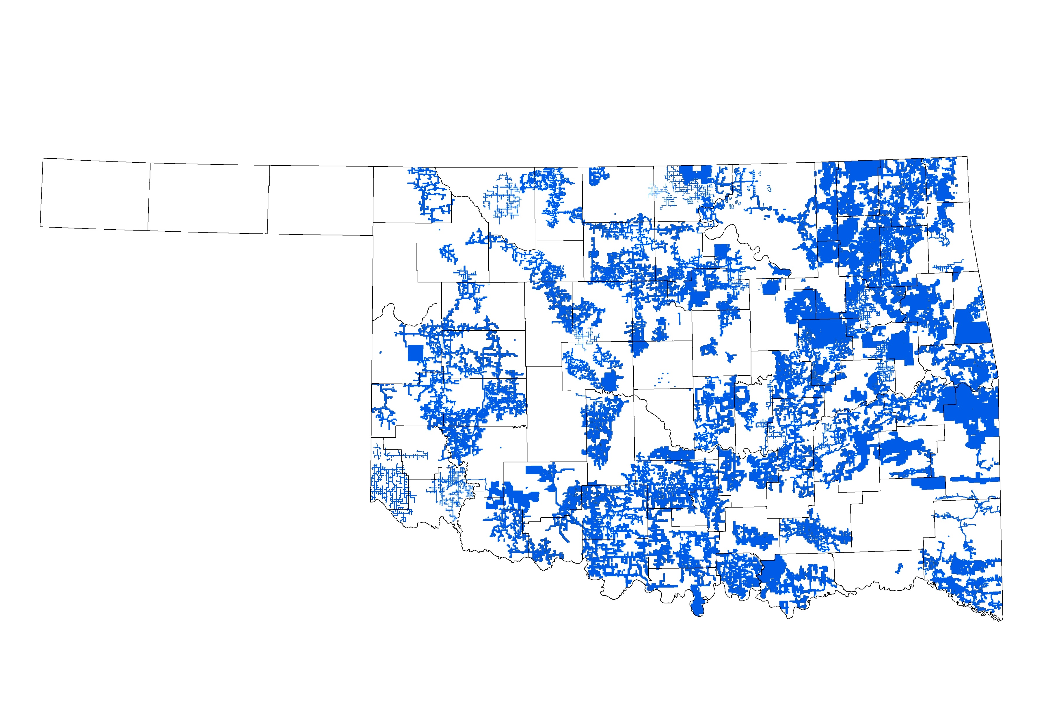
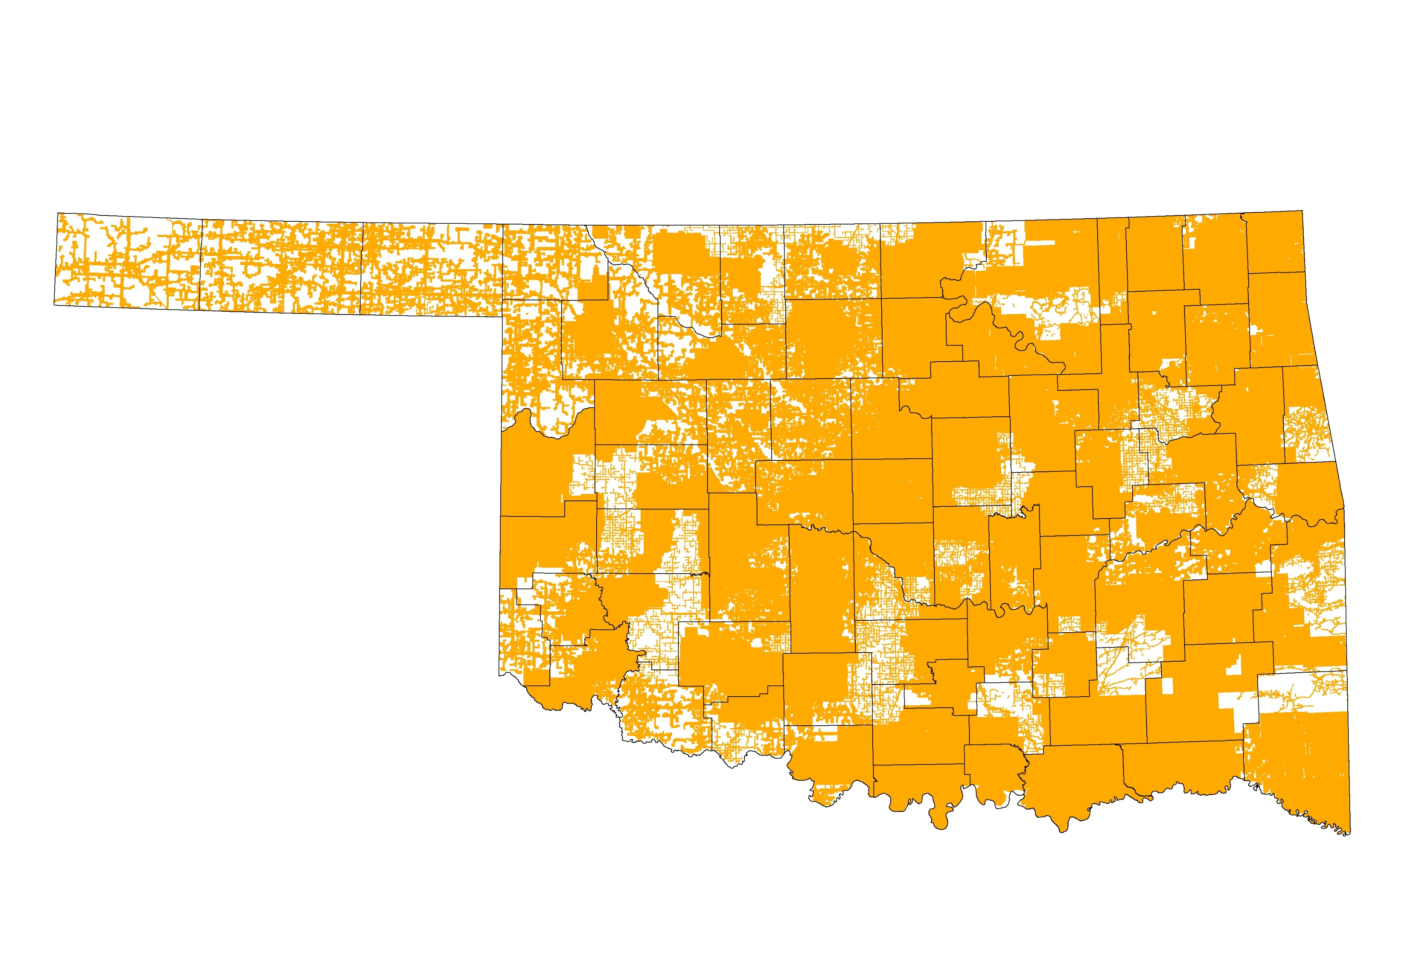
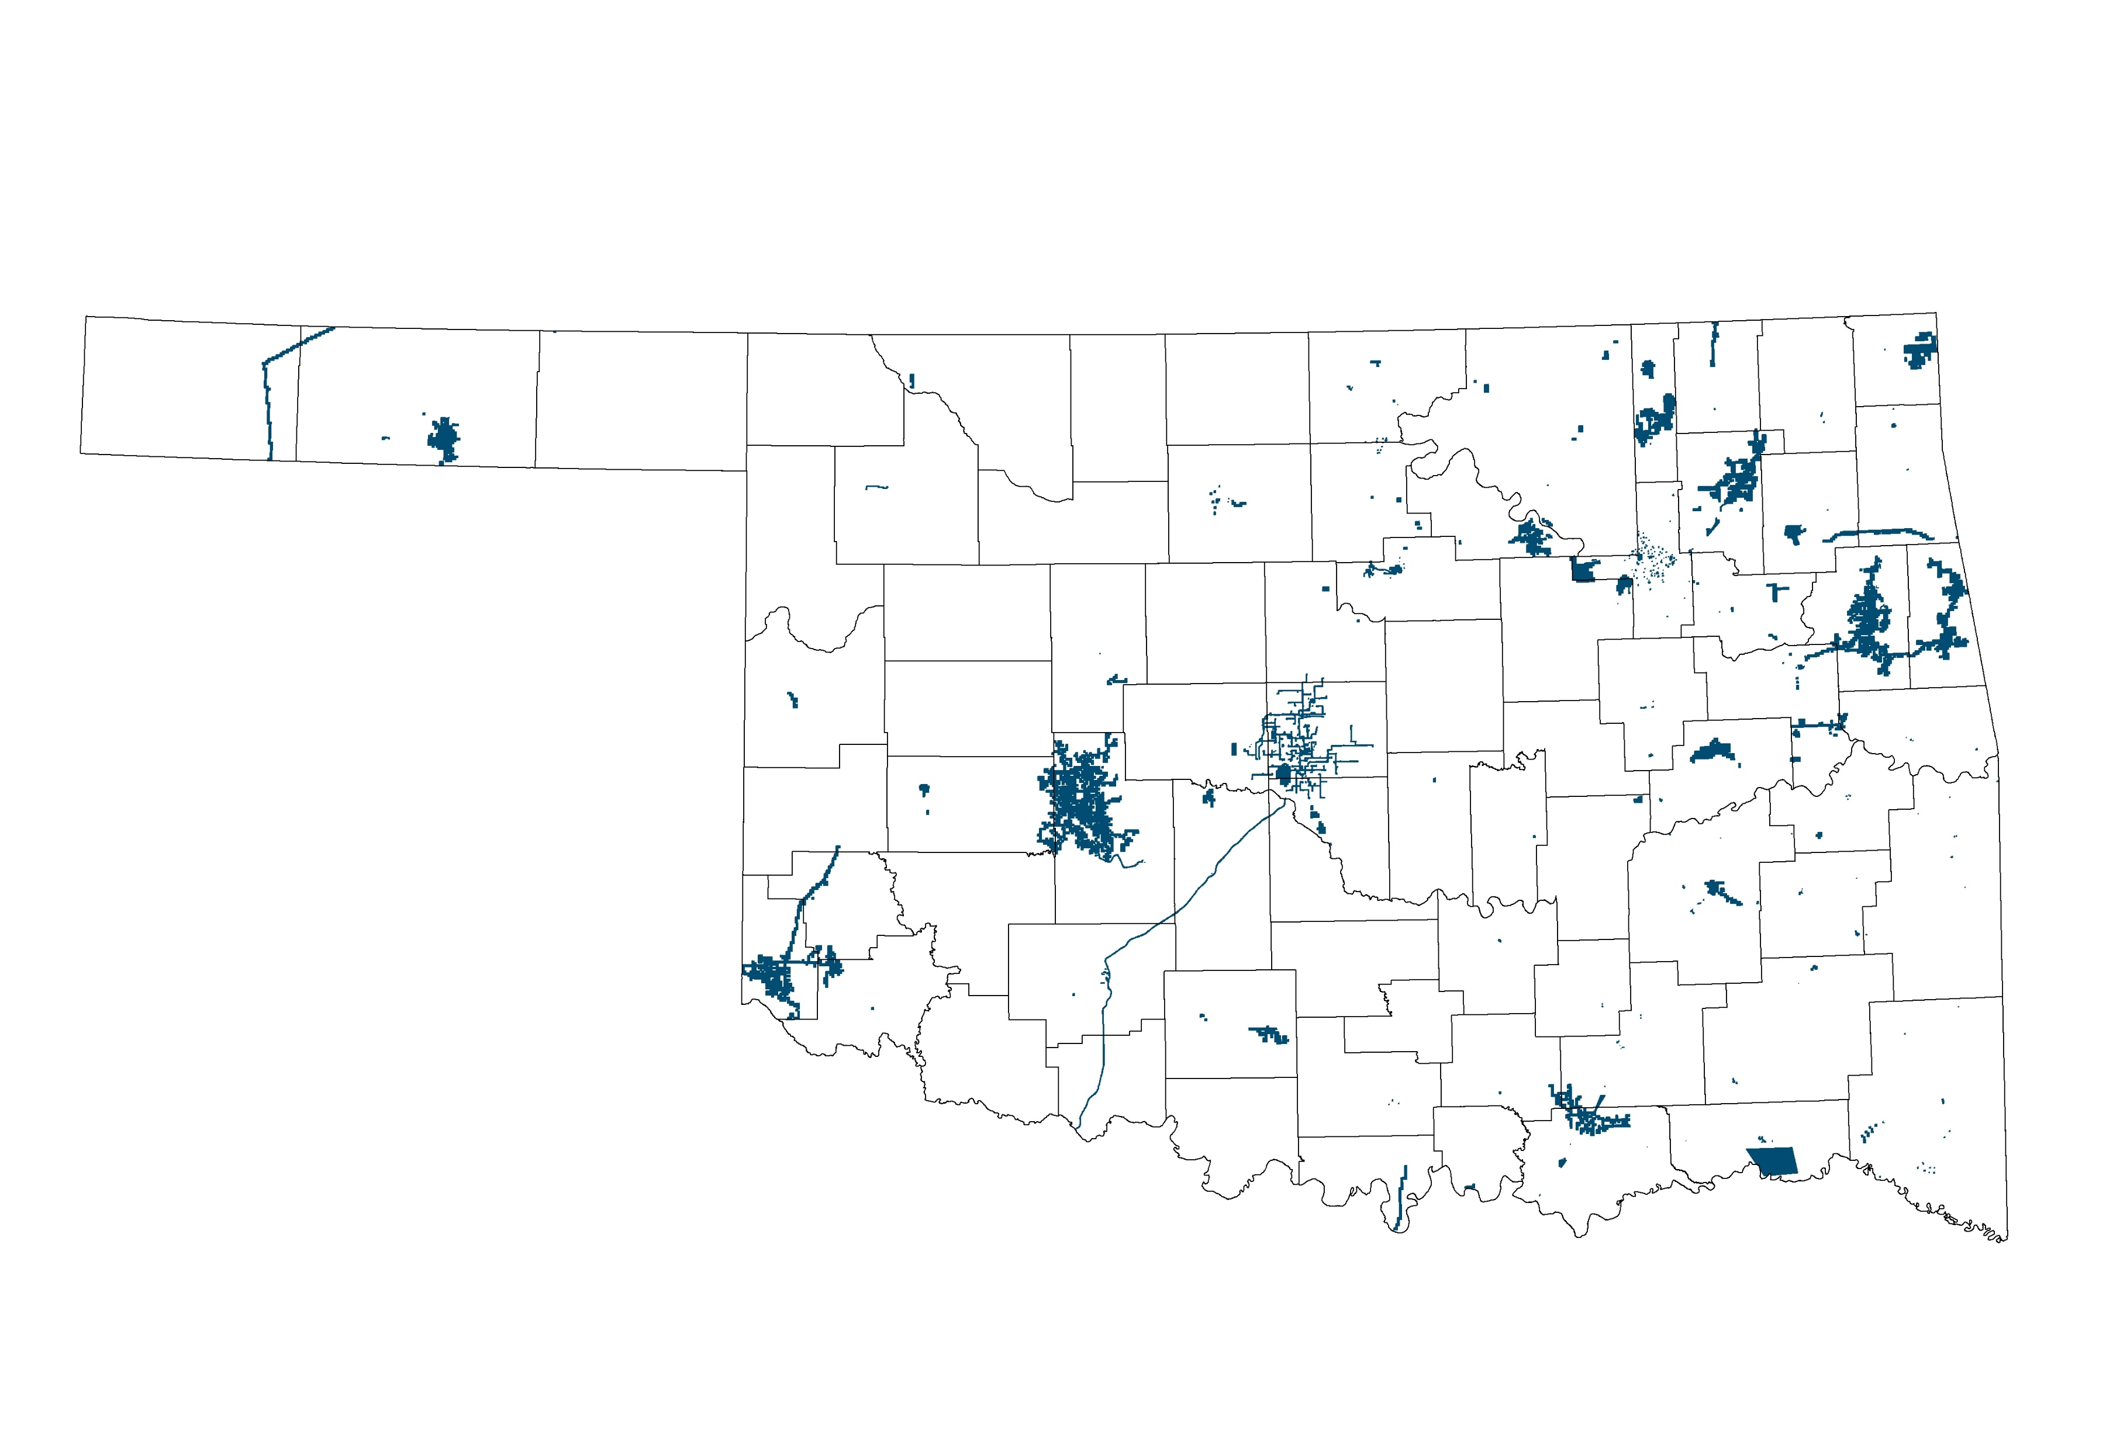
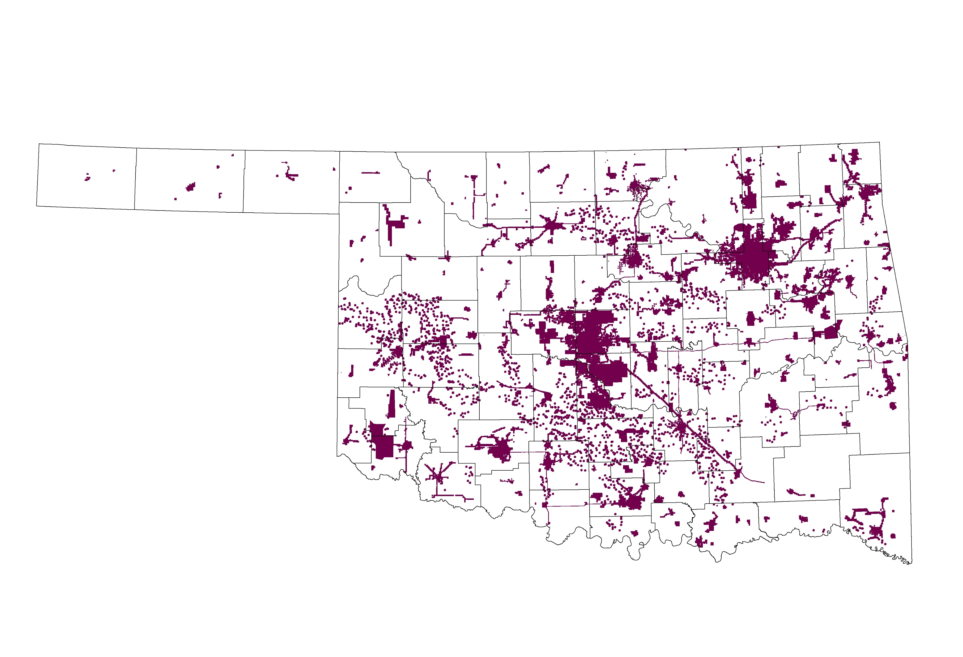
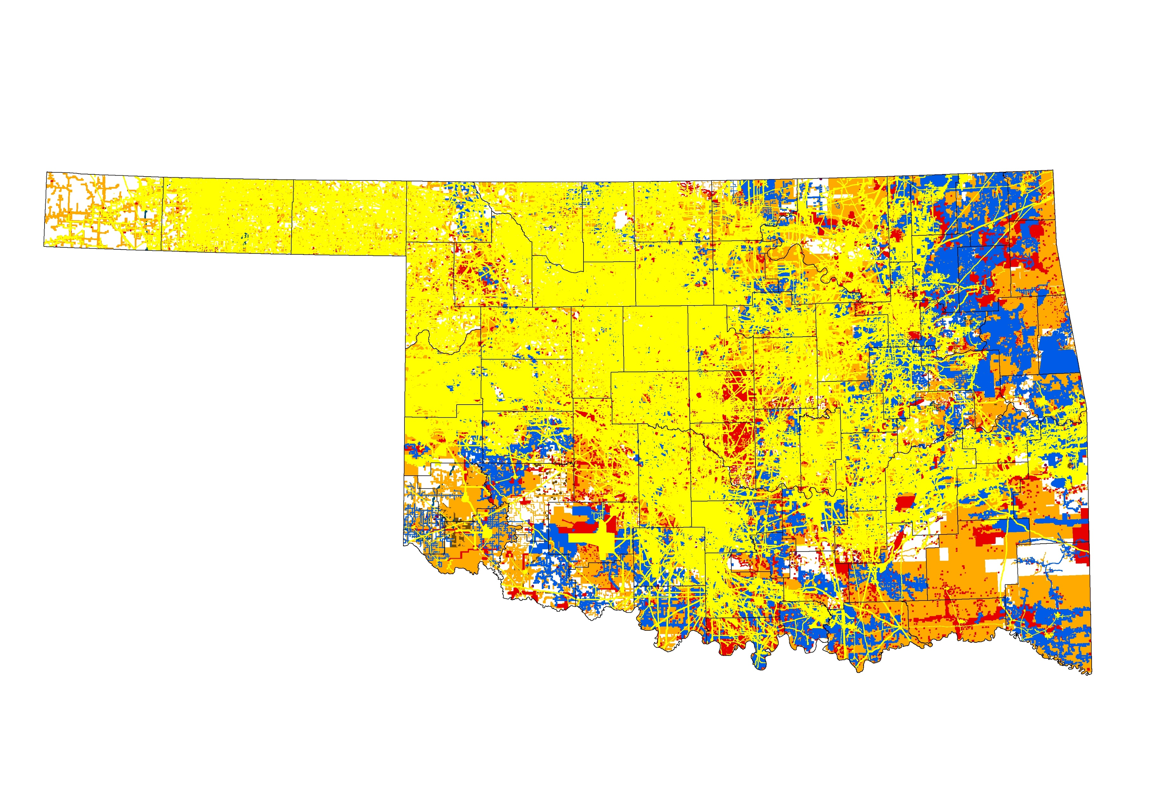
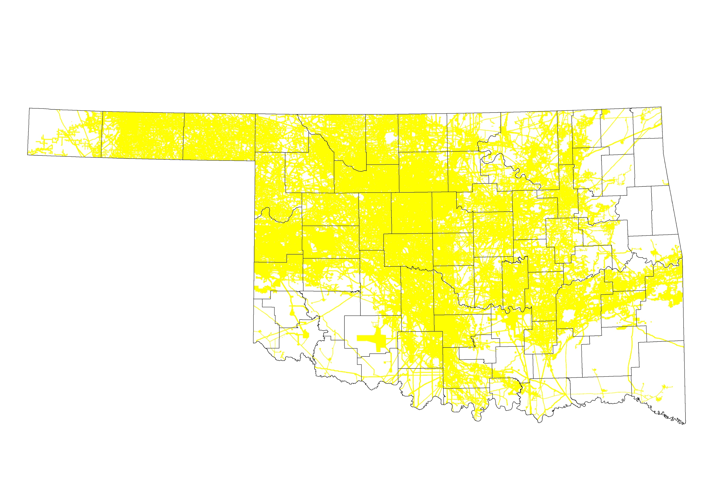
Underground Assets Registered with OKIE811
Underground Assets Registered with OKIE811
Underground Assets Registered with OKIE811
Underground Assets Registered with OKIE811
Underground Assets Registered with OKIE811
Underground Assets Registered with OKIE811
Underground Assets Registered with OKIE811
Underground Assets Registered with OKIE811
Underground Assets Registered with OKIE811
Telecommunications
Telecommunications
Pipeline
Pipeline
Electric
Electric
Rural Water
Rural Water
Municipalities
Municipalities
Other
Other

Slide 4
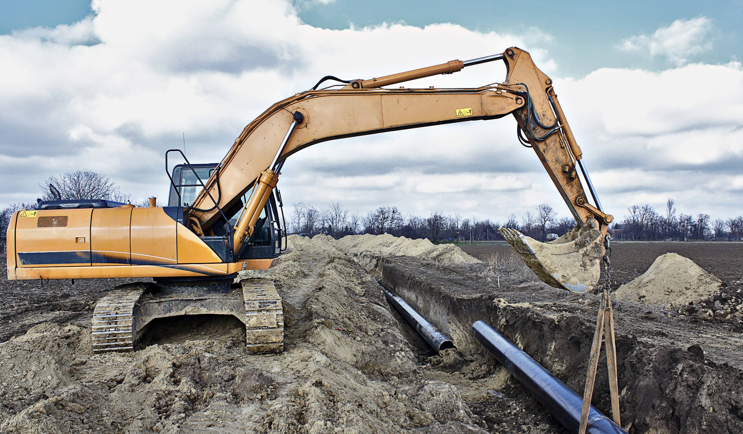
How It Works
Excavator Contacts OKIE811
Website or Phone Call
No less than forty-eight (48) hours, excluding the date of notification, Saturdays, Sundays and legal holidays before excavation.
A Locate Request is Generated
OKIE811 processes the excavator’s request
Maps out the dig site described by excavator
Ticket number is generated and provided to excavator
Notifications are Sent
OKIE811 transmits the locate request to the members in respective area
Average of 6 members notified per ticket
Each Member Responds to the Request Prior to Work to Begin Date/Time
Marks approximate location of their underground facilities
Paint, flags or stakes
APWA uniform color code
Communicates with excavator
Mandatory Positive Response
Excavator Confirms Before Digging
Must wait the required time before digging
Ensure response is received by each member listed on the ticket
Must dig test holes to identify and properly protect the underground facility
Important to Know
Private lines will not be marked
OKIE811 does not locate the lines

Slide 5
WHITE LINING
White lining is the industry best practice of marking the outer limits, route, or perimeter of the proposed excavation with white paint, flags or stakes to outline the dig site.
Notes:
Instructor Note:
This is done prior to notifying the one call center to accurately communicate to facility owner/operators and locators where the excavation is to occur. OKIE811 recommends that all excavators employ the industry best practice of white lining the proposed excavation site on all excavation projects in Oklahoma.

Slide 6
Continuous Line
Dashes Marking the Four Corners
Whitelining
Dots Marking the Radius or Arc
Dashes Outlining Excavation Project
Notes:
Instructor Note:
[Click to advance]
Describe the use of each of the different types of lines

Slide 7
LOCATE REQUEST
A locate request is a communication between an excavator and 811 center personnel in which a request for locating underground facilities is processed.
CGA 14.0
Notes:
Instructor Note:

Slide 8
Each excavator, company or contractor doing excavation work on the worksite MUST have their own separate 811 Dig ticket covering their specific excavation activity.
Notes:
Instructor Notes:
There is absolutely no piggy-backing on One Call/Dig tickets allowed. Providing Notification is NOT the same as obtaining approval to excavate. Notification is the process of advising the operators of underground facilities of the imminent intent to excavate, or disturb the ground, and request that they identify and mark the approximate horizontal locations of their underground facilities at the site.

Slide 9
Ticket Entry Methods
Web Ticket
Dialing 811
Available 24/7/365 for normal locate requests
Able to view/update locate requests from the last 30 days submitted by your company
Mapping available to pinpoint your dig site
No hold times
Office Hours:
Monday – Friday, 6:00am - 6:00pm
After business hours only emergency locate requests will be accepted via phone
Needed for:
Emergency requests
2nd/3rd Notices
Demolition Notice
Damage Report Tickets
Wildland Fire Notification

Slide 10
REQUIRED NOTIFICATION
CENTER INFORMATION
There is a minimum amount of information that is vital to OKIE811 in determining which underground facility operators need to be notified.
OUFDPA 142.6 (D)

Slide 11
VITAL INFORMATION
The name of the individual serving such notice
The location of the proposed area of excavation or demolition
The excavator’s field telephone number

Slide 12
VITAL INFORMATION
The name, address, phone number of the excavator
Type and extent of proposed work
The intended use of explosives
The date and time when work is to begin

Slide 13
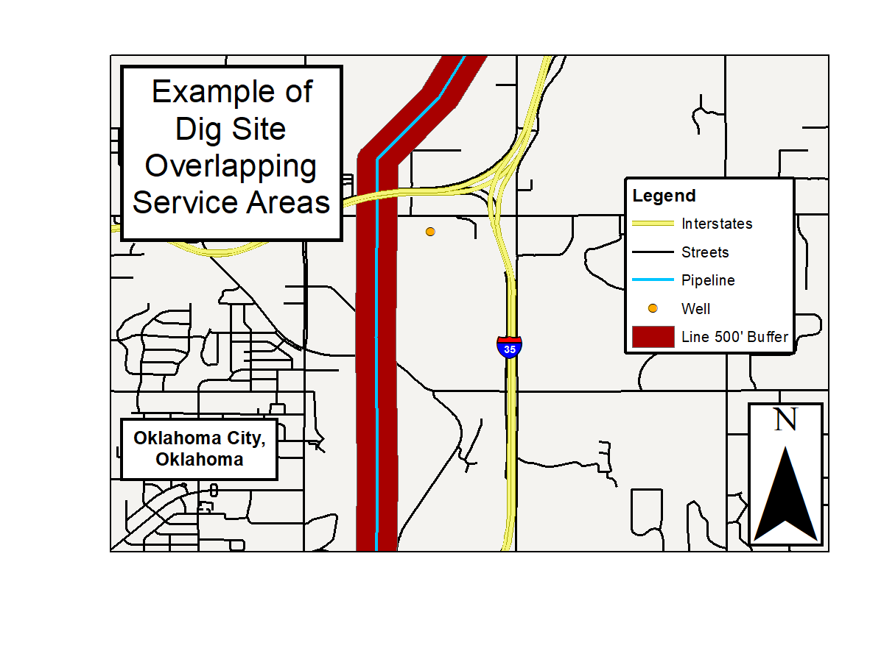
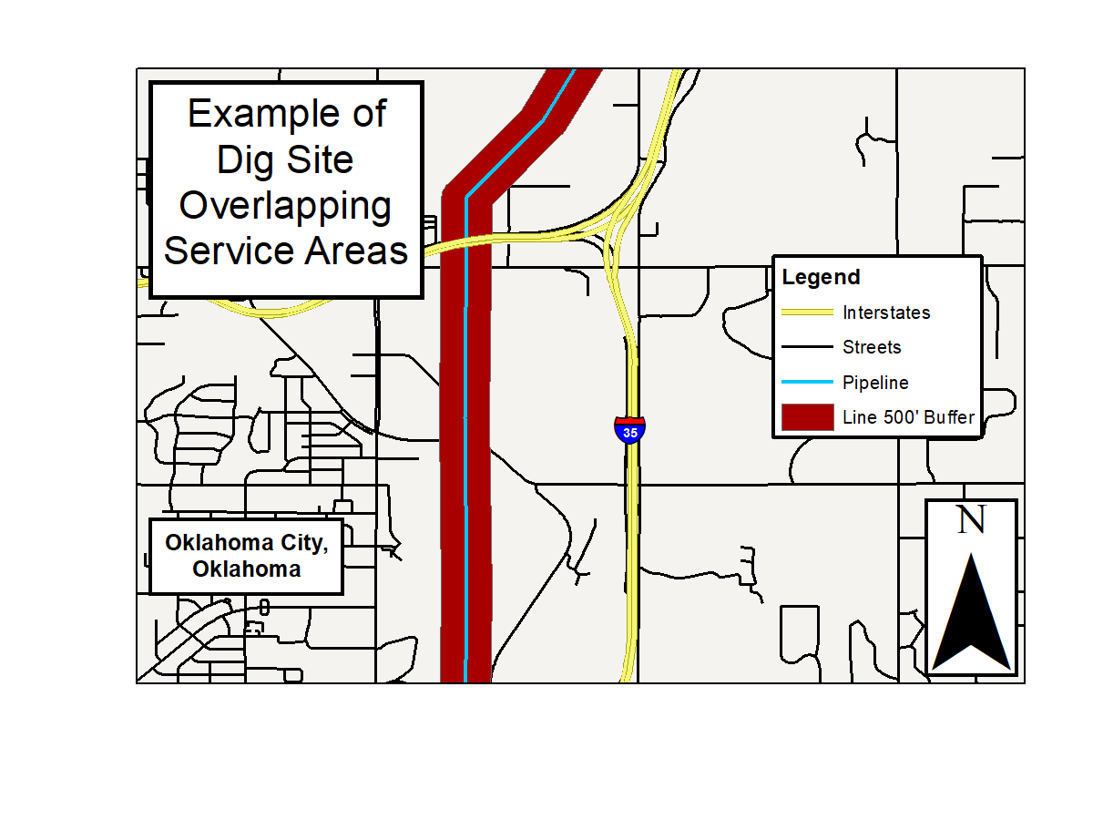
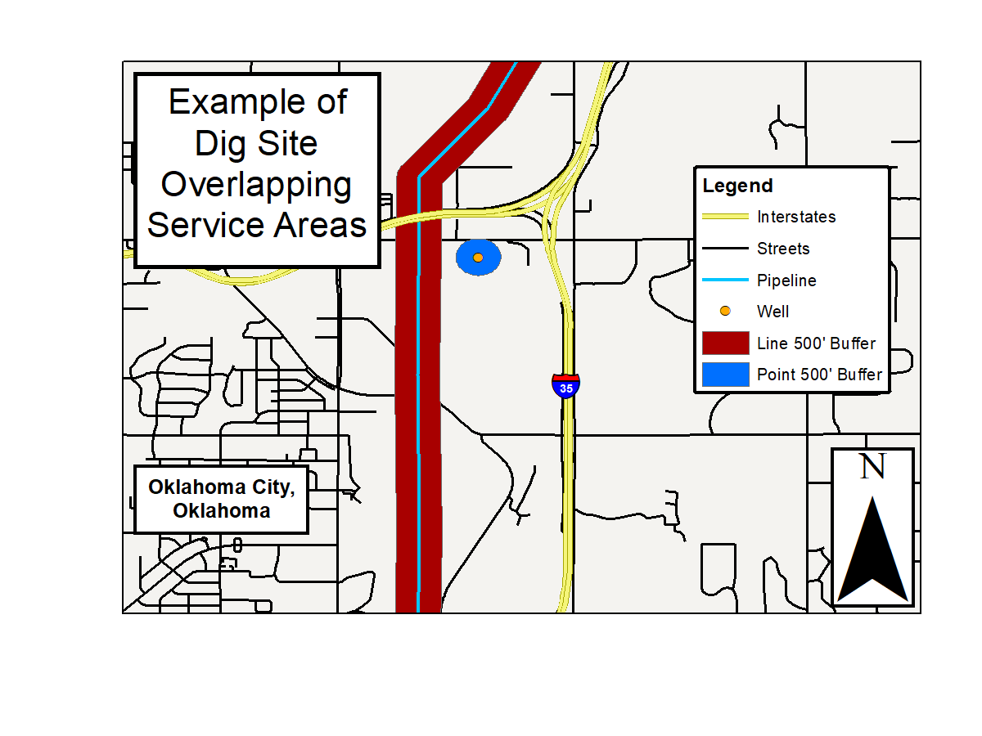
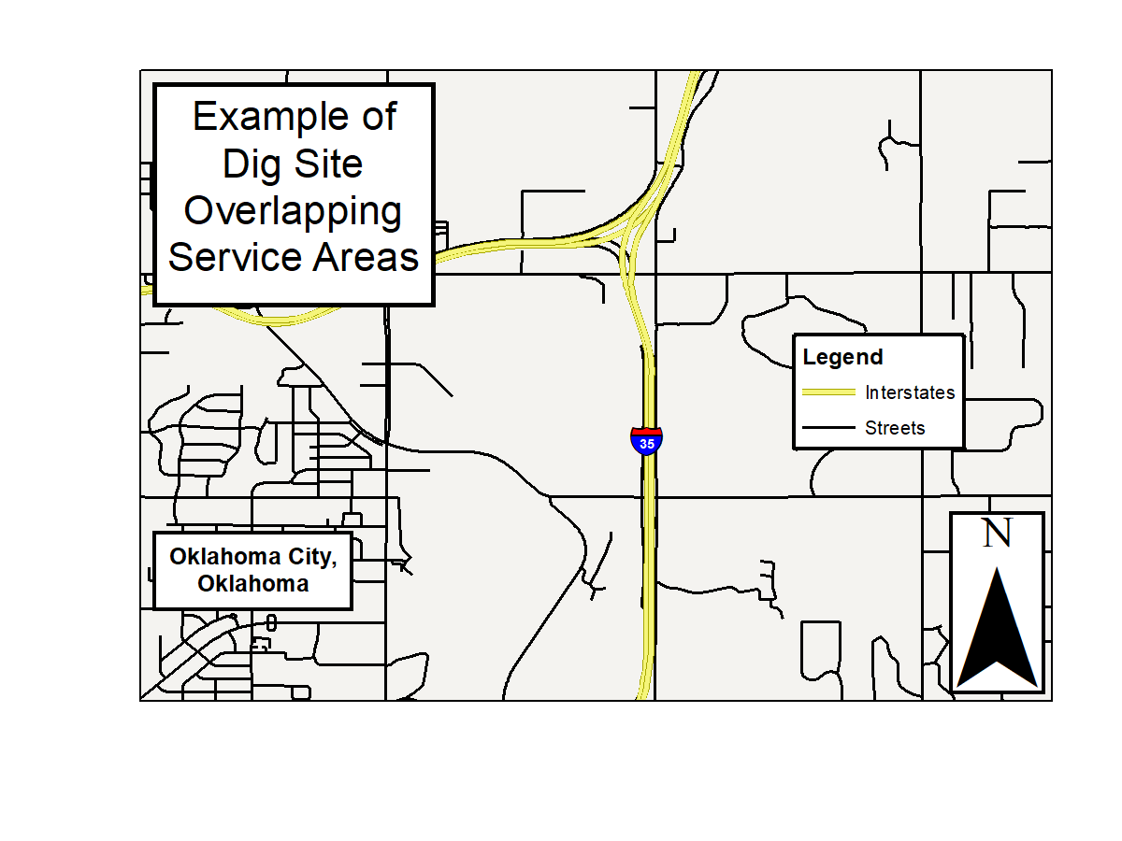
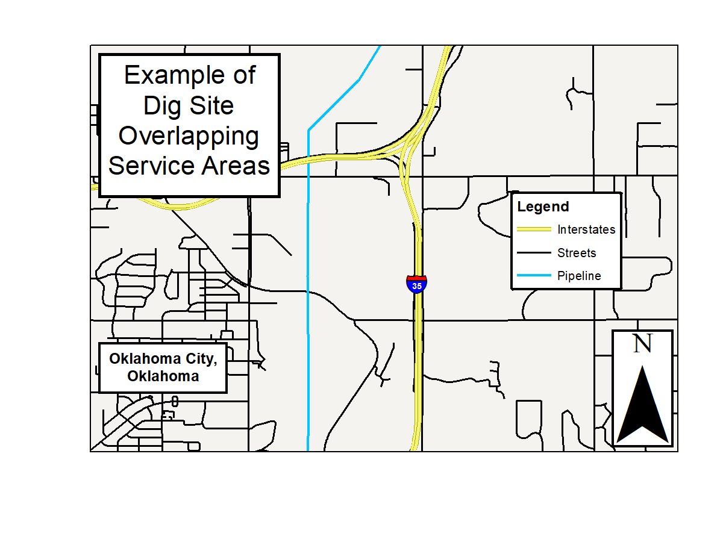
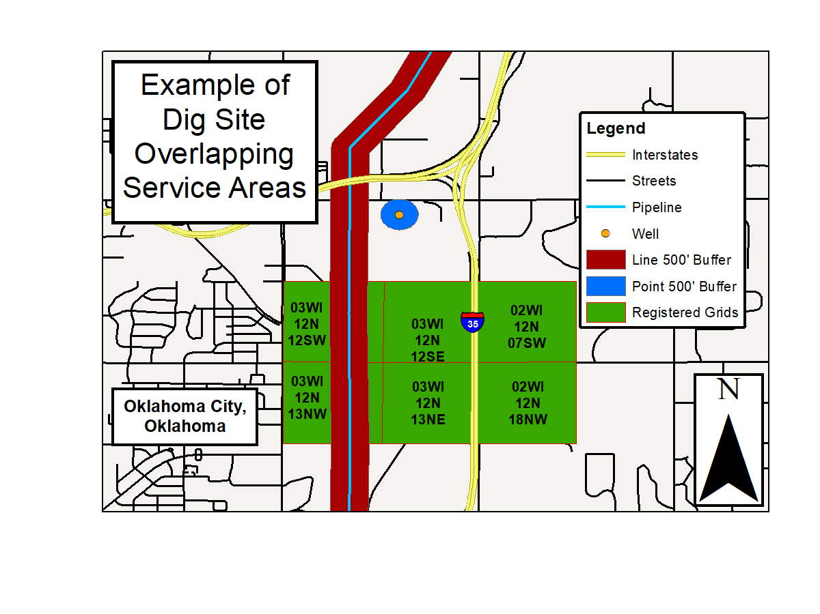
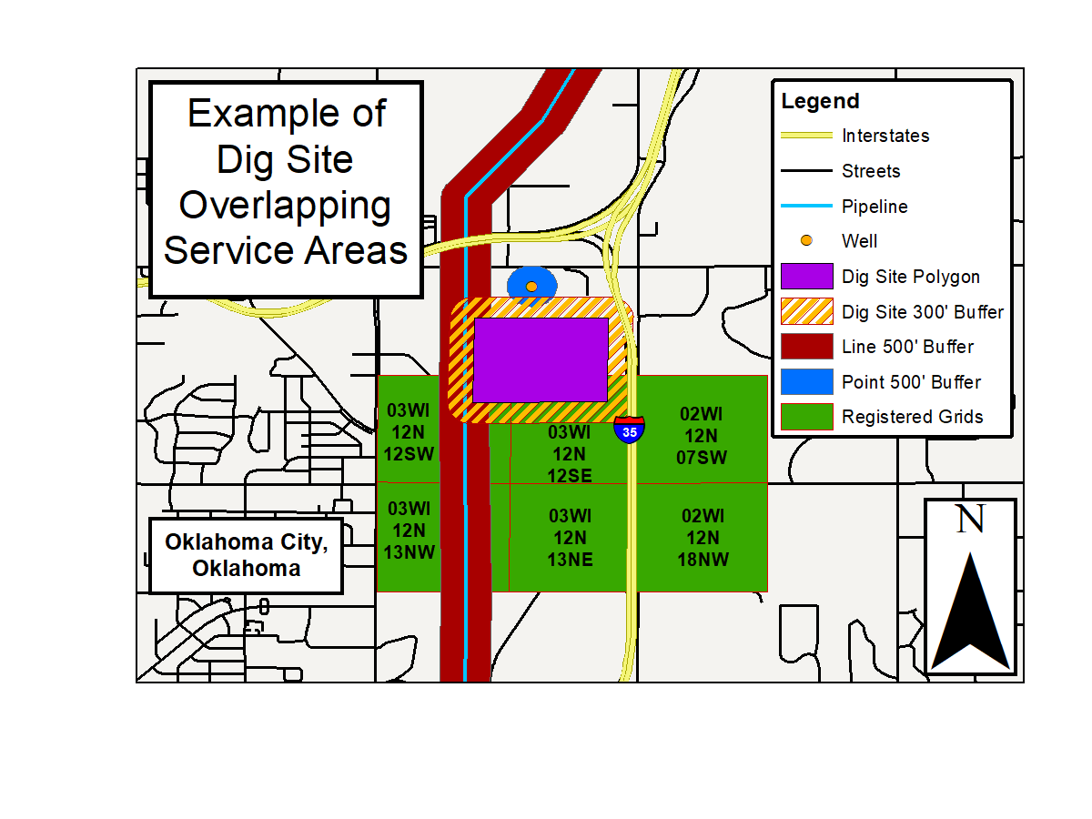
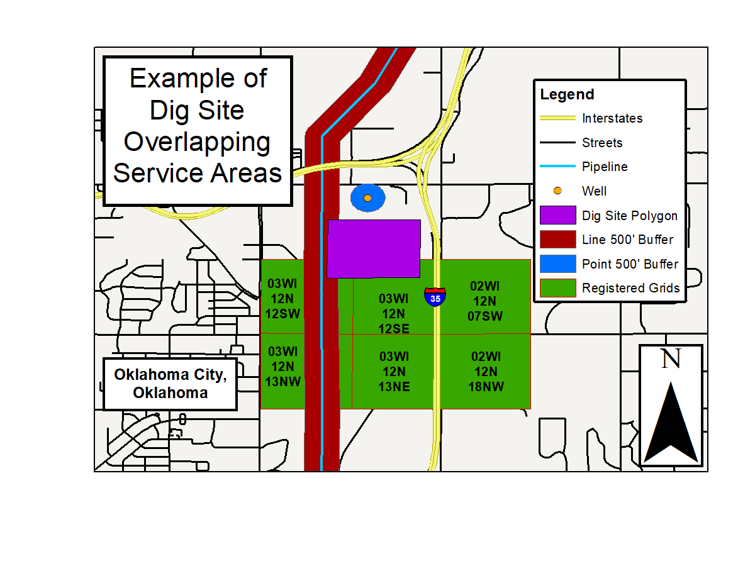
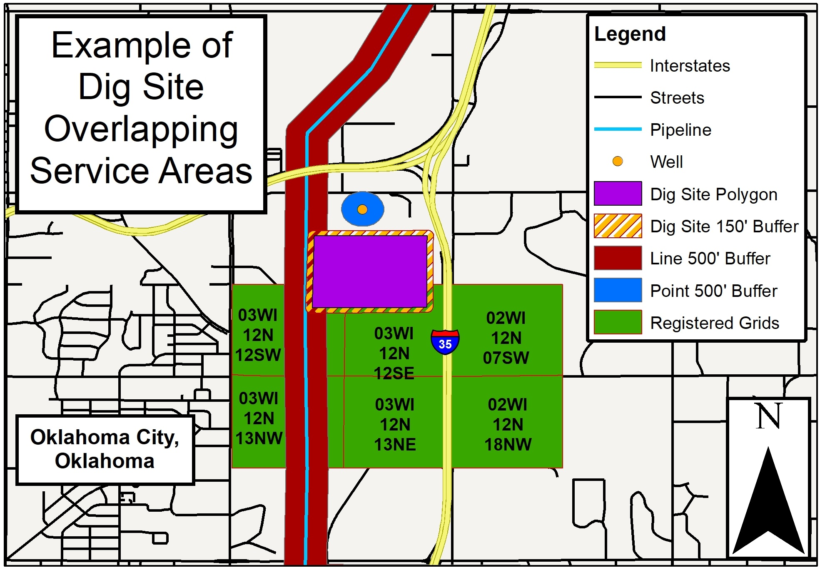

Slide 14
IT’S OKLAHOMA LAW
You have a legal duty to notify underground facility operators no less than forty-eight (48) hours, excluding the date of notification, Saturdays, Sundays and legal holidays before excavation.
Notes:
Instructor Note:

Slide 15
CONTACT OKIE811
Contact OKIE811 to make a locate request to determine if there are any underground facilities within the worksite.
WAIT
Wait until the given “work to begin” date and time.
CONFIRM
Confirm that positive response has been received by all underground facility operators that were notified of your intent to excavate within the worksite.
2nd Call
If you have not received a response from all the underground facility operators, make a second call to OKIE811.
Notes:
Instructor Note:
[CLICK TO ADVANCE]
Describe each of the steps within the OKIE811 notification process.
Ask students to predict the next steps.

Slide 16
Ticket Types
Normal / Compliant
Non-emergency where the excavator contacts OKIE811 at least 48 hours prior to excavation, not including date of notification, weekends and state holidays.
Non-Compliant
Less than required notice
NOT A VALID TICKET
Emergency
Unavoidable situation that endangers life, health, or property.
Give as much notice as possible.
Exception to the 48 hours’ notice.
Dig with care.
2nd / 3rd Notice
Ticket is resent to members who have not marked their lines.
Does not extend life of a ticket beyond original 14 calendar days.
Demolition
7 business days notice after the excavator has met local code requirements for a demolition permit.
Only for the intent of demolition
Excavator must still call OKIE before demolition begins
Damage Report
Report damage to lines, exposure to lines, damaged signs, pedestals etc.
Notification is immediately sent to all Facility Operators with underground lines in the dig area

Slide 17
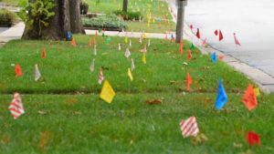
Updating Locate Requests
A locate request is good for 14 calendar days from the work to begin date stated on that request.
An updated ticket will be required if work is going to extend beyond 14 calendar days, or if underground facilities need to be remarked because of work activity or weather has destroyed the original marks.
Re-Mark: Notifies facility operators that the markings need to be refreshed and extends the life of the ticket another 14 days.
Facility operators have 48 hours, excluding date of notification, weekends, and legal holidays to respond.
Extend: Notifies facility operators that the markings are still clearly visible and don’t need to be refreshed while extending the life of the ticket another 14 days.
Facility operators may or may not return to the site to validate markings, but still have 48 hours, excluding date of notification, weekends, and legal holidays to do so.
This constitutes an agreement between the excavator and all facility operators on the ticket.

Slide 18
LEGAL DUTY OF FACILITY OPERATOR
Must mark the approximate horizontal location of its underground facilities prior to the date and time work is to begin.
Provide Positive Response to the excavator the status of the locate.
If no response, make a second call to OKIE811 to report which facility operators
have not responded.
OUFDPA 142.6 (B)
Notes:
Instructor Note:
Click to advance the notifications
In some cases, the underground facility operator will determine that their underground facilities are not within the proposed area of excavation or demolition and may deem it not necessary to mark the approximate location of underground facilities and will communicate this information to the excavator prior to the commencement of the excavation/demolition.
If no response from the facility operator, make a second call to Okie811 to report which facility operators have not responded and file a complaint with the OCC when pipelines are not marked or no response to the locate request has been received.
If an excavator has a lack of confidence with the locator or the quality of the locate marks themselves the excavator must inform the buried facility operator directly.

Slide 19
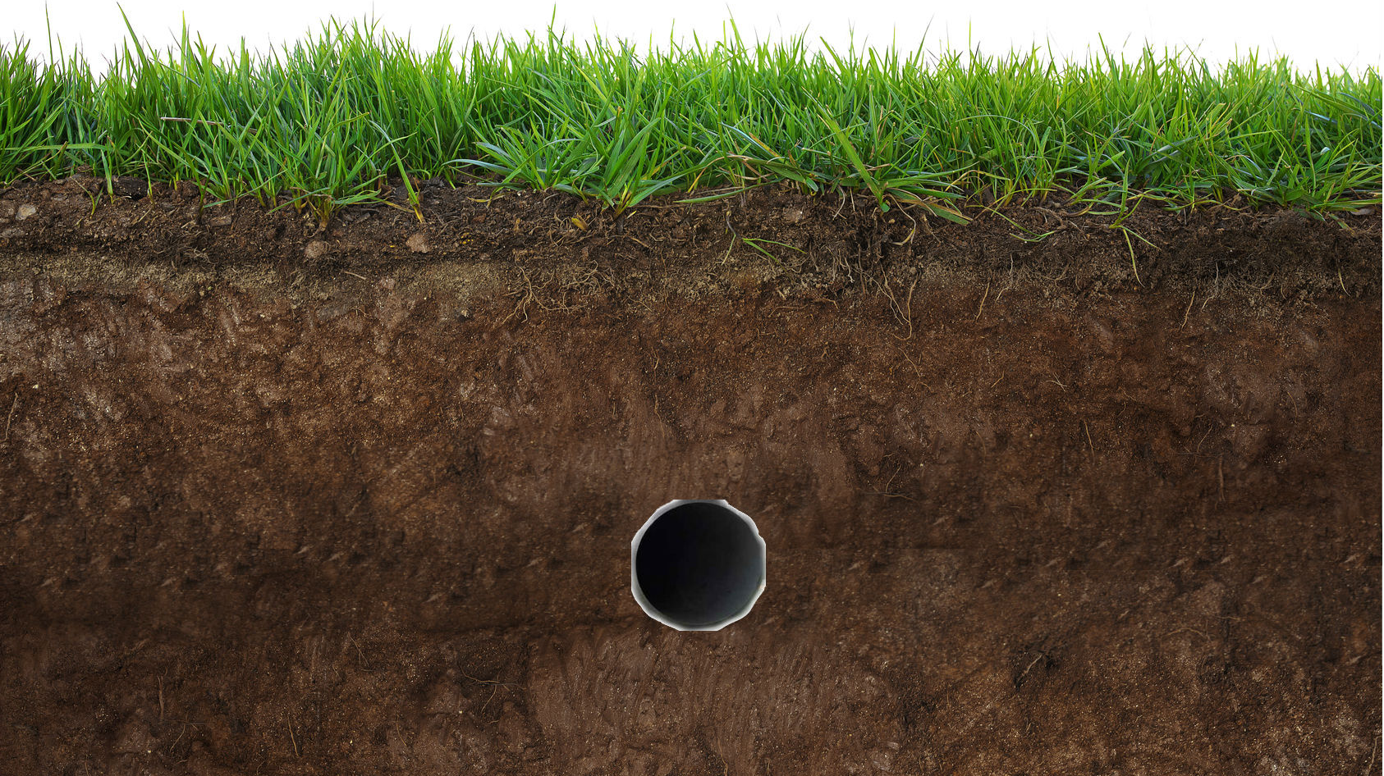
LOCATING AND MARKING
Not exact science
Employ hand dug test holes
Dig with caution
Notes:
Instructor Notes:
[Click to Advance Bullet Points]
Although technology is continuously improving, locating is not an exact science. The locate marks only provide the “Approximate Horizontal Location” and should not be taken as the exact location. Generally, the depth of the underground facility is not provided and an excavator must not assume that a depth reading is accurate.
A competent excavator would employ hand dug test holes to determine the exact location of the underground facility, respect the marks and dig with caution in proximity to the locate marks and take all reasonable precautions to ensure that no damages occur.

Slide 20
LOCATING AND MARKING
24 inches
24 inches
Locating and marking
Not exact science
Employ hand dug test holes
Dig with caution
Notes:
Instructor Notes:
A locator will locate and mark the approximate location of the underground facilities so that the Excavator can use hand dug test holes 24” on either side of the marks to determine the precise location and direction of the underground facilities in advance of the excavation.

Slide 21
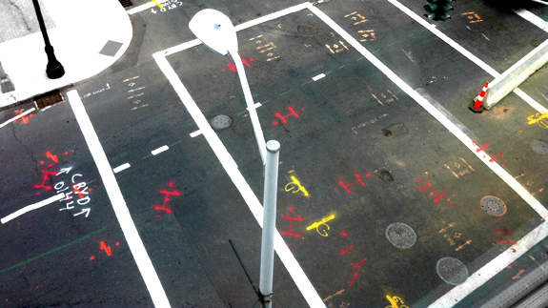
MARKINGS
The operator of the underground facility will mark the approximate horizontal location of the underground facility using the standard APWA color code.
Notes:
Instructor Notes:
An excavator must understand that the operators’ locator can use various markings, methods and materials to mark the approximate location of underground facilities.
The markings can appear as singles lines of stakes, paint or flags, or any combination of two or more of these depending on the unique challenges of the excavation site such as terrain, vegetation, surface material, livestock and weather.
The marks will appear at sufficient intervals to provide the excavator with a clear indication of the approximate horizontal location and direction of the underground facilities within the worksite.

Slide 22
APWA UNIFORM COLOR CODES
White
Proposed Excavation
ORANGE
Telecomm
PINK
Survey Markings
BLUE
Water
RED
Electric
GREEN
Sewer
YELLOW
Oil and Gas
PURPLE
Irrigation
Notes:
Instructor Notes:
The markers used to designate the approximate location of underground facilities must follow the current color code standard developed by the American Public Works Association, known as the APWA Uniform Color Code
Ask students:
Can you explain the color codes and how they are used?
WHITE – Defines the limits of the proposed excavation
PINK – Temporary Survey Marks
RED – Electric power lines, cables, conduit and lighting cables
YELLOW – Gas, oil, petroleum and gaseous materials
ORANGE – Telephone, cable, TV, communication, alarm and signal lines
BLUE – Potable water
GREEN – Sanitary sewers, storm sewers, culvert and drain lines
PURPLE – Irrigation, reclaimed water, slurry lines or pipes

Slide 23
HAND DIGGING
Any movement of earth using non-mechanized tools or equipment, soft digging, or vacuum excavation. Hand digging includes but is not limited to digging with shovels, picks, and manual post hole diggers.
Notes:
Instructor Note:

Slide 24
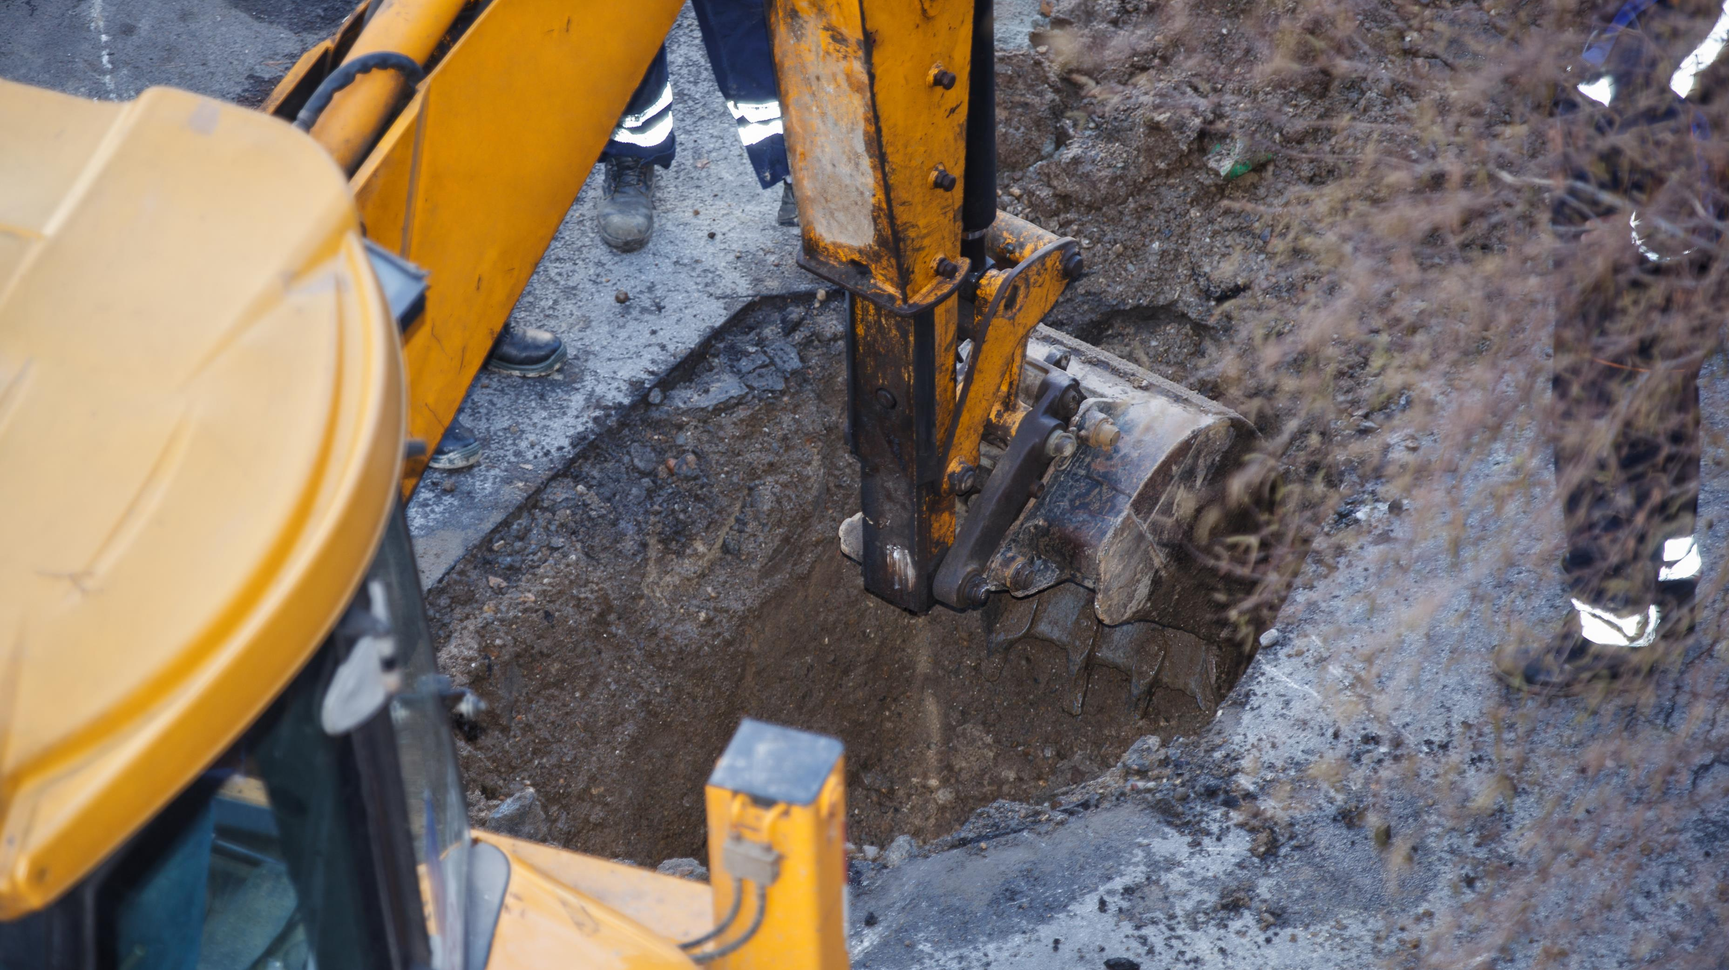
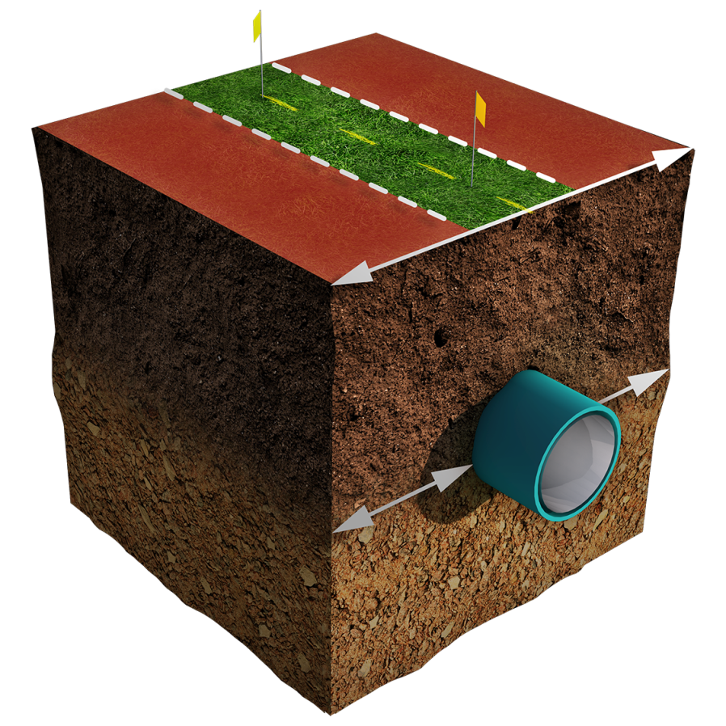
Tolerance Zone Defined
A defined horizontal space 24” from the outside wall or edge of an underground line or pipe
Best Practice:
“No automated or mechanical equipment should be used inside the tolerance zone…”

Slide 25
Hazardous Consequences
Excavation activities can be very dangerous and have severe consequences. However, by completing this training this you can significantly reduce the risks involved by becoming properly trained, educated and informed of laws, rules, regulations and best practices when excavating.

Slide 26
Take Reasonable Action
Learn the location of any underground facilities in or near the area.
The location of the proposed area of excavation or demolition
plan excavation activities in such a way as to avoid interference with, or damage to, any facilities within the worksite.

Slide 27
Shared responsibility
Contact OKIE811 no less than 48 hours, excluding the date of notification, Saturday’s, Sunday’s and legal holidays, before beginning your excavation.
Wait a mini​mum of 48 hours, excluding the date of notification, weekends and legal holidays for locates to be completed.
Respect & protect the locate marks.
Always Hand Expose facilities when digging within the Tolerance Zone

Slide 28
Shared responsibility
Properly protect and support exposed facilities.
Immediately report all facility damages to the facility operator and OKIE811, regardless of who’s at fault.
And backfill the excavation with caution.

Slide 29
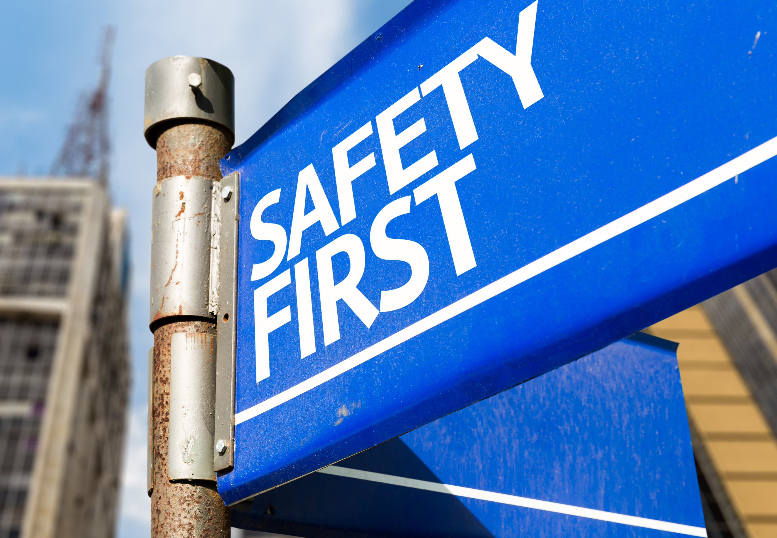
Damage Prevention is a Collaborative Effort
Facility Owners
Locators
OKIE811
Excavators

Slide 30
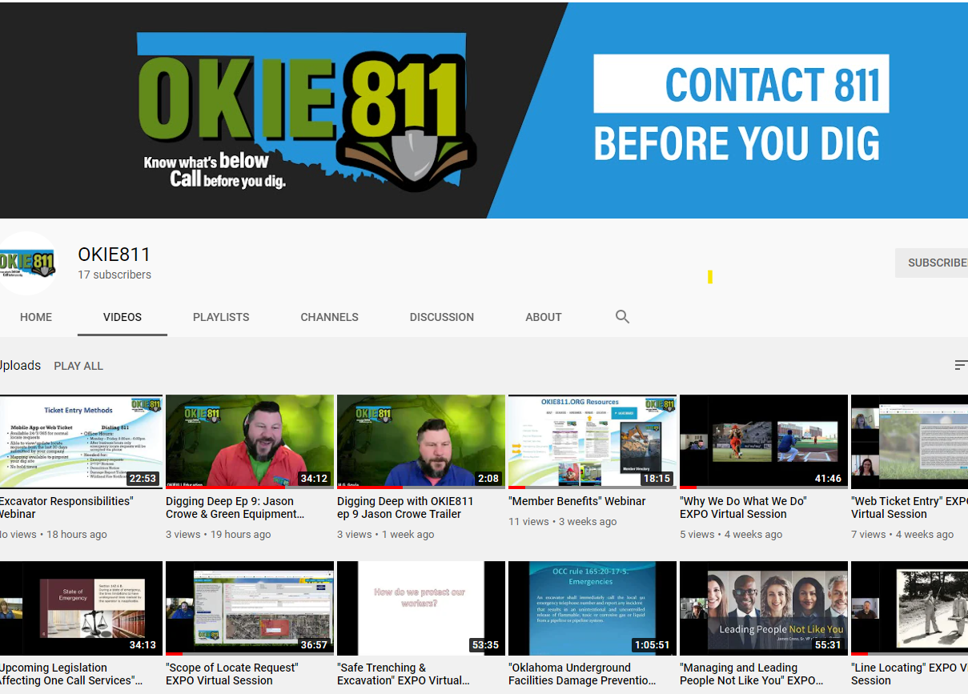

Slide 31
If you think of any questions or have suggestions for future presentations, email us at: Education@OKIE811.org

