Slide 1
MUNICIPAL PROJECT FUNDING
MIKE BAILEY, CPA
CITY OF BARTLESVILLE
CITY MANAGER

Slide 2
WHY???????
Teach you to advocate for your utility
Give you the tools to discuss this with administrators and council

Slide 3
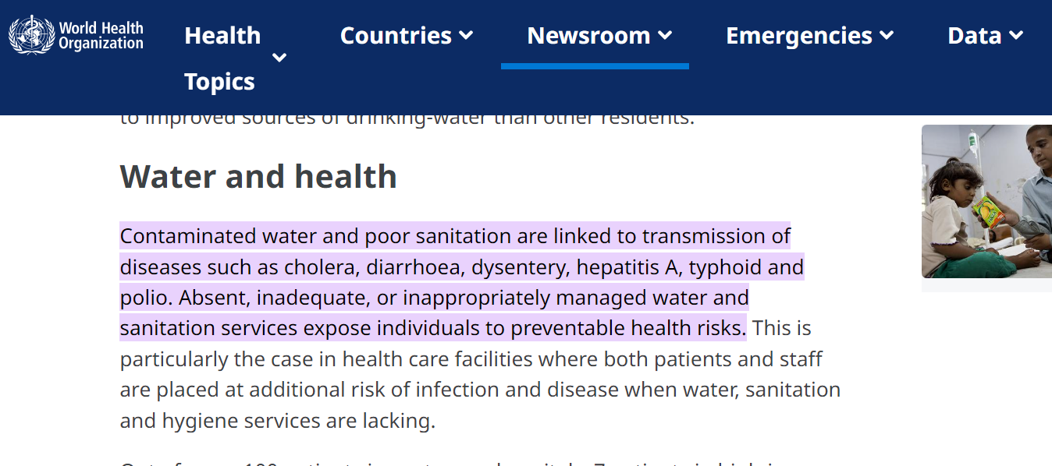
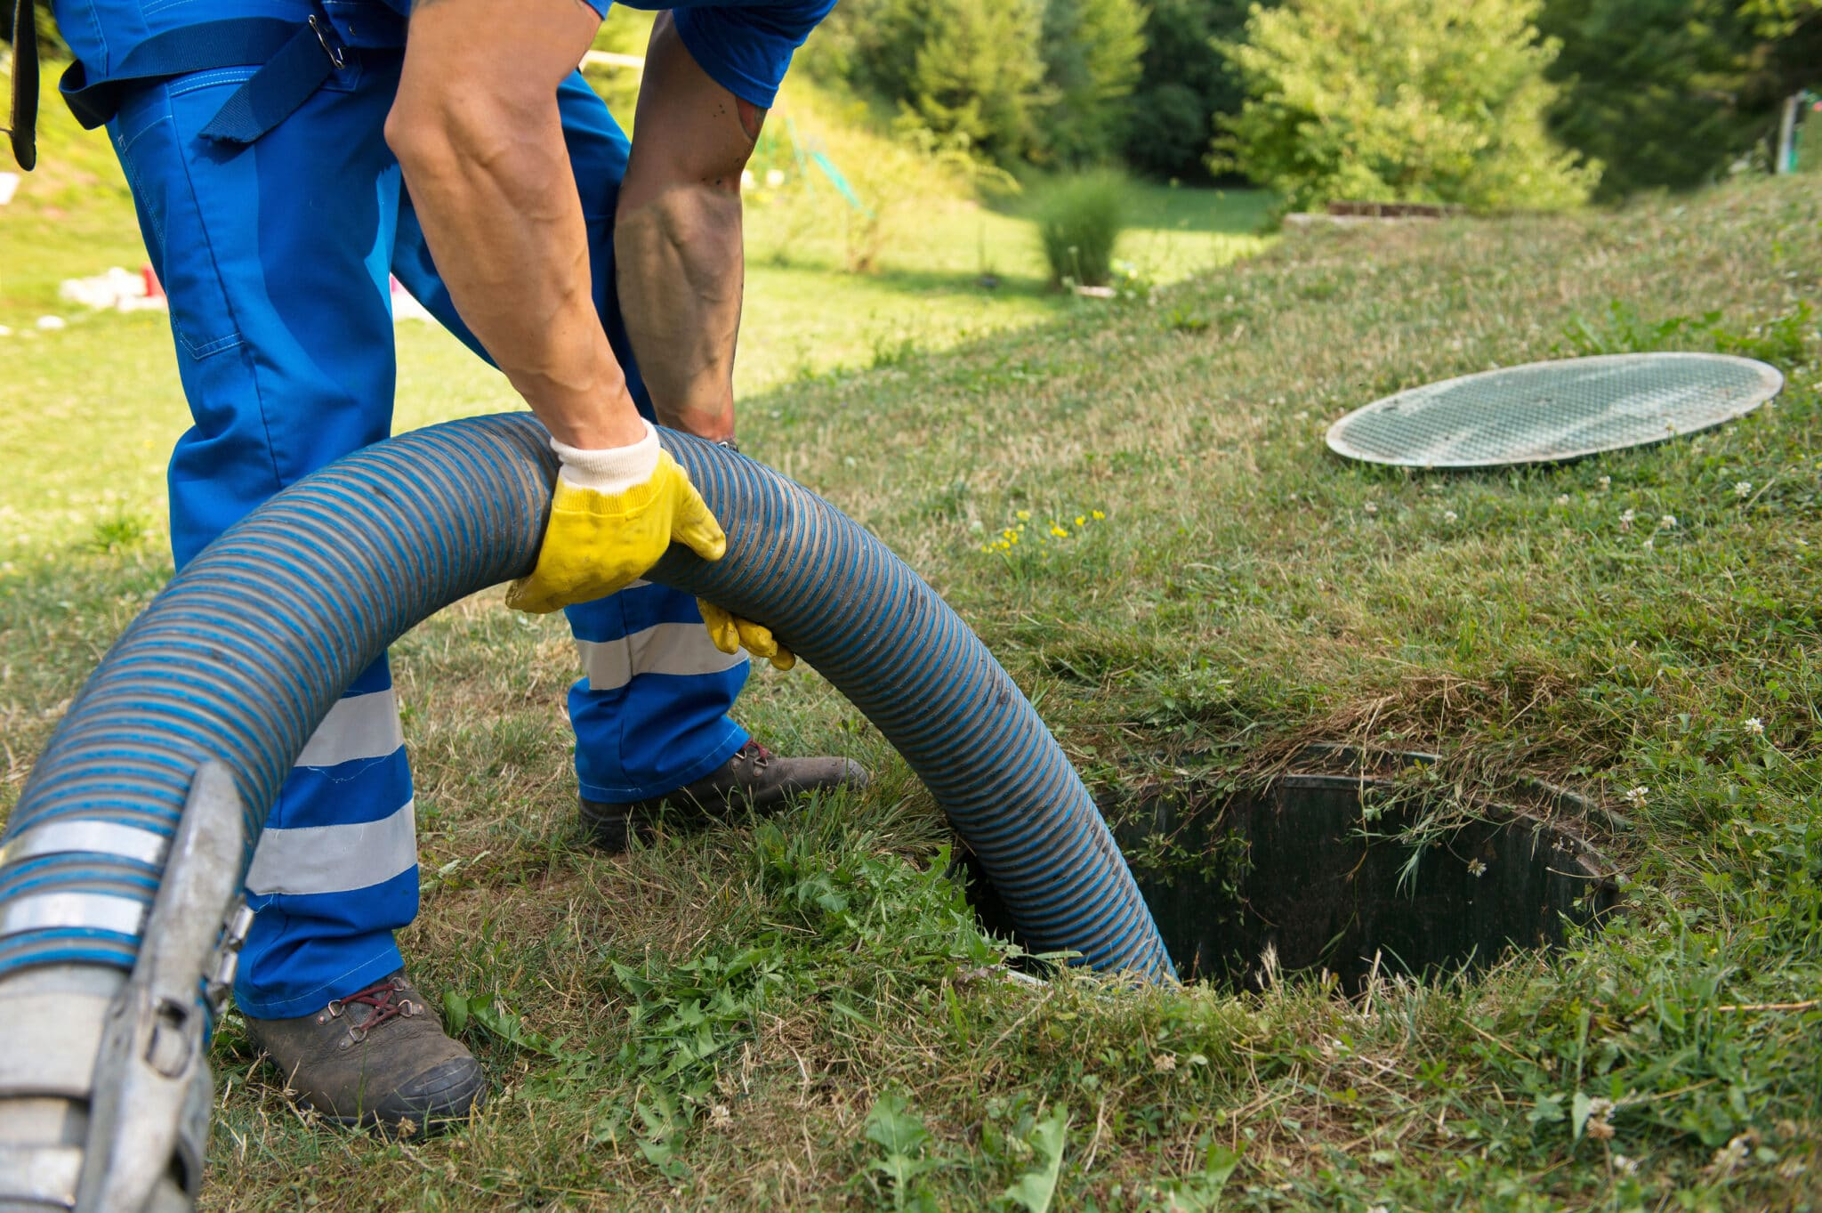
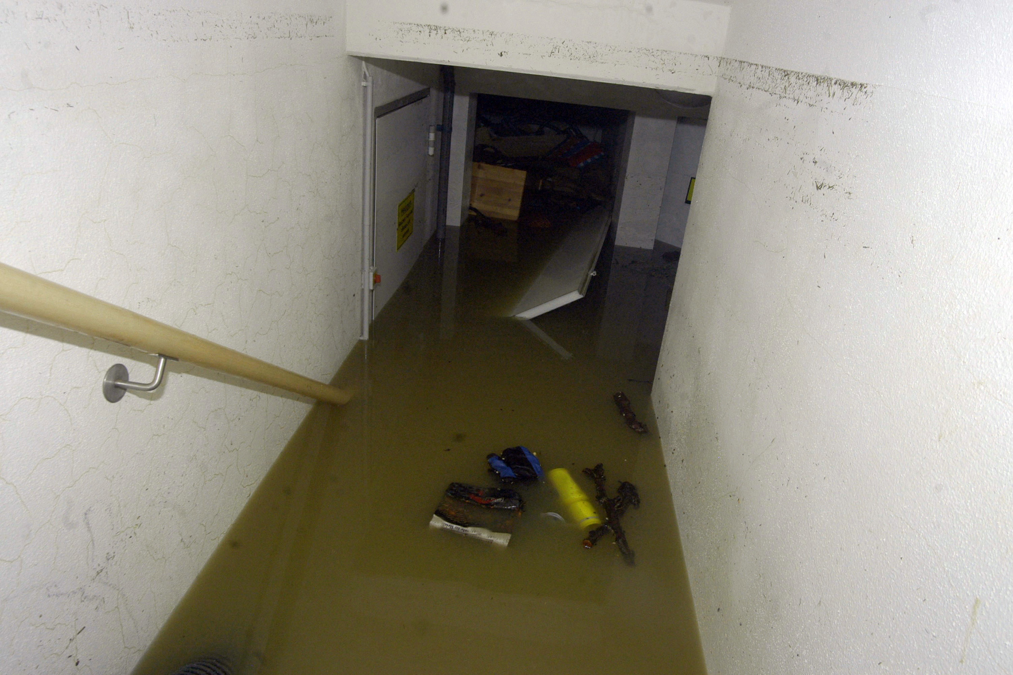
WHAT IS IT WE REALLY DO?

Slide 4
KEY POINTS WHEN ADVOCATING FOR YOUR UTILITY
Proper wastewater treatment is critical to the public health and safety
Back ups are preventable but our systems must be adequately funded
EPA/ODEQ standards are increasing = higher costs = these are not optional
Just like police, fire, and EMS you serve public health and safety
  YOUR UTILITY IS NOT LESS IMPORTANT THAN ANY OF THESE SERVICES

Slide 5
HOW TO FINANCE YOUR IMPROVEMENTS

Slide 6
GRANTS
CDBG – Community Development Block Grant
  HUD/ODOC
OWRB
  REAP – Rural Economic Action Plan
  Emergency Grant
Others

Slide 7
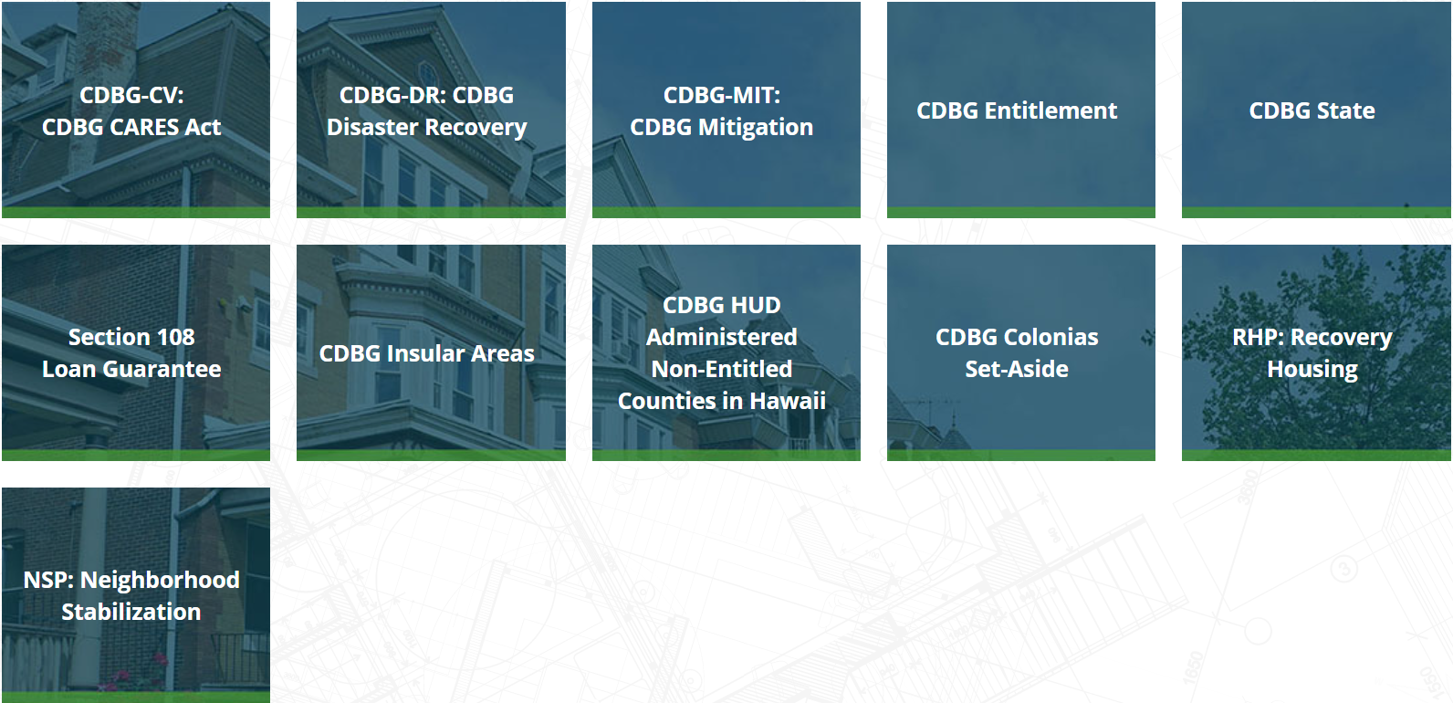
COMMUNITY DEVELOPMENT BLOCK GRANT

Slide 8
COMMUNITY DEVELOPMENT BLOCK GRANT
CDBG State – passed through Oklahoma Department of Commerce
  CDBG Capital Improvement Planning
  CDBG Small Cities
  CDBG Community Revitalization
  CDBG Water-Wastewater Construction
  CDBG Water-Wastewater Design
  CDBG Rural Economic Action Plan
  CDBG Coronavirus Relief Program

Slide 9
CDBG – CIP GRANT
Eligibility
  Non-entitlement units of local government
  $40,000 per sub-state planning area
  No match requirement
  Can apply for CIP grant AND other CDBG grants in the same year
Projects
  To complete a comprehensive inventory of all governmentally owned assets.
  Based on this inventory a 5 year strategic capital improvement plan is developed
  All assets placed on GIS mapping.

Slide 10
CDBG – Water and Wastewater Construction Grant
Eligibility
  Non-entitlement units of local government
  $450,000 maximum funding
  No match requirement but projects with local match will be given higher priority
  Must meet CDBG requirement of providing benefit to low-to-moderate income households
Projects
  Funds may only be utilized for construction, inspection, and administration costs
  Engineering costs are prohibited
    A separate CDBG grant is available for engineering and design

Slide 11
RURAL ECONOMIC ACTION PLAN GRANT - OWRB
Eligibility
  7,000 or less in population (1,750 or less in population given higher priority)
  $150,000 maximum per project per applicant
  No match requirement
  Counties, municipalities, public works authorities, rural water districts, etc.
Projects
  Sewer line construction or repair and related storm or sanitary sewer projects
  Water line construction or repair
  Water treatment
  Water acquisition
  Distribution or recovery and related projects

Slide 12
EMERGENCY GRANT - OWRB
Eligibility
  Applicant cannot reasonably finance project without OWRB assistance
  $100,000 maximum per project per applicant
  15% local match required
  Counties, municipalities, public works authorities, rural water districts, etc.
Projects
  Water and wastewater system projects designed to assist in emergency situations – defined as a life, health, or property threatening situation.

Slide 13
OTHERS
Foundations
Tribes
Any others?

Slide 14
FINANCING OPTIONS
General Obligation Bonds
Bank loans
OWRB Clean Water State Revolving Fund
Others

Slide 15
GENERAL OBLIGATION BONDS
Requirements to obtain:
  Authorization requires an election of the registered voters
    Majority required for most issues
    Super majority in some rare circumstances
  Issuance requires that bonds be sold by competitive bid
    Generally will be purchased by banks or financial institutions
Projects:
  Streets, drainage, facilities, equipment, water and wastewater utilities, etc.
Terms:
  Repaid through property tax levies
  Term will be set by municipality and may be as much as 20 years
  Rates will be determined by bids and will be based primarily on the market
  Unlike schools, there is no limit on G.O. debt that may be issued

Slide 16
BANK LOANS
Requirements to obtain:
  Bank approval
Projects:
  Any that bank will agree to finance
Terms:
  Any that bank will agree
  Typically will require security of some sort
    Complicated by the nature of the improvement – hard to repossess infrastructure
    Often will be secured against the revenues of the system

Slide 17
CLEAN WATER STATE REVOLVING FUND - OWRB
Requirements to obtain:
  OWRB approval
Projects:
  Wastewater infrastructure projects
Terms:
  Up to 30 year term depending on the type of improvement to be financed
  Subsidized interest rate based on prime plus small administrative fee (usually .25%)
  Loan must be secured against the revenues of the system
  Will require 125% debt coverage

Slide 18
OTHERS
Lease purchase
HUD Section 108 loan guarantee program
Others

Slide 19
ENSURING THE FINANCIAL VIABILITY OF YOUR SYSTEM

Slide 20
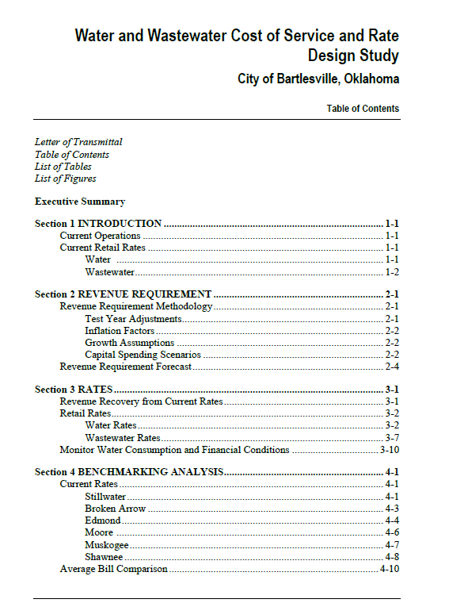
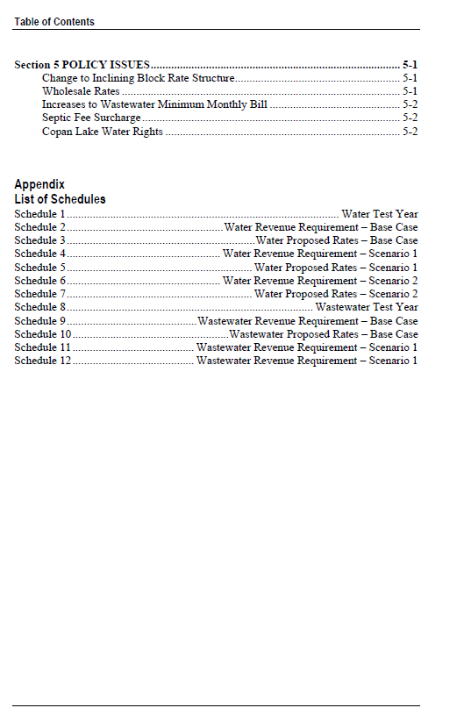
RATE STUDY
Many consultants can provide this service
  Cost between $10,000-$80,000
  Comprehensive report may be as many as 100 pages long

Slide 21
HOW TO DO YOUR OWN RATE STUDY
Starts with revenue requirement
  Calculate total expenses that you will incur
  Apply reasonable inflationary amounts to calculate future years’ revenue requirements
Calculate revenue generated at current rates
Determine excess/deficiency in revenue recovery
Calculate adjusted rates

Slide 22
REVENUE REQUIREMENT
What’s missing?
  Capital expenditures

Slide 23
5 YEAR CAPITAL PLAN

Slide 24
REVENUE REQUIREMENT WITH CAPITAL EXPENDITURES
What rate increase would be necessary to ensure that you could pay $150,000 in year 5?
  About 15%
  This would also mean that you would be collecting $100,000 more than operational costs annually

Slide 25
CAPITAL EXPENDITURE NEEDS TO FUND 5 YEAR PLAN

Slide 26
REVENUE REQUIREMENT WITH PAY-AS-YOU-GO CAPITAL EXPENDITURES
What rate increase is necessary to fund this scenario?
  About 8% will result in having the $45,000 per year by FY 2027
  Some projects will need to be delayed due to cash flow issues

Slide 27
5 YEAR CAPITAL PLAN
Some capital expenditures should be funded through debt
Debt service payments should be treated similarly to pay-as-you-go capital expenses

Slide 28
REVENUE REQUIREMENT WITH CAPITAL AND DEBT SERVICE
What rate increase is necessary to fund this scenario?
  About 6% will fully fund this scenario
  Projects can actually be started earlier than scheduled

Slide 29
RATE INCREASE CALCULATION

Slide 30
BEST PRACTICE SUGGESTIONS
Adopt a 5 year capital plan
  Review and adjust this annually
  Identify how each item will be funded (rates, grant, financing, etc.)
Create a separate capital charge on your utility bills
  These funds should be reserved for payment of capital expenses and debt service on capital financing
Adopt multi-year rate increase plans
  Considering rate increases every year creates unnecessary adversity
  Multi-year plans also allow large increases to be spread across several years
Ensure that your utilities are paying the full cost of their operations
  Personnel, overhead, direct costs, capital, debt service, etc.
Make rate study available to the public
  Most criticism of rate increases is based on mistrust and misunderstanding of the public

Slide 31
QUESTIONS?
Mike Bailey
(918) 338-4282
mlbailey@cityofbartlesville.org

