Slide 1
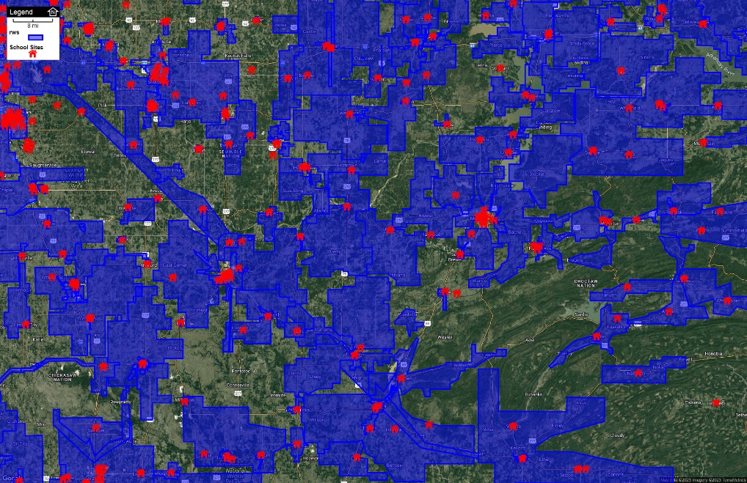
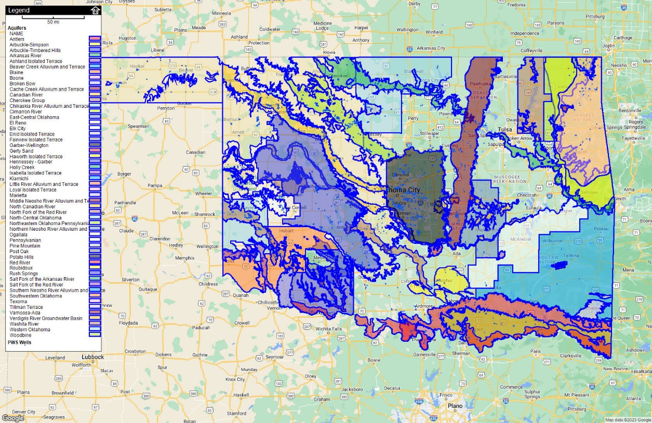
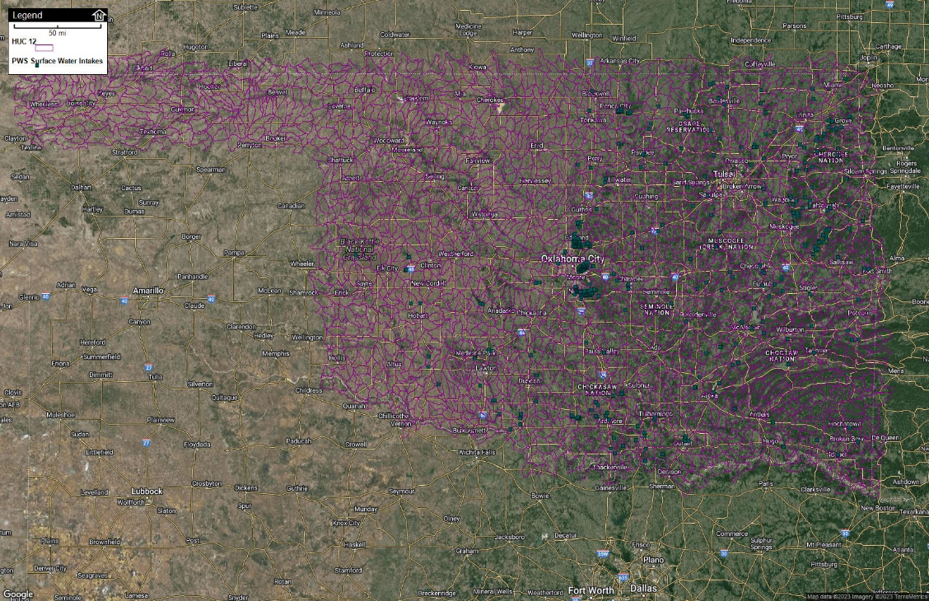
Geographic Information Systems for Water & Wastewater Utilities
Lindsay Roland
Rural Infrastructure Grant Administrator
Sustainability Program Specialist
Oklahoma Rural Water Association
405.413.7942 (c)
lindsayr@orwa.org
linkedin.com/in/lindsayroland

Slide 2
About Me
B.Sci Environmental Sustainability, University of Oklahoma, College of Atmospheric and Geographic Sciences
M.Sci Environmental Science – Hydrology and Water Security, University of Oklahoma, Gallogly College of Civil Engineering and Environmental Science
I’ve always loved field work in the sciences and have had the privilege of collecting field data for all types of purposes: forestry research, stream bio-surveys, plant ecology, assessments of fecal indicator bacteria in OK streams, hydrologic assessments of OK streams, wastewater based epidemiology, source water protection, and smoke testing wastewater collection systems. Mapping these data points to tie information to space has been a key feature in each of these projects. I’ve also used GIS data to analyze stormwater runoff and pollutant control, and I work with other GIS specialists at ORWA to produce maps related to our programs.
My experience using a variety of geographic information systems and field GPS and survey equipment has helped me as a Sustainability Specialist at ORWA to assist small water utilities in managing their utilities through digital mapping. Through ORWA’s Long Range Sustainability Program and Technical Assistance services I’m able to offer GIS services and training to water operators across the state to make this invaluable tool and skillset available to small utilities.

Slide 3
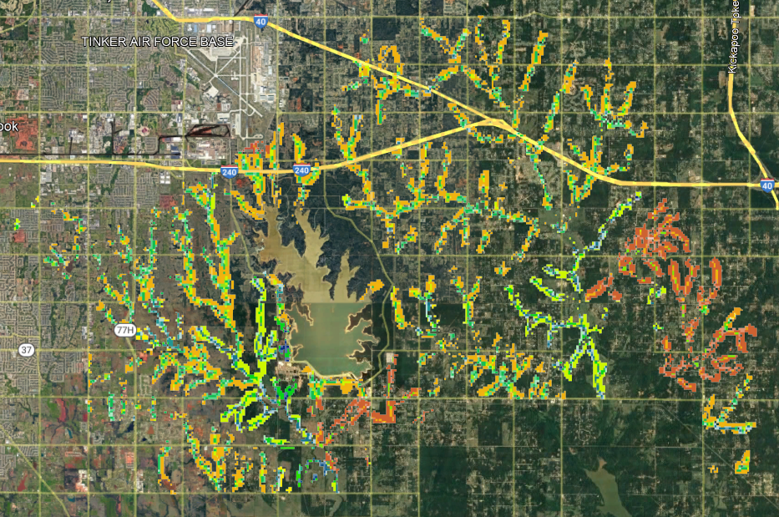
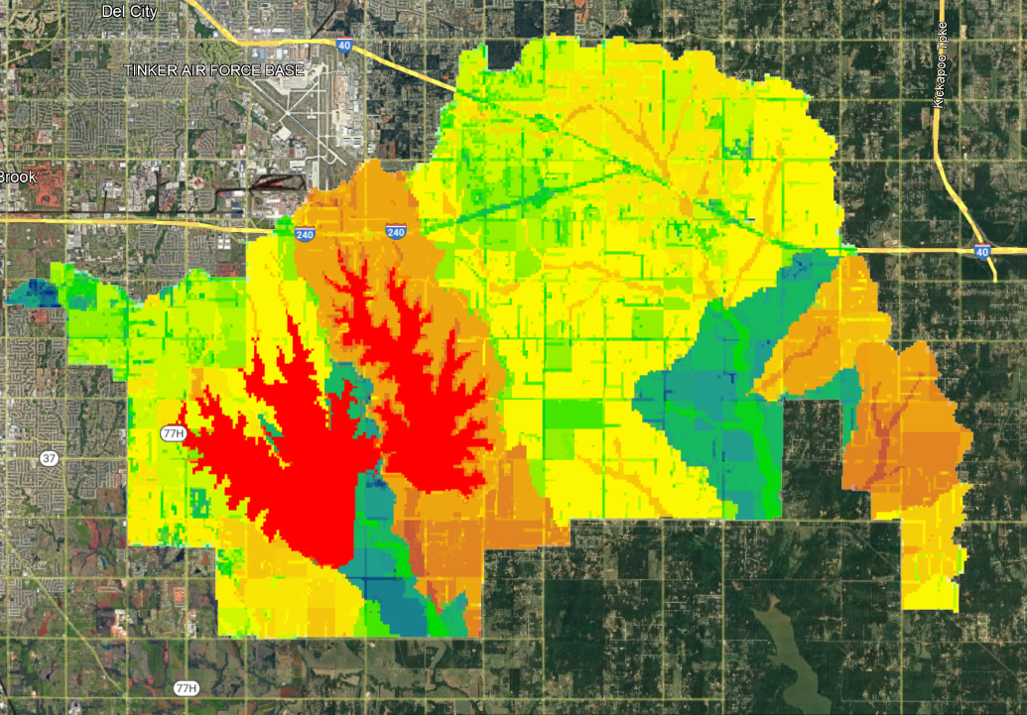
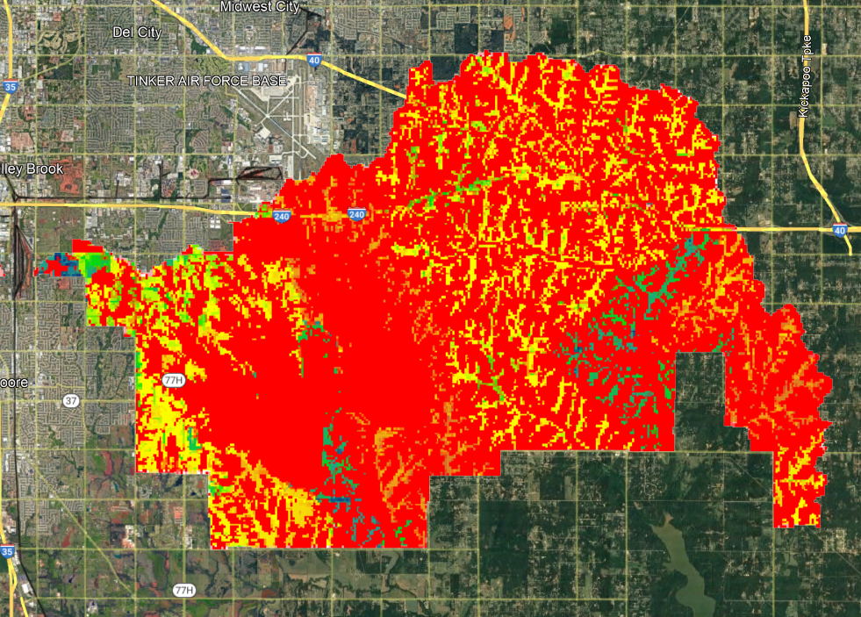
What is GIS?
You’ll hear GIS sometimes referred to as “Geographic Information Science” or “Geographic Information Systems”.
Geographic data is extremely useful in the analysis of environmental, social, political, and economic subjects –this analysis should be approached as a science.
Optimization of placement of above ground BMPs for the control of stormwater runoff and pollutant reduction by analyzing multiple environmental and political parameters
Optimization of placement of infiltration-based BMPs for the control of stormwater runoff and pollutant reduction by analyzing multiple environmental and political parameters
Optimization of placement of in-stream structures for the control of stormwater runoff and pollutant reduction by analyzing multiple environmental and political parameters

Slide 4
What is GIS?
You’ll hear GIS sometimes referred to as “Geographic Information Science” or “Geographic Information Systems”.
The software we use for analysis of data spread over geographic areas are the geographic information systems we use to perform this analysis.

Slide 5
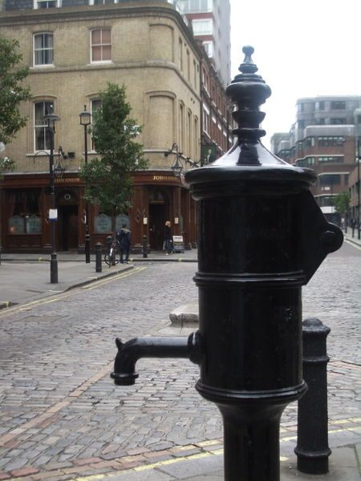
Why do we need GIS for water utilities? The Story of the Broad Street Pump
In 1854, those living in London were constantly at risk of cholera, which afflicted the city in waves. At this time germ theory was not yet a theory, and the causes of illness were unknown. The prominent theory of the time was that cholera was caused by “miasmas” or foul odors which carried particles that were inhaled to make people sick.

Slide 6
Why do we need GIS for water utilities? The Story of the Broad Street Pump
Dr. John Snow had a strong suspicion that cholera was instead caused by something people ingested, and contaminated water was his best guess.

Slide 7
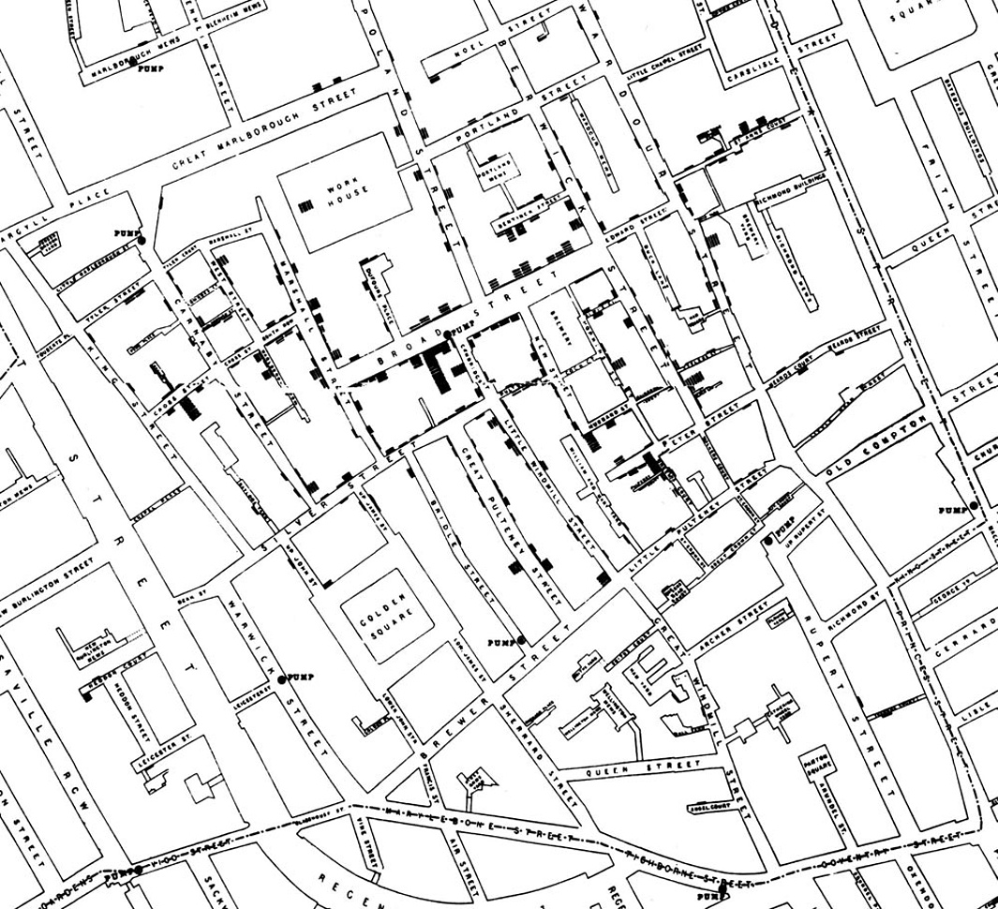
Why do we need GIS for water utilities? The Story of the Broad Street Pump
John Snow used a street map of London and began marking the locations of deaths by cholera. Each bar on this map represents one death, and multiple bars show multiple deaths at the same dwelling.

Slide 8
Why do we need GIS for water utilities? The Story of the Broad Street Pump
Through this analysis of disease using geography, Dr. Snow was able to show that there was a geographic relationship among every cholera death in the most recent outbreak.

Slide 9
Why do we need GIS for water utilities? The Story of the Broad Street Pump
His investigation lead him to pinpoint the communal water tap on Broad Street as the likely source of cholera for the surrounding community.

Slide 10
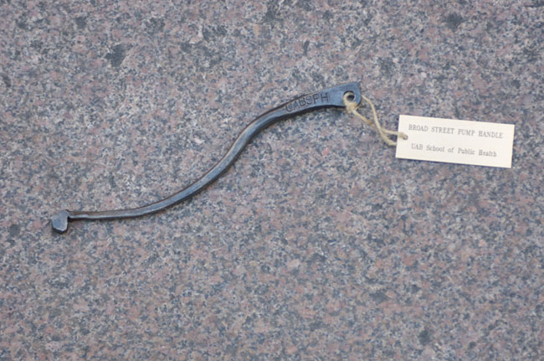
Why do we need GIS for water utilities? The Story of the Broad Street Pump
In an act of guerilla public health management, Dr. Snow removed the handle to the pump, closing off the source of contaminated water for the community. When the cholera wave came to an end, his theory of water contaminated by sewage from a nearby sess pit was accepted by public officials, and this became a landmark case in epidemiology.

Slide 11
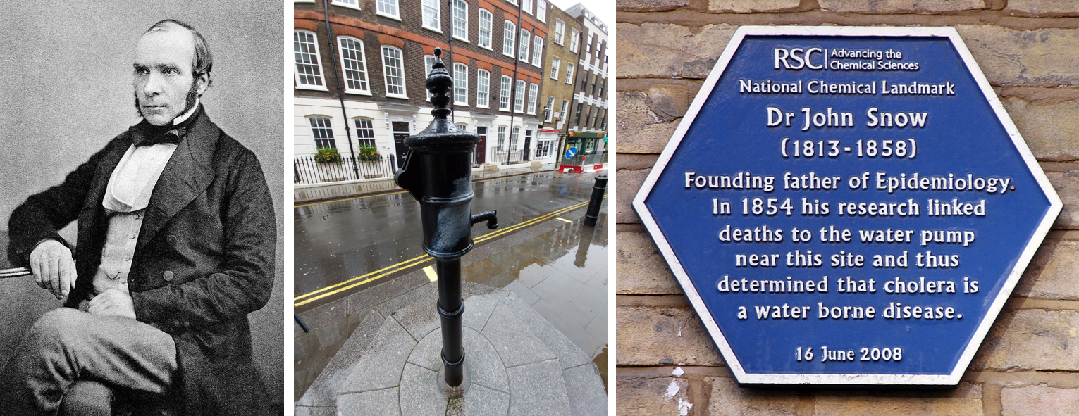
This story is often referred to as the beginning both of epidemiology and geographic information science. This also marked the beginning of a new era of water quality management.

Slide 12
Prior to the Clean Water Act, mapping continued to be used in the U.S. to pinpoint the sources of cholera outbreaks – sewage upstream of surface water intakes.

Slide 13
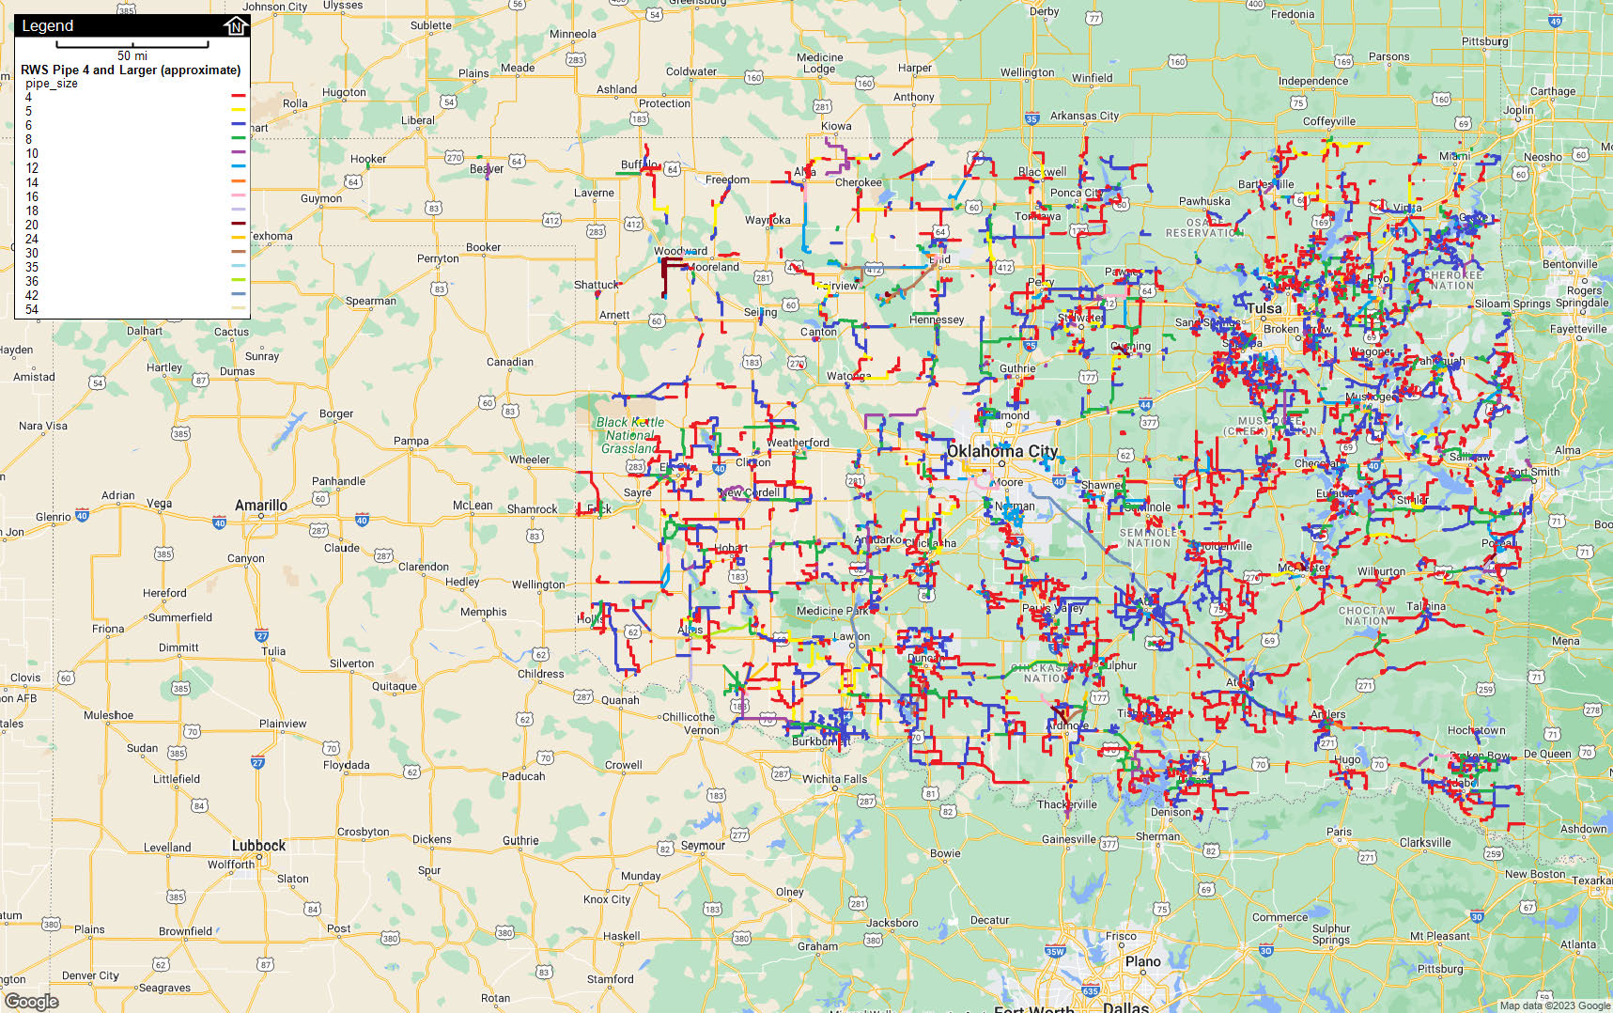
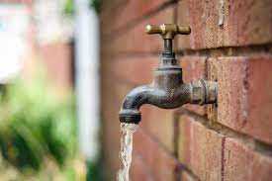
If we recognize that water service is a public health discipline, the importance of the utilization of geographic information systems can not be overstated. The public is best served by water utilities that use GIS.

Slide 14
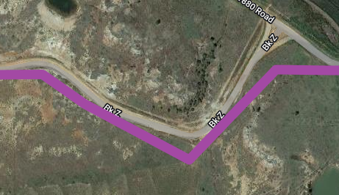
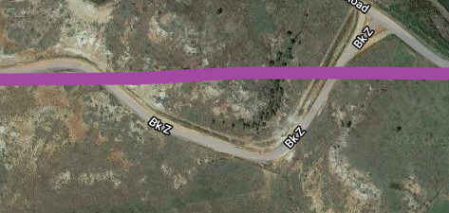
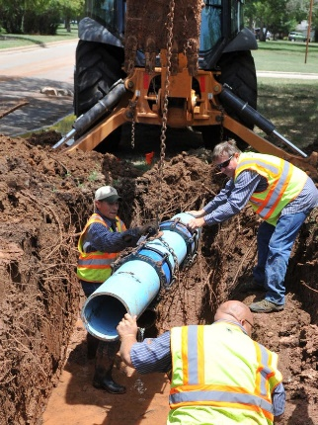
Why Digital Geographic Data?
Digital maps can be updated. Often maps will contain errors, and this is even more likely when key structures – such as waterlines – are hidden underground. Creating and using a digitized map allows the operator to make corrections to known errors. Points and lines should be updated with photos and notes on a utility’s map:
When there is inconsistency in the map and the “ground truth”
When damage is observed
X
When repairs are made
When non-routine work is completed in a utility.

Slide 15
Why Digital Geographic Data?
Geographic data is uniquely suited to analyze and communicate issues within a utility’s infrastructure. Nothing makes an old busted water line jump off the screen like seeing damage reports stacked up over months or years. If used as intended, a map should demonstrate the optimal locations in a water system to allocate resources by indicating where the greatest need is.

Slide 16
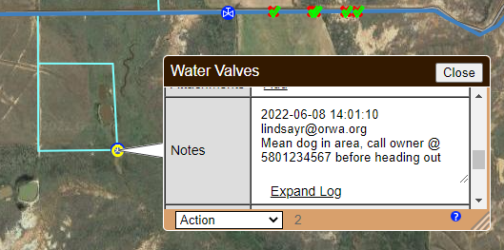
Why Digital Geographic Data?
Geographic data is an essential part of the preservation of institutional knowledge in a water system. The information operators and managers leave behind about the management of their water systems is as important as the exceptional work they carry out every day in ensuring continuous service of quality drinking water. As water systems age and new staff take over, the loss knowledge about the details (small and large) of each water system is one of the obstacles to the continuity of high quality water service.

Slide 17
Why Digital Geographic Data?
Digital geographic inventories created for water system infrastructure can also be used for documentation for asset management and insured assets. Inspection videos, photos, and other documentation can be appended to each infrastructure asset (geographic data points) on digital maps. Determining the current condition of critical infrastructure is valuable to both waterworks operators and administrators in a water system.

Slide 18
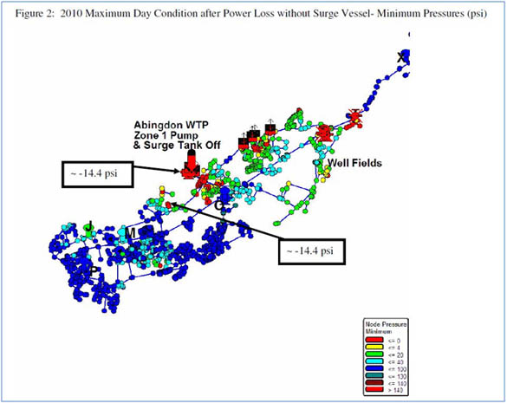
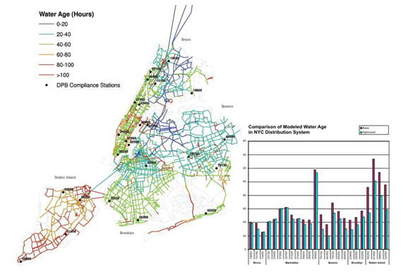
Why Digital Geographic Data?
Up-to-date geographic information sharing with system engineer allows for the best hydraulic information. Every time the system changes with the addition or loss of lines, the hydraulic model created by a water utility’s engineer will need to be updated.

Slide 19
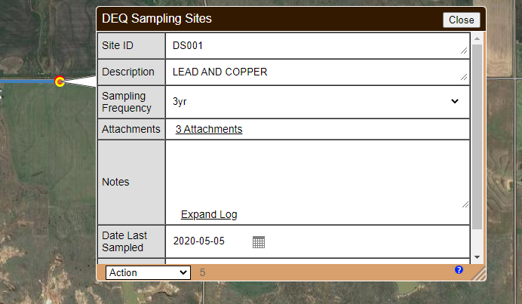
Why Digital Geographic Data?
Documenting water sampling results as a layer is allows for easy visual assessments of water quality history at utility sampling points. This data is also very easy to export to interested parties such as regulators, engineers, or helpful program staff at ORWA.

Slide 20
Why Digital Geographic Data?
Utility infrastructure updates
Recording issues and coordinating solutions
Preservation of institutional knowledge
Asset management
Infrastructure management
Water quality monitoring and utility management
These are some of the benefits of implementing GIS for water utilities. In the State of Oklahoma, most large municipalities have been utilizing GIS for quite a while. In small water utilities across Oklahoma, we often find that at best a utility has a paper map tacked to a wall.
The skillset necessary to take advantage of modern geographic information systems is often a barrier for small utilities, but ORWA is stepping in to change that!

Slide 21
Recommended Equipment
Desktop or laptop computer with internet connection
Tablet with data plan for use in the field
Smart phones for employee use
4. Optional – Handheld GPS point collection device such as those made by Garmin or Trimble
Routine work will not usually require the level of accuracy provided by these specialty GPS devices, and the accuracy provided by your smart devices combined with staff knowledge of the system will be enough to provide great maps. Smart phones and tablets can, at best, only be expected to give you location accuracy of 12-15 feet.
Some non-routine work, such as correcting locations of points on the map, leak detection, or system defect documentation should aim for greater location accuracy than can be provided by most smart devices. Look for handheld GPS units that can connect to your computer for easy transfer of the location points collected in the field, with location accuracy of less than 1 meter or 3.3 feet.

Slide 22
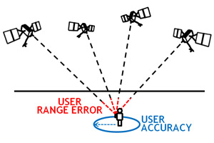
About GPS Accuracy
GPS works by using signals transmitted by satellites and calculations related to the speed of those signals to determine the location of a receiver on the Earth’s surface.
These calculations are assumed to have some error, which means the exact location recorded for the GPS receiver will also have some error.
This error is expressed as a radius around the observer (or GPS receiver) on the ground. In a fun marketing twist, those who sell GPS devices have renamed this level of error “accuracy”.

Slide 23
About GPS Accuracy
In GPS terms, “accuracy” refers to the amount of error you can expect from different types of GPS devices, and is expressed as a radius around the GPS receiver on the ground in feet or meters.
Devices with accuracy ratings at smaller distances are tested in the field to provide more accurate geo-location records than devices with ratings at larger distances.
Accuracy of various GPS devices under clear sky conditions:
Smart phones $≈$ 12-16 ft
Specialized GPS data collection tablets $≈$ 9 ft
GPS receiver paired with another device for data collection $≈$ <1ft – 12 ft

Slide 24
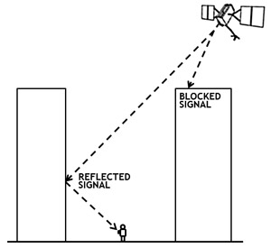
About GPS Accuracy
Common Causes of GPS Location Errors
Satellite signal blockage due to buildings, bridges, trees, etc.
Indoor or underground use
Signals reflected off buildings or walls ("multipath")

Slide 25
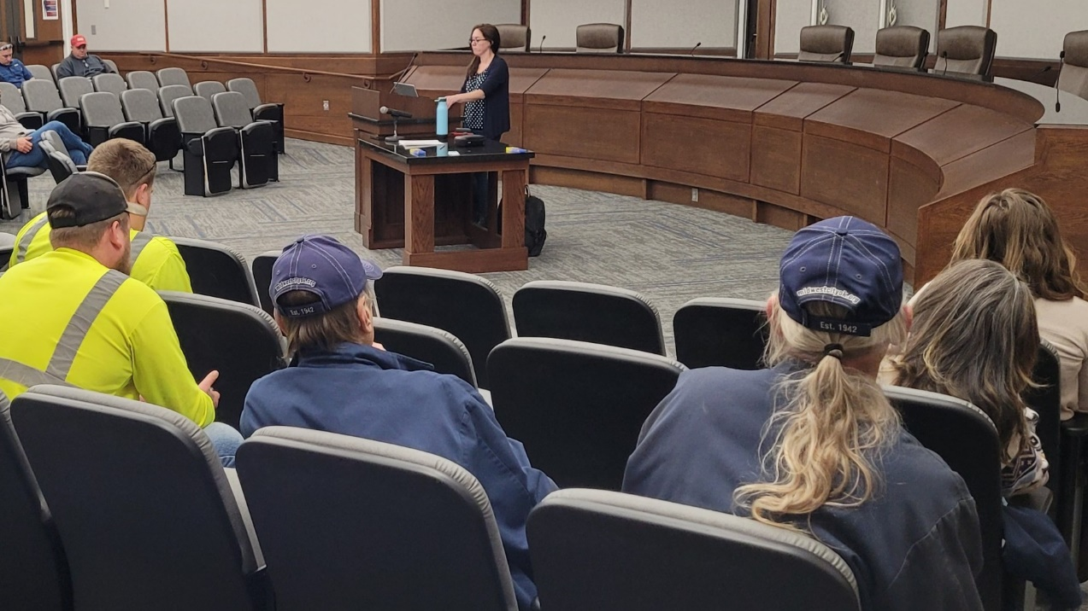
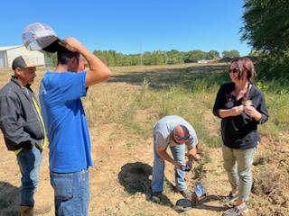
ORWA’s field staff trains water operators to think like geographers.
At operator renewal training events hosted at town halls and other small to large venues across Oklahoma, ORWA staff provide GIS training in a classroom setting.
For most, the best way to learn is by doing, so we try to make this training as interactive as possible.

Slide 26
Would you rather play on your phone than watch a PowerPoint Presentation?
Scan this QR code with the camera on your smart phone or tablet!
Learn by doing!
Or just open your phone’s browser and go to diamondmaps.com

Slide 27
Would you rather play on your phone than watch a PowerPoint Presentation?

Slide 28
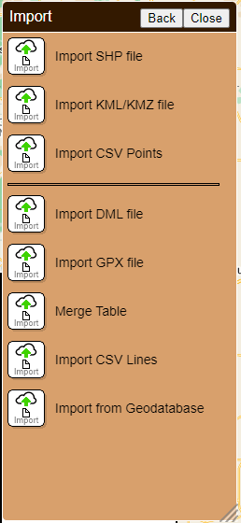
ORWA mapping specialists are often asked by operators to help them move their inventory of digital map files to another GIS. Quite a lot of our work involves tracking down the map files that already exist for utilities. This is often difficult for those without GIS training because the file types are unfamiliar if you don’t have a GIS background.

Slide 29
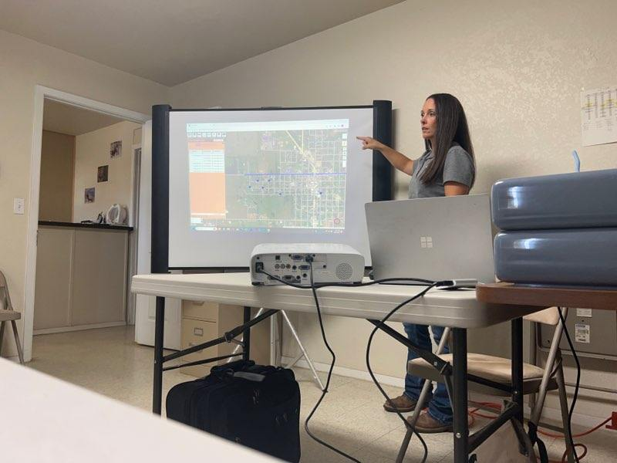
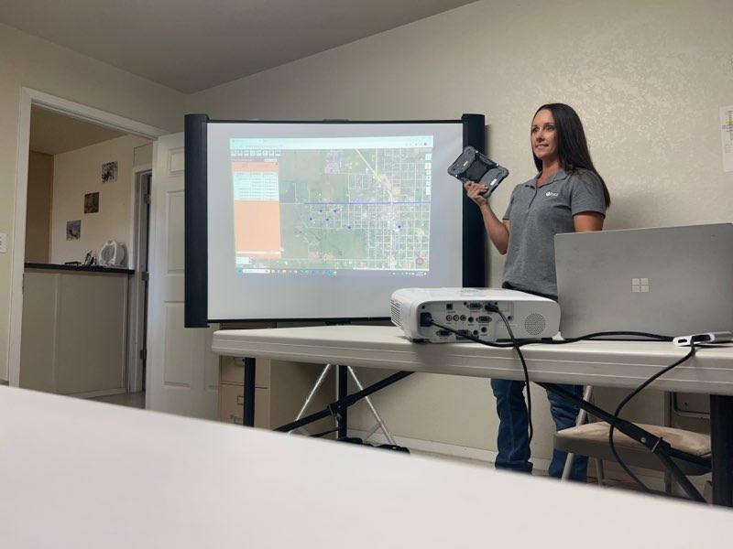
ORWA Sustainability Specialist Karen Risely Presents Diamond Maps to a water utility board for approval.

Slide 30
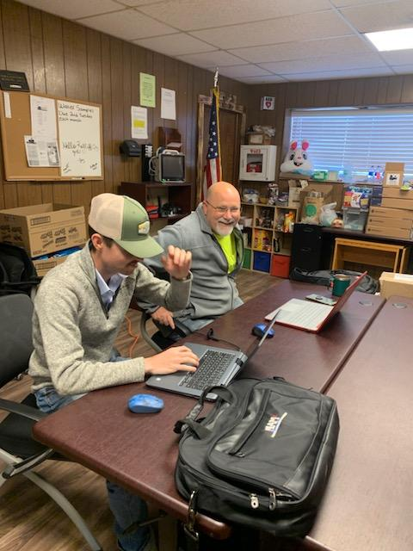
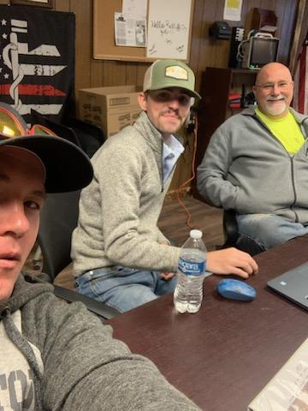
ORWA Mapping Specialists Use All Available Resources to Help Water Utilities Create Maps of Their Systems
Sustainability Specialist Sawyer Seago helps systems all over Oklahoma to create maps from scratch. Trey Horton, an ORWA Circuit Rider, is a great supporter of mapping and GIS training for water utilities.

Slide 31
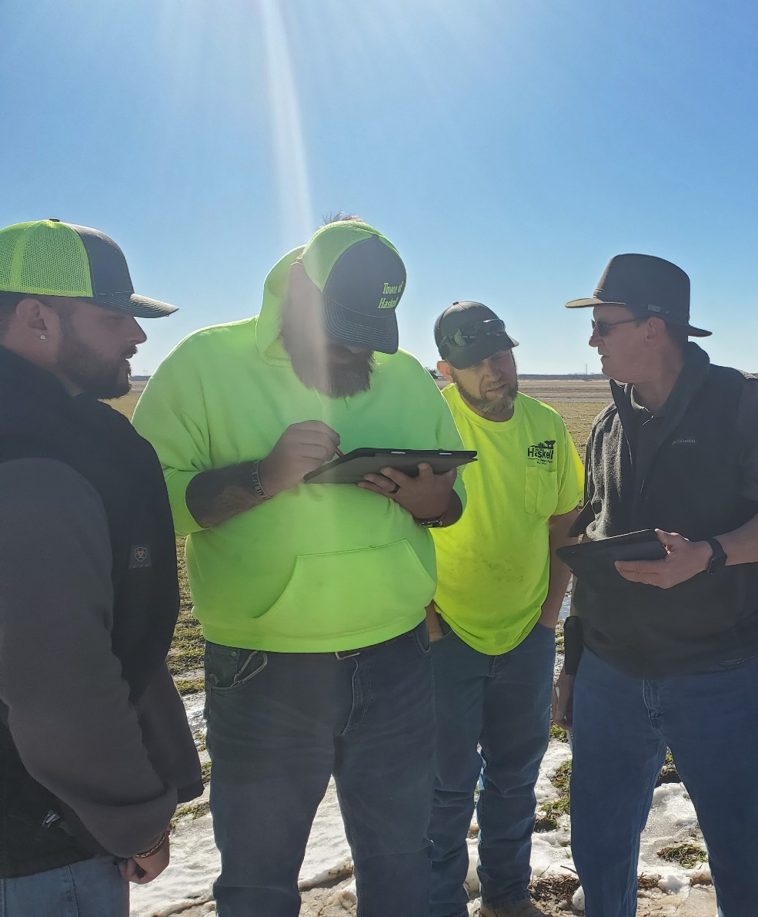
ORWA’s field staff trains water operators to think like geographers.
Sustainability Specialist Richey Kirkpatrick trains staff at the Town of Haskell to use a cloud-based GIS to map their water utility starting from scratch.

Slide 32
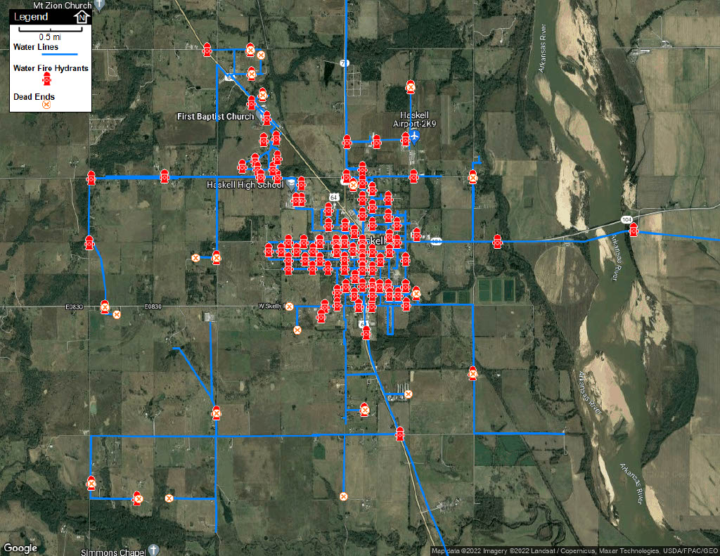
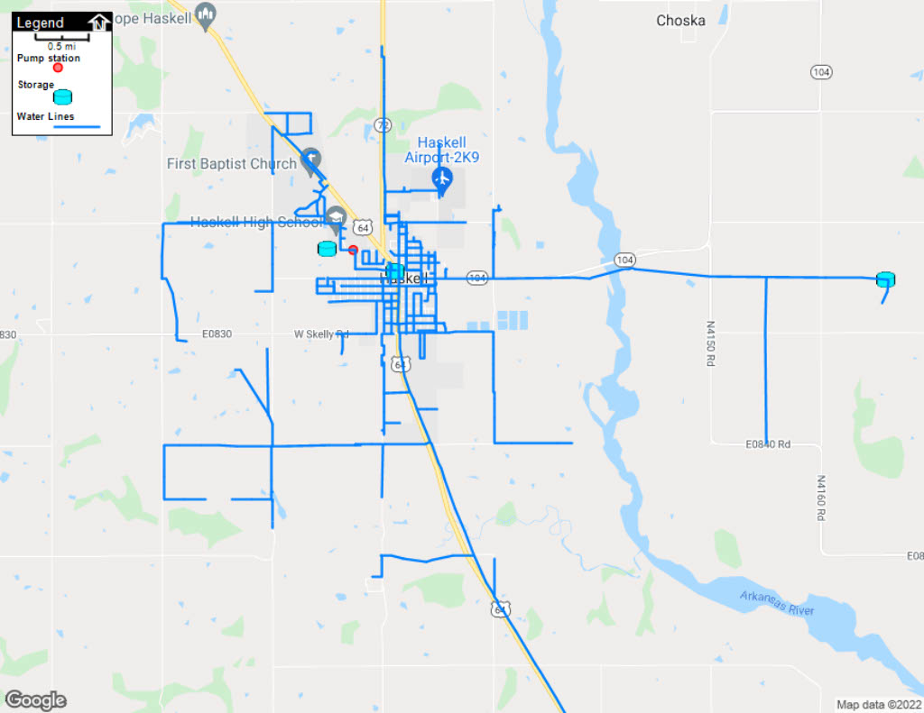
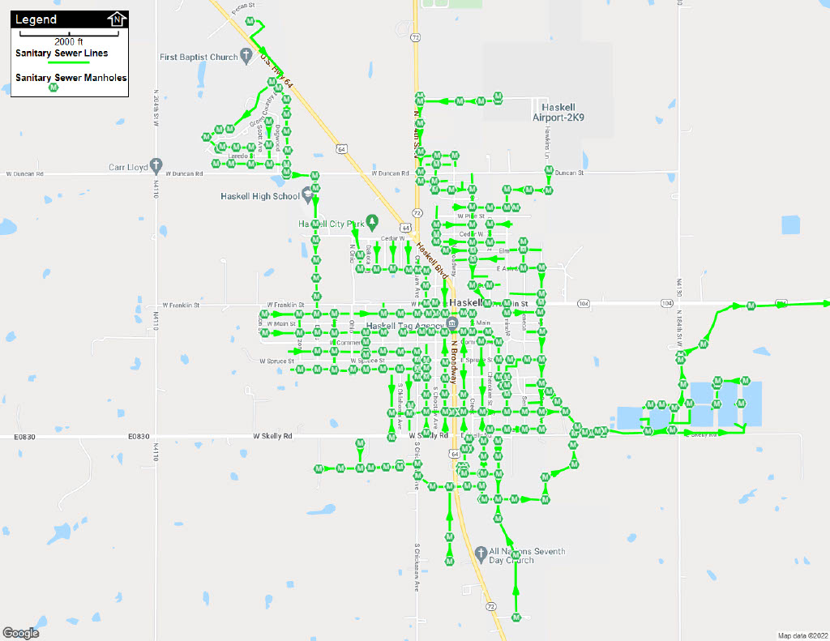
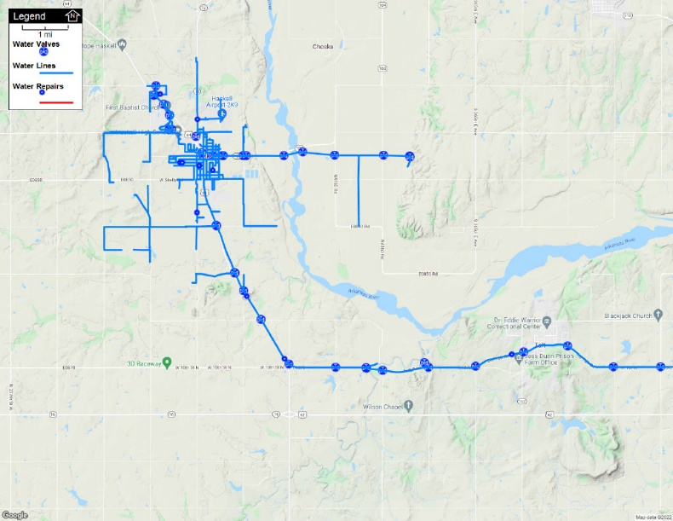
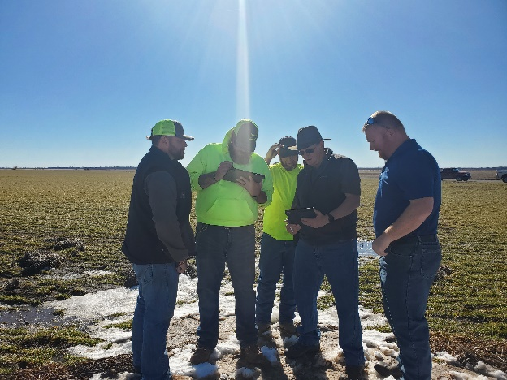
Digital Mapping Training for Rural Water Systems
Technical Assistance Services & Long Range Sustainability Program

Slide 33
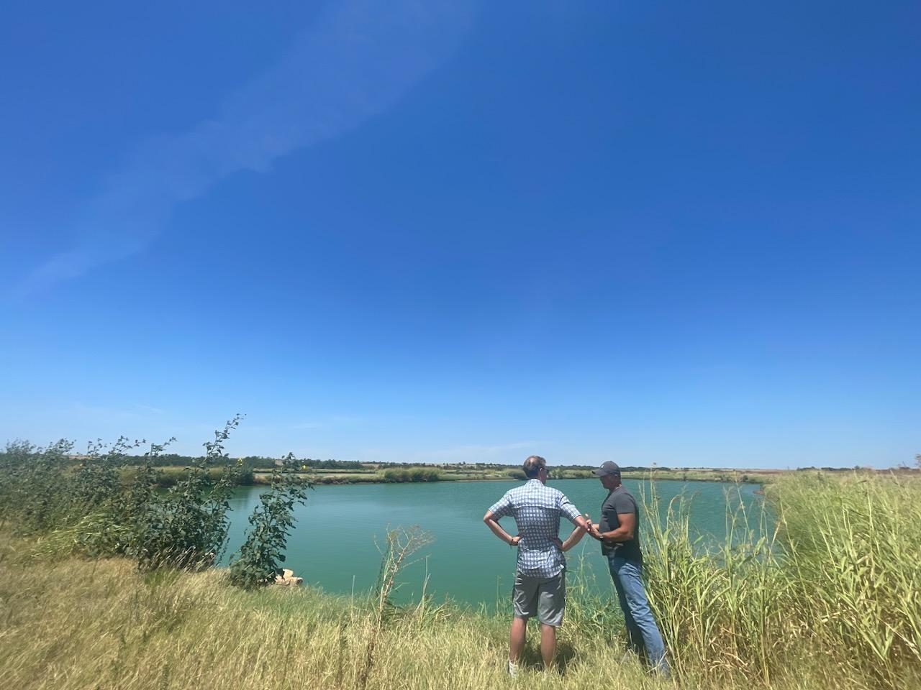
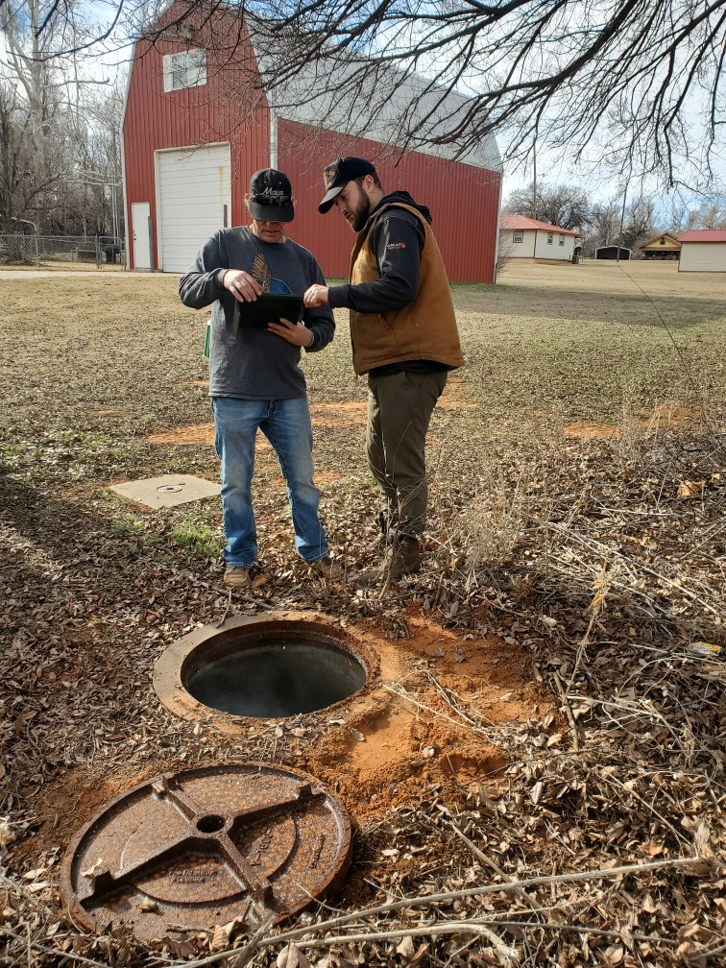
ORWA staff show operators how GIS can help them in the everyday management of their utilities through several of our technical services.
ORWA Sustainability and Leak Detection Specialist Logan Davis takes advantage of a smoke test to show this water operator how to use Diamond Maps to document defects in the wastewater collection system that cause inflow and infiltration.
Mapping the Grady Co RWD #1 wastewater system starting at the Lagoons. ORWA Circuit Rider Mike Black works with water operator Shon Riley.

Slide 34
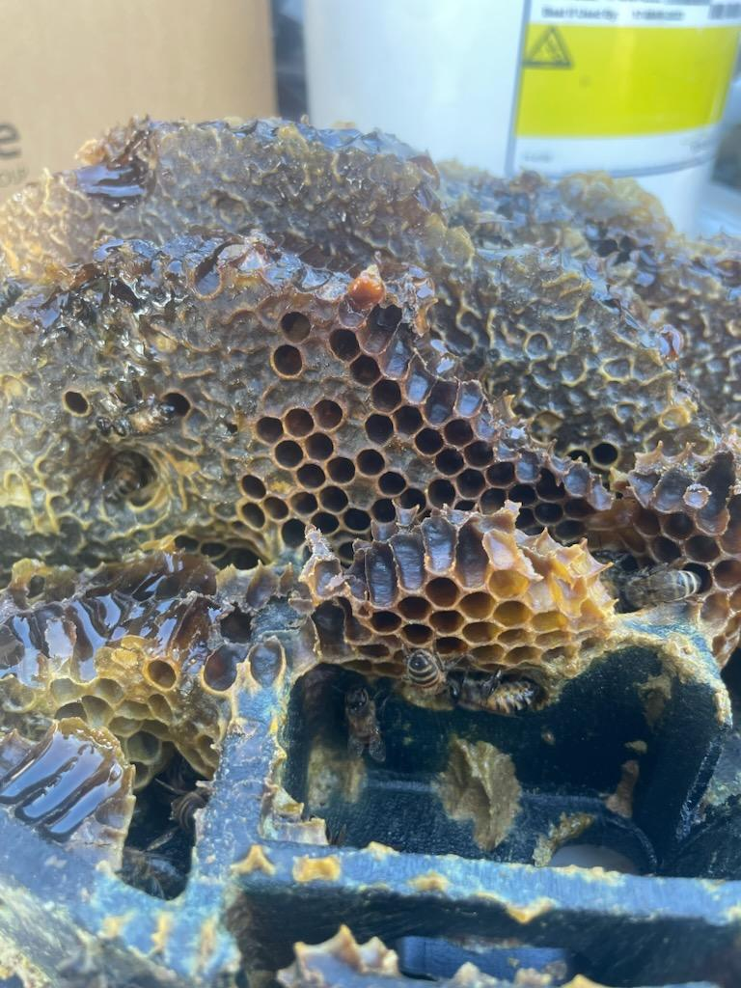
Treasures from the Hunt
ORWA Sustainability and Leak Detection Specialist Logan Davis found this in a meter box while in the field showing operators at Lincoln Co RWD #4 how to collect and map GPS points in their district.

Slide 35
Oklahoma Rural Water Association is rapidly developing our GIS team and technical services related to mapping for small water and wastewater utilities. Stay tuned!

Slide 36
Sources
“Oklahoma Rural Water Association Maps”, diamondmaps.com, Lindsay Roland, ORWA
“Stormwater Optimization Maps”, Oklahoma Water Survey, Lindsay Roland
GIS Company Logos
https://www.esri.com
https://www.qgis.org
https://www.openstreetmap.org
https://www.google.com/earth/versions/
https://www.diamondmaps.com

Slide 37
Sources
Broad Street Water Tap
“John Snow’s Map”, Computational and Inferential Thinking, https://inferentialthinking.com/chapters/02/1/observation-and-visualization-john-snow-and-the-broad-street-pump.html
“Broad Street Pump, Historical Marker Database, https://www.hmdb.org/m.asp?m=145183
“Pump Handle”, https://www.edwardtufte.com/bboard/q-and-a-fetch-msg?msg_id=0002Je
“Broad Street Pump”, https://www.atlasobscura.com/places/broad-street-cholera-pump

Slide 38
Lindsay Roland
Rural Infrastructure Grant Administrator
Sustainability Program Specialist
Oklahoma Rural Water Association
405.413.7942 (c)
lindsayr@orwa.org
linkedin.com/in/lindsayroland

