Slide 1
Pipeline Bedding material
Ensuring Stability and Longevity

Slide 2
Importance of pipe bedding
Proper bedding of a pipeline in a trench can be paramount in preventing pipeline failure.
Appropriate bedding material is essential for the stability and durability of pipelines.
Proper bedding is essential to assure the pipe does not inordinately deflect
Bedding must be designed to support the respective pipeline materials installed and control its interactions with external loading upon the pipeline
Proper bedding during pipe installation saves money long-term

Slide 3
Objectives
Understand the role of bedding material and external loading forces effects on the pipe
Types/Classes of bedding material
Benefits of proper bedding
Environmental and public health considerations

Slide 4
Role of bedding material
When a pipeline is installed in a trench, proper bedding of the pipeline is essential to assure the pipe does not inordinately deflect.
Bedding is the material installed in the bottom of the trench on which the pipe is laid.
The bedding must be designed to support the respective pipeline material installed and control its interaction with external loading upon the pipeline.
Various pipe materials require a specific type of bedding to not deflect and not fail.
Notes:
We are going to do a brief overview of how buried flexible and rigid pipes behave when encountering live and earth loading
Lets use the analogy of soil springs to illustrate how rigid and flexible pipes behave differently

Slide 5
Role of bedding material
When a pipeline is installed in a trench, proper bedding of the pipeline is essential to assure the pipe does not inordinately deflect.
Bedding is the material installed in the bottom of the trench on which the pipe is laid.
The bedding must be designed to support the respective pipeline material installed and control its interaction with external loading upon the pipeline.
Various pipe materials require a specific type of bedding to not deflect and not fail.
Notes:
The rigid pipe can be represented as a stiff spring because its not going to compress or deflect very much
The side soil represented as a flexible spring because relative to the pipe the side soil is more compressible

Slide 6
Role of bedding material
When a pipeline is installed in a trench, proper bedding of the pipeline is essential to assure the pipe does not inordinately deflect.
Bedding is the material installed in the bottom of the trench on which the pipe is laid.
The bedding must be designed to support the respective pipeline material installed and control its interaction with external loading upon the pipeline.
Various pipe materials require a specific type of bedding to not deflect and not fail.
Notes:
When loaded with typical live load or earth load the side soil is a little more compressible than the middle column when looking at a rigid pipe

Slide 7
Role of bedding material
When a pipeline is installed in a trench, proper bedding of the pipeline is essential to assure the pipe does not inordinately deflect.
Bedding is the material installed in the bottom of the trench on which the pipe is laid.
The bedding must be designed to support the respective pipeline material installed and control its interaction with external loading upon the pipeline.
Various pipe materials require a specific type of bedding to not deflect and not fail.
Notes:
What happens when this occurs is you will get a frictional force or down drag
The pipe in the center column is not only carrying the load from directly above, it’s also carrying some of the load from the column beside it because of the fact the side soil is more compressible
(EXPLAIN FRICTIONAL FORCE)
When you look at the plastic pipe side you situate the springs in the exact opposite

Slide 8
Role of bedding material
When a pipeline is installed in a trench, proper bedding of the pipeline is essential to assure the pipe does not inordinately deflect.
Bedding is the material installed in the bottom of the trench on which the pipe is laid.
The bedding must be designed to support the respective pipeline material installed and control its interaction with external loading upon the pipeline.
Various pipe materials require a specific type of bedding to not deflect and not fail.
Notes:
A flexible pipe is going compress a little easier or more than the side soil
This is not a defect in the pipe, its just how the pipe was designed, to transfer some of the load to the soil, its not designed to carry much load
So what happens when you load the springs is the middle column, is the middle column is more compressible than the side soil
As the middle column compresses and the pipe deflects this applies an outward force to the side soil

Slide 9
Role of bedding material
When a pipeline is installed in a trench, proper bedding of the pipeline is essential to assure the pipe does not inordinately deflect.
Bedding is the material installed in the bottom of the trench on which the pipe is laid.
The bedding must be designed to support the respective pipeline material installed and control its interaction with external loading upon the pipeline.
Various pipe materials require a specific type of bedding to not deflect and not fail.
Notes:
A combination of the outward force from the flexible pipe’s deflection and the downward shift of the soil in the middle column from the flexible pipes deflection causes a frictional force opposite of the one shown with the rigid pipe

Slide 10
Role of bedding material
When a pipeline is installed in a trench, proper bedding of the pipeline is essential to assure the pipe does not inordinately deflect.
Bedding is the material installed in the bottom of the trench on which the pipe is laid.
The bedding must be designed to support the respective pipeline material installed and control its interaction with external loading upon the pipeline.
Various pipe materials require a specific type of bedding to not deflect and not fail.
Notes:
(EXPLAIN FRICTIONAL FORCE)
The frictional force is called the vertical arching factor
In the case of the rigid pipe the VAF value is greater than 1 which is just a mathematical way of saying that not only is the pipe carrying the weight of the soil above but is also carrying some of the weight from the soil on either side of it
In the case of a flexible pipe the VAF is generally less than 1, which is a way of representing that the pipe is not carrying all of the load above but is distributing some of the load into the surrounding soil envelope

Slide 11
Role of bedding material
When a pipeline is installed in a trench, proper bedding of the pipeline is essential to assure the pipe does not inordinately deflect.
Bedding is the material installed in the bottom of the trench on which the pipe is laid.
The bedding must be designed to support the respective pipeline material installed and control its interaction with external loading upon the pipeline.
Various pipe materials require a specific type of bedding to not deflect and not fail.
Notes:
When you load a rigid pipe like the one on the left what happens is

Slide 12
Role of bedding material
When a pipeline is installed in a trench, proper bedding of the pipeline is essential to assure the pipe does not inordinately deflect.
Bedding is the material installed in the bottom of the trench on which the pipe is laid.
The bedding must be designed to support the respective pipeline material installed and control its interaction with external loading upon the pipeline.
Various pipe materials require a specific type of bedding to not deflect and not fail.
Notes:
That load gets transferred through the pipe into the foundation or the bedding that it is sitting in
Due to how this load is transferred, the bedding area and haunching area up to the spring line of the pipe (the mid point of the pipe) are the most critical for rigid pipe
It’s the lower half of the support that the rigid pipe is getting

Slide 13
Role of bedding material
When a pipeline is installed in a trench, proper bedding of the pipeline is essential to assure the pipe does not inordinately deflect.
Bedding is the material installed in the bottom of the trench on which the pipe is laid.
The bedding must be designed to support the respective pipeline material installed and control its interaction with external loading upon the pipeline.
Various pipe materials require a specific type of bedding to not deflect and not fail.
Notes:
Rigid pipe does rely a little on lateral support but it’s not as critical
For flexible pipe obviously the foundation is critical to make sure that you don’t get settlement but imagine if this pipe was being loaded with only support on the bottom

Slide 14
Role of bedding material
When a pipeline is installed in a trench, proper bedding of the pipeline is essential to assure the pipe does not inordinately deflect.
Bedding is the material installed in the bottom of the trench on which the pipe is laid.
The bedding must be designed to support the respective pipeline material installed and control its interaction with external loading upon the pipeline.
Various pipe materials require a specific type of bedding to not deflect and not fail.
Notes:
In many circumstances the pipe could potentially be flattened out

Slide 15
Role of bedding material
When a pipeline is installed in a trench, proper bedding of the pipeline is essential to assure the pipe does not inordinately deflect.
Bedding is the material installed in the bottom of the trench on which the pipe is laid.
The bedding must be designed to support the respective pipeline material installed and control its interaction with external loading upon the pipeline.
Various pipe materials require a specific type of bedding to not deflect and not fail.
Notes:
So what flexible pipe also requires is this passive side soil support to control the deflection
To sum it up, flexible pipe is a lot more installation sensitive causing need for more consideration for the materials in the soil envelope and compaction requirements

Slide 16
Role of bedding material
When a pipeline is installed in a trench, proper bedding of the pipeline is essential to assure the pipe does not inordinately deflect.
Bedding is the material installed in the bottom of the trench on which the pipe is laid.
The bedding must be designed to support the respective pipeline material installed and control its interaction with external loading upon the pipeline.
Various pipe materials require a specific type of bedding to not deflect and not fail.
Notes:
For the reasons explained in the previous slides there are very different details for backfill requirements for rigid and flexible pipes
Be sure to consult with your engineer or project specifications to ensure you are using the correct embedment as it changes tremendously with different pipe materials and bury depths
On the left is ASTM C1479 which is the detail for concrete pipe
On the right is ASTM D2321 which is the detail for plastic pipe

Slide 17
Role of bedding material
When a pipeline is installed in a trench, proper bedding of the pipeline is essential to assure the pipe does not inordinately deflect.
Bedding is the material installed in the bottom of the trench on which the pipe is laid.
The bedding must be designed to support the respective pipeline material installed and control its interaction with external loading upon the pipeline.
Various pipe materials require a specific type of bedding to not deflect and not fail.
Notes:
If you take a look at the shaded area you will see the critical zones or the structural backfill required around each of these types of pipe
As discussed previously the main concern with backfill around rigid pipe is the bedding area up to the spring line, while flexible pipe relies on support provided by the entire soil envelope

Slide 18
Criteria
To function effectively as a flexible pipe when buried, it's crucial for the pipe to be more pliable than the surrounding embedment soil.
This characteristic is what enables flexible pipes to bear external loads. When subjected to soil loads, the pipe naturally undergoes deflection.
This deflection involves compression of the vertical diameter and expansion of the horizontal diameter in both directions.
As the horizontal diameter expands, it encounters resistance from the soil support at the sides of the pipe. Simultaneously, the compression of the vertical diameter relieves the pipe of the majority of the vertical soil load, which is then distributed to the surrounding soil through an arching mechanism over the pipe.

Slide 19
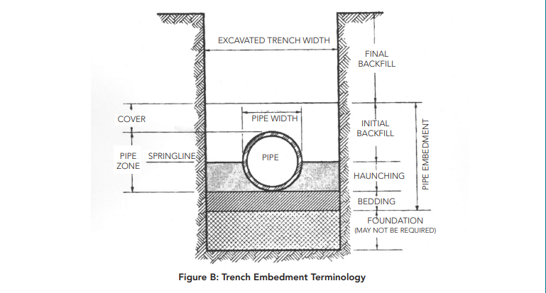
Role of bedding material
When a pipeline is installed in a trench, proper bedding of the pipeline is essential to assure the pipe does not inordinately deflect.
Bedding is the material installed in the bottom of the trench on which the pipe is laid.
The bedding must be designed to support the respective pipeline material installed and control its interaction with external loading upon the pipeline.
Various pipe materials require a specific type of bedding to not deflect and not fail.
Notes:
Lets discuss the different zones of the pipe embedment

Slide 20
Role of bedding material
The use of proper embedment materials is crucial in pipeline construction.
These materials can either be imported, like crushed stone, or the native soil excavated from the trench.
They should possess qualities such as strength, stiffness, uniform contact around the pipe, and stability to prevent deformation due to earth pressures.
Materials with larger grains, like gravel, offer higher stiffness and support strength.
Density also plays a significant role, with denser soil providing better stiffness and support.

Slide 21
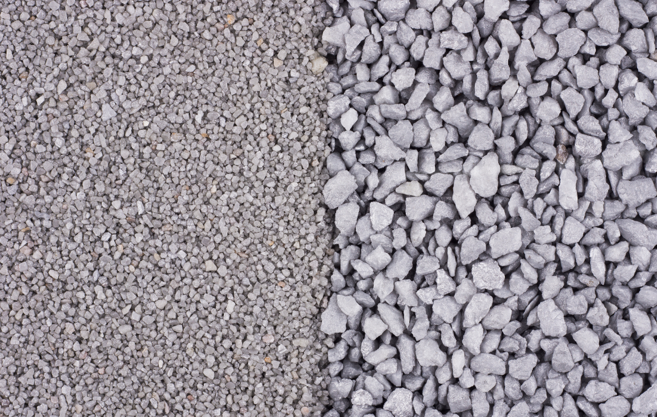
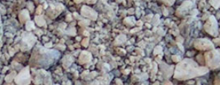
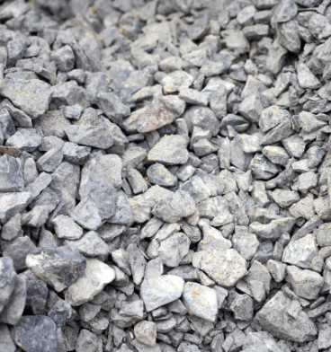
Class I and Class II Materials
Class I and II soils, which include manufactured aggregates like crushed stone and natural sands and gravels, offer strong embedment support.
These materials are often preferred when they are readily available.
The maximum aggregate size of Class I and II materials should be compatible with the pipe size.
When pipes are located below the groundwater level, the potential for side support loss due to soil migration must be considered, especially with fine sand, silts, and dispersive clays. This issue is more critical when a groundwater gradient exists from outside to inside the trench.
Notes:
When ground water is encountered clean poorly graded rock is preferred to facilitate drainage with minimal risk of soil migration

Slide 22
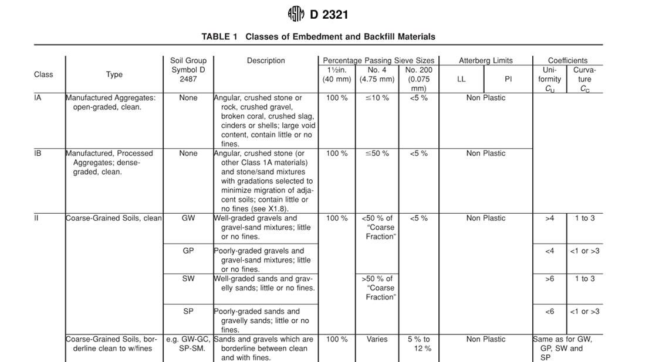
Role of bedding material
When a pipeline is installed in a trench, proper bedding of the pipeline is essential to assure the pipe does not inordinately deflect.
Bedding is the material installed in the bottom of the trench on which the pipe is laid.
The bedding must be designed to support the respective pipeline material installed and control its interaction with external loading upon the pipeline.
Various pipe materials require a specific type of bedding to not deflect and not fail.
Notes:
The sieve size is referring to the number of holes in a linier inch
LL= Liquid limit (the moisture content at which a fine-grained soil no longer flows like a liquid)
PI= plasticity index how well a soil can be deformed or molded without cracking, or appreciable volume change

Slide 23
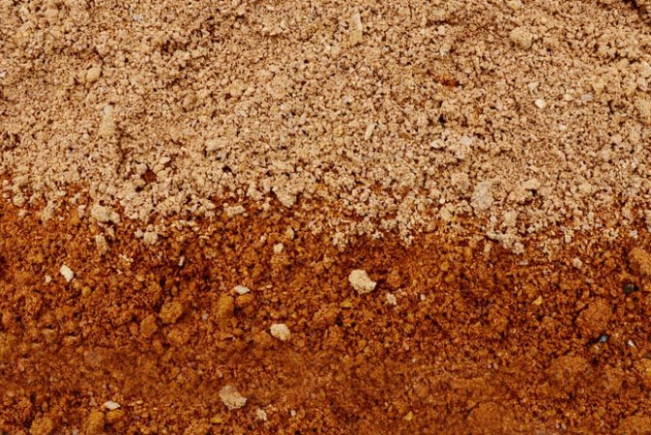
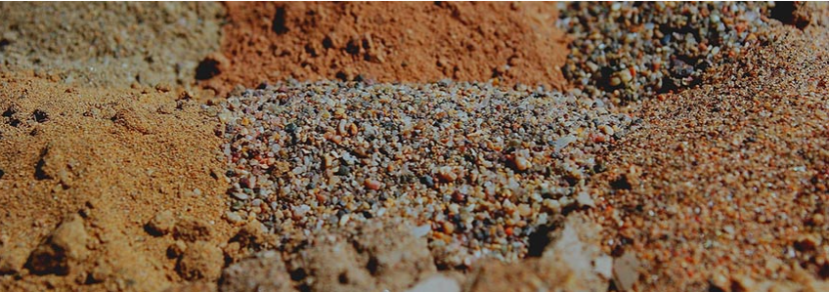
Class III, IVA, IVB, and V Materials
Class III and Class IVA materials provide less supporting stiffness than Class I and Class II material for a given density or compaction level, in part because of the increased clay content.
In addition, they require greater compaction effort to attain densities and their moisture content must be closely controlled within the optimum limit, especially for Class IVA soil, which is typically to applications with pressure pipe at shallow cover.
Class IVB and Class V materials offer only minimal support for a buried pipe and are often difficult to properly place and compact. Where the embedment material becomes saturated, provide sufficient depth to avoid floatation.

Slide 24
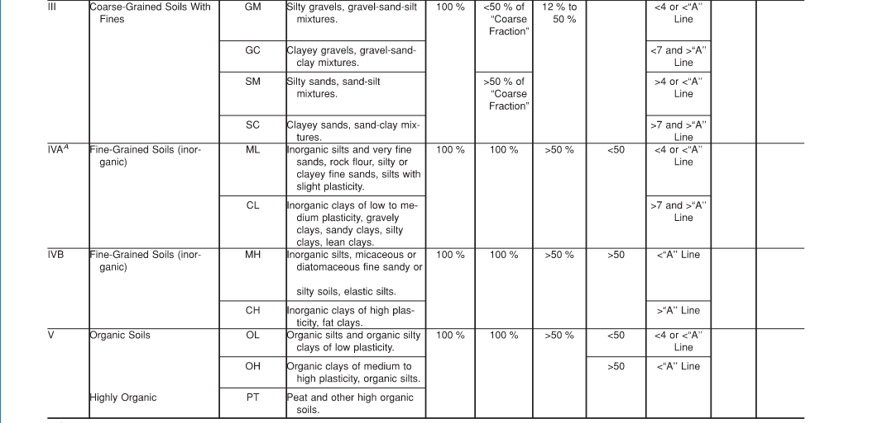
Role of bedding material
When a pipeline is installed in a trench, proper bedding of the pipeline is essential to assure the pipe does not inordinately deflect.
Bedding is the material installed in the bottom of the trench on which the pipe is laid.
The bedding must be designed to support the respective pipeline material installed and control its interaction with external loading upon the pipeline.
Various pipe materials require a specific type of bedding to not deflect and not fail.
Notes:
The sieve size is referring to the number of holes in a linier inch
LL= Liquid limit (the moisture content at which a fine-grained soil no longer flows like a liquid)
PI= plasticity index how well a soil can be deformed or molded without cracking, or appreciable volume change

Slide 25
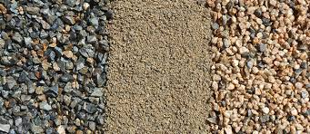
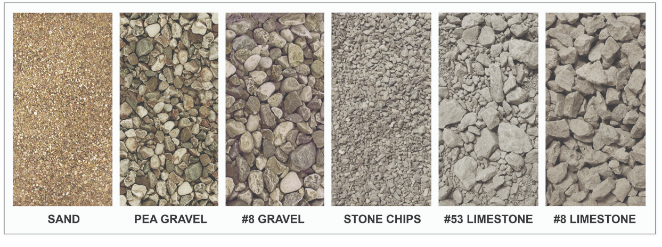
Role of bedding material
When a pipeline is installed in a trench, proper bedding of the pipeline is essential to assure the pipe does not inordinately deflect.
Bedding is the material installed in the bottom of the trench on which the pipe is laid.
The bedding must be designed to support the respective pipeline material installed and control its interaction with external loading upon the pipeline.
Various pipe materials require a specific type of bedding to not deflect and not fail.
Notes:
The sieve do not refer to the mesh count but are arbitrary designations that refer to the number of holes in a linier inch

Slide 26
Benefits of proper bedding
Ensuring the correct placement of a pipeline within a trench is of utmost importance in preventing pipeline failures.
Consequently, achieving a balance in the design, harmonizing the inherent strength of the pipeline material with the trench construction, becomes essential in many instances for a successful construction outcome.
For instance, a flexible pipe such as PVC, due to its lower stiffness, requires thorough support from the surrounding soil to maintain integrity.
On the other hand, more robust pipe materials like ductile iron (DI) can endure comparable external loads with less need for extensive bedding support.

Slide 27
Potential RISKS OF Improper embedment
Additional costs associated with water loss/gain due to leaks and infiltration cause by poor pipe installation practices.
Public risk due to damage of adjacent infrastructure caused by leaks and soil migration
Contamination of drinking water and other public health concerns
Effects to wildlife from direct contact and damaged ecosystems

Slide 28
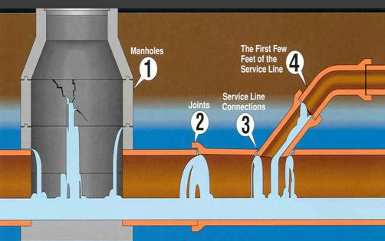
Role of bedding material
Preventing leaks

Slide 29
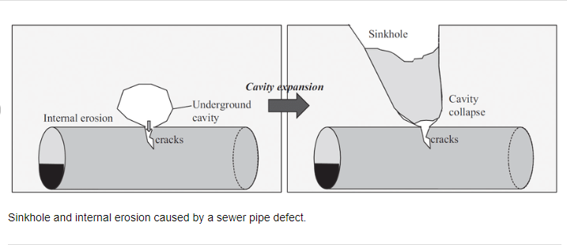
Role of bedding material
Soil Migration

Slide 30
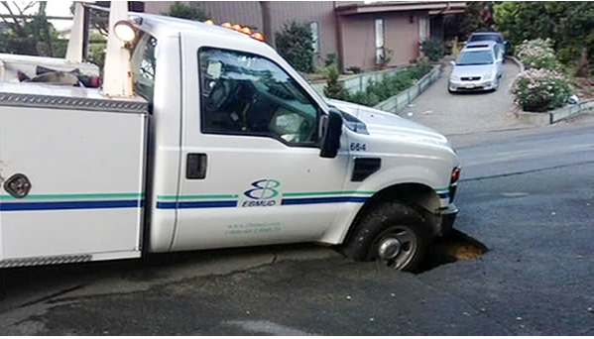
Role of bedding material
Excessive soil migration could lead to sinkholes

Slide 31
Conclusion
In summary, pipeline bedding is a critical component of pipeline infrastructure that ensures structural integrity, protects against environmental factors, and enhances the overall safety and longevity of the pipeline system.

