Slide 1

PEOSH
Workplace Safety for Public Employees

Slide 2
What Is PEOSH?
Public
Employees
Occupational
Safety &
Health

Slide 3
MISSION
To Ensure the Safety and Health
of all Oklahoma Public Employees

Slide 4
Workplace Safety for the Public Sector
PEOSH has jurisdiction over all public sector employees in Oklahoma, including city, county, state, schools, public hospitals, career techs, public universities, and municipal trusts. Oklahoma public sector employees are not within the jurisdiction of federal OSHA.
  PEOSH is responsible for:
    Fatality/Hospitalization
    Recordkeeping
    Annual Public Sector Survey
    SOII (Survey of Occupational Injuries and Illnesses)
    CFOI (Census of Fatal Occupational Injuries)
    Enforcement
    Complaints
    Consultation & Training

Slide 5
Workplace Safety for the Public Sector
The Oklahoma Occupational Health & Safety Standards Act
  40 O.S. § 401, et seq. and OAC 380:40
The Act also Adopts:
  Federal OSHA Regulations (Code of Federal Regulations)
    CFR 1904
    CFR 1910
    CFR 1926
  National Standards (ANSI, ASME, NEC, NFPA, etc.)

Slide 6
Workplace Safety for the Public Sector
  380:40-1-2. Applicable national standards
    (a) The Federal Occupational Safety and Health Standards for General Industry (29 CFR 1910) and the Construction Industry (29 CFR 1926) shall be automatically adopted by incorporation as currently published and as hereafter may be revised in the Code of Federal Regulations …

Slide 7
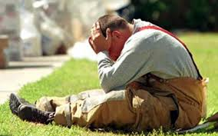
Employer’s Duties & Responsibilities
Each employer shall furnish to each employee, employment and a place of employment which are free from recognized hazards that are causing or are likely to cause death or serious physical harm to employees. [40 O.S. § 403 Employer’s Duties and Responsibilities]
  No person shall discharge, discriminate or take adverse personnel action against any employee because such employee has filed any complaint, or instituted or caused to be instituted any proceeding under or related to this act.

Slide 8
Employer’s Duties & Responsibilities
Every employer having twenty-five (25) or more full- or part-time employees shall:
  Designate (in writing) an employee who shall coordinate all safety programs of the employer;
  Provide safety classes to each type or class of employee no less than quarterly, except that public schools shall only be required to provide safety classes or instruction to their employees during the school year; and
  Cooperate with the Department of Labor inspections conducted for the purpose of determining compliance with this subsection.

Slide 9
Annual Public Sector Survey
Participation in the Public Sector Survey of Occupational Injuries and Illnesses is mandatory.
The Survey is conducted by the Statistical Research Division of PEOSH.
ALL Public Employers are required to submit electronically.
Letters will be mailed out each year and contain important instructions, the survey site URL and a list of establishments we require responses for.
  The survey typically begins 2nd week of January.
    Over survey letters are sent each year.
  Second notifications are sent first week of March.
  Third notifications are sent first week of April.
  Final notices are sent first week of May.

Slide 10
Annual Public Sector Survey
If I do not have any occupational injuries or illnesses to report on the OK300 series forms, do I still need to respond to the Public Sector Survey?
  Answer: Yes, all public sector employers are required to submit an annual response to the Public Sector Survey for each establishment within an agency, regardless of any work-related injuries or illnesses occurring.
    You must maintain an OK 300A in your records as well and answer all questions within section 1 of the OK 300A.

Slide 11
Annual Public Sector Survey
IF YOU DO NOT RESPOND TO THE ANNUAL SURVEY OF OCCUPATIONAL INJURIES AND ILLNESSES, YOU WILL BE PUT ON THE NON-RESPONDERS LIST AND HAVE A 100% CHANCE THAT YOUR FACILITIES WILL BE INSPECTED BY ODOL.

Slide 12
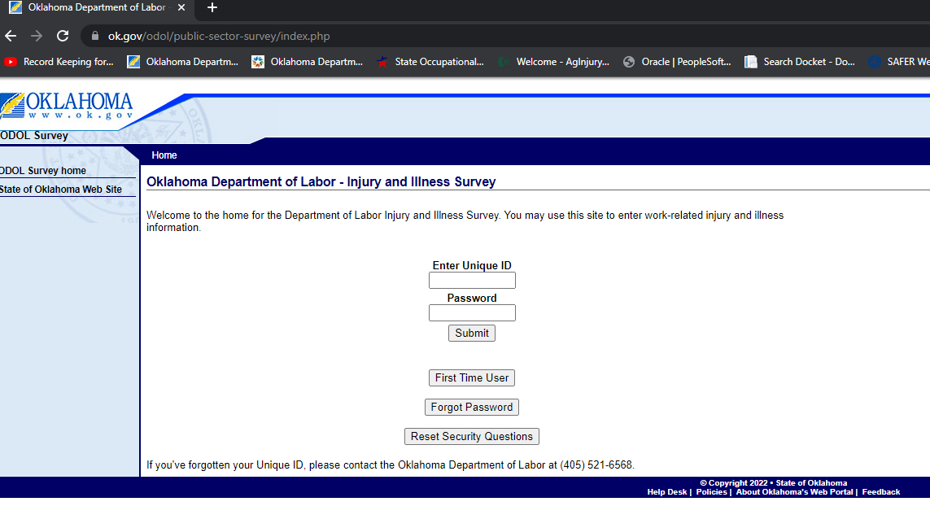
Public Sector Survey Home Page
Select this option for the first login attempt of each year.

Slide 13
Annual Public Sector Survey
Changes to List of Facilities (Refinement)
If you have a new facility, or consolidate with another entity, you need to notify the Public Sector Survey prior to the start of the survey year so your Survey can be updated.
Also notify the Public Sector Survey if your facilities are not properly broken down into individual facilities.
Note: Changes cannot be made while the survey is active, unless necessary.
        Eric Williams – 405-521-6568
        Eric.Williams@labor.ok.gov

Slide 14
Keep in Mind: The Recordkeeping System & Workers Compensation Systems are completely separate systems.
Recordkeeping Basics
One has no bearing upon the other!
You may have cases that are compensable, but not recordable.
You may have cases that are recordable, but not compensable.

Slide 15
Recordkeeping Basics
The Oklahoma Occupational Health & Safety Act of 1970 adopts the Federal OSHA Recordkeeping requirements, with a few minor variations: (Shown under 380:40-1-5. Recordkeeping)
    Must use OK Forms
    Must notify Oklahoma Department of Labor if there is a fatality of one or more employee(s), or catastrophe (hospitalization of five or more workers for treatment) within 48 hours
      Must be within the work environment, and can include heart attacks, loss of consciousness, cancer or exposures, vehicle accidents (MVA), violence, etc. We may use the DC or ME reports to determine if an investigation is required.
    Fatality & catastrophe report must be in writing on forms prescribed by the Commissioner
      https://oklahoma.gov/labor/safety-and-health/workplace-safety/peosh/forms-and-publications.html
    Other exceptions are shown under 380:40-1-5(a)(1)-(6).

Slide 16
Recordkeeping Basics
There are three recordkeeping forms required by PEOSH to be used:
  OK301 – First Notice of Injury and Incident Report (may use alternative form if it meets the requirements)
  OK300 – Log of Work-Related Injuries and Illnesses
  OK300A – Annual Summary of Work-Related Injuries and Illnesses
  Your OK300A, & any OK301s with days away from work are reported annually to us through the Public Sector Survey.

Slide 17
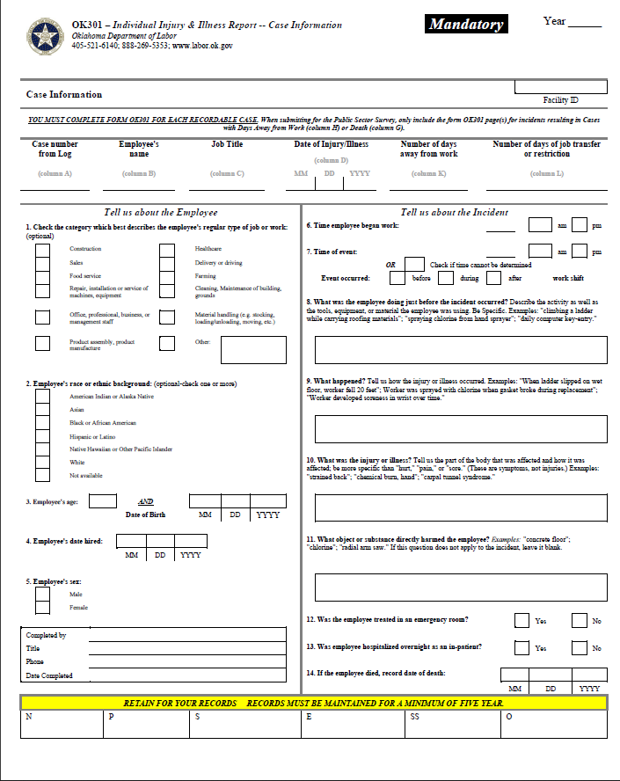
OK301
Important!
  For your records: You must fill out an OK301 form for each recordable injury or illness.
  For the Public Sector Survey: you must submit OK301s for cases with DAYS AWAY only.

Slide 18
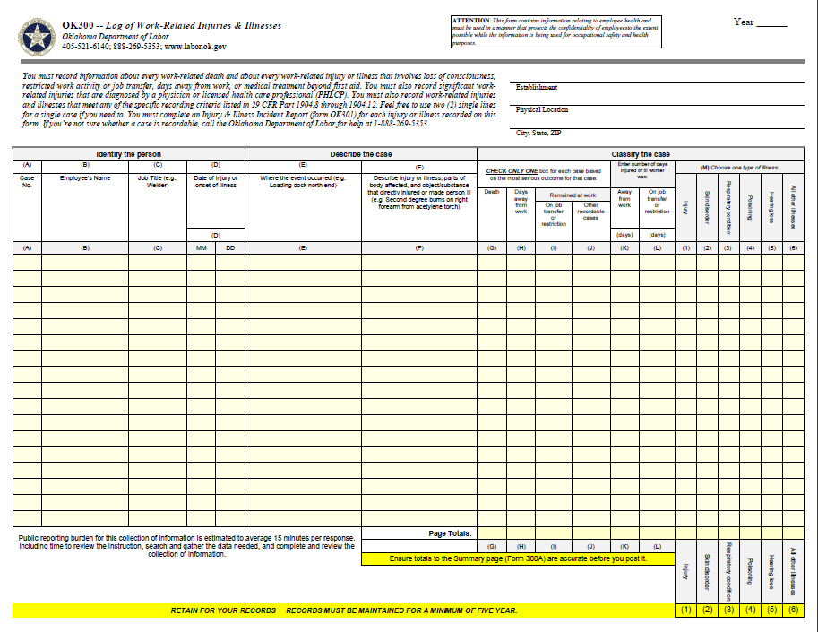
OK300
Must be filled out within 7 days from date of injury or illness

Slide 19
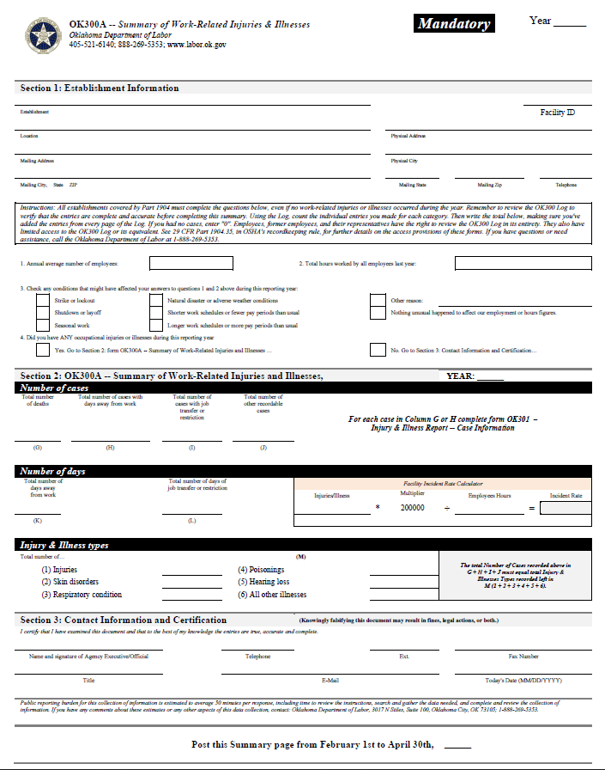
OK300A
380:40-1-7: The OK300A must be posted from February 1st – April 30th the following year, “in a conspicuous place or places where notices to employees are customarily posted”.
Do not post the OK300 or Privacy Log!

Slide 20
Recording Criteria (Starts with 1904.4)
Each public sector employer must keep records of fatalities, injuries, and illnesses and must record each fatality, injury and illness that:
  Is work-related (OSHA 1904.5); and
  Is a new case (1904.6); and
  Meets one or more of the general recording criteria (1904.7):
    death,
    days away from work,
    restricted work or transfer to another job,
    medical treatment beyond first aid, or loss of consciousness
    a significant injury or illness diagnosed by a physician or other licensed health care professional, even if it does not result in death, days away from work, restricted work or job transfer, medical treatment beyond first aid, or loss of consciousness.

Slide 21
What is Considered and “Establishment”?
Under Section 1904.46(2) & 380:40-1-7(c)
  “ ”Establishment” means a single physical location where agency business is conducted or where services or operations are performed.”
  An establishment can include more than one physical location only if “the direct daily supervision of all staff is the responsibility of one common individual.”
1904.46(1)(i)-(iv): An employer may divide one location into two or more establishments only when:
  Each of the establishments represents a distinctly separate business;
  Each business is engaged in a different economic activity;
  No one industry description in the NAICS codes applies to the joint activities of the establishments; and
  Separate reports are routinely prepared for each establishment on the number of employees, their wages and salaries, sales or receipts, and other business information.

Slide 22
Multiple Locations
Please keep and maintain your records for a minimum of FIVE YEARS and keep copies at each of your facilities that are expected to be in operation for one year or greater.
You may keep the records at a central location, provided:
You can transmit accident reports to the recordkeeper and get the injuries recorded within 7 days and;
  You can transmit the records back to the workplace or jobsite within 4 hours if requested by government officials, or by the next business day if requested by the employee or their authorized representative.
This does not negate your requirement to submit your data to ODOL through the annual survey.

Slide 23
Multiple Locations (Continued)
What about employees in the field or other locations?
  You must link each of your employees with one of your establishments, for recordkeeping purposes.
  You must record the injury and illness on the OK300 Log of the injured or ill employee's establishment, or on the OK300 Log that covers the employee's short-term establishment.
  380:40-1-7(c): “Where employees are engaged in activities which are physically dispersed, such as agriculture, construction, transportation, communications, and electric, gas and sanitary services, the notice or notices required by this section shall be posted at the location to which employees report each day.”
    Applies the same for recording injuries and illness, not just posting.

Slide 24

What is an “Employee”?
Employees include all employees on your payroll, whether they are hourly, salary, executive, part-time, seasonal or migrant workers.
Also includes those who are not on your payroll if you supervise these employees on a day-to-day basis:
  Contract labor
  Temporary labor

Slide 25

What is Considered “Day-To-Day Supervision”?
Day-to-day supervision generally exists when the employer:
  "in addition to specifying the output, product or result to be accomplished by the person's work, the employer supervises not only the output, product, or result to be accomplished by the person's work, but also the details, means, methods, and processes by which the work objective is accomplished.“ 1904.31

Slide 26

Temp Employees
Injuries that occur to temporary workers that you supervise on a day-to-day basis are recorded on your OK300 log. Refer to 1904.31 for definitions. You must also complete an OK301 form for each case.
You must also report any fatalities/catastrophes that may occur to these temp employees.
You must also count their hours worked when figuring up hours for your annual summary.
Ultimately, you are responsible for their safety and health while they are performing duties for you.

Slide 27
Temp Employees (Continued)
If I obtain employees from a temporary help service, employee leasing service, or personnel supply service, do I have to record an injury or illness occurring to one of those employees?
  According to 1904.31(b)(2), you must record these injuries and illnesses if you supervise these employees on a day-to-day basis.
If an employee in my establishment is a contractor's employee, must I record an injury or illness occurring to that employee?
  If the contractor's employee is under the day-to-day supervision of the contractor, the contractor is responsible for recording the injury or illness. If you supervise the contractor employee's work on a day-to-day basis, you must record the injury or illness.

Slide 28
Volunteers and ODOL/PEOSH Authority
According to OSHA, “Federal OSHA does not generally cover volunteers, unless they are compensated in some way and would therefore be considered employees”
  and according to PEOSH: “For purposes of injury and illness recordkeeping and the Public Sector Survey, injuries occurring to those employees who are classified as volunteers are not recordable and are not included in the survey.” 380:40-1-21
However, under 380:40-1-21, specifically for volunteer firefighters:
  “Volunteer fire departments that exist as a subdivision of a larger municipal organization are within Oklahoma Department of Labor jurisdiction if that larger municipal organization employs one or more paid workers. In such cases, the inspection and enforcement jurisdiction of ODOL extends to all duties performed by any worker or volunteer on behalf of the Volunteer Fire Department.”

Slide 29
Work-Relatedness
Cases are considered to be work-related if an event or exposure in the work environment:
  Either caused or contributed to the resulting condition
  Significantly aggravated a pre-existing injury or illness.
Work-relatedness is presumed for injuries and illnesses resulting from events or exposures occurring in the work environment, unless an exception..

Slide 30
Work-Related Exceptions
Under 1904.5(b)(2), injuries or illnesses that meet the following criteria would NOT be considered recordable:
  At the time of the injury or illness, the employee was present as a member of the general public, rather than as an employee
  The injury or illness involves signs or symptoms that surface at work but resulted solely from a non-work-related event or exposure that occurred outside the work environment
  The injury or illness results solely from voluntary participation in a wellness program or in a medical, fitness or recreational activity, such as blood donation, physical examination, flu shot, exercise class, racquetball, softball or basketball.

Slide 31
Work-Related Exceptions (Continued)
The injury or illness is solely the result of an employee eating, drinking or preparing food or drink for personal consumption (whether bought on premises or brought in).
  Note: If the employee is made ill by ingesting food contaminated by workplace contaminants (such as lead) or gets food poisoning from food provided by the employer, the case would be considered work-related.
The injury or illness is solely the result of an employee doing a personal task (unrelated to their employment) at the establishment outside of the employees assigned working hours.

Slide 32
Work-Related Exceptions (Continued)
The injury or illness is solely the result of personal grooming, self-medication for a non-work-related condition, or is intentionally self-inflicted.
The injury or illness is caused by a motor-vehicle accident and occurs on the company parking lot or access road while the employee is commuting to or from work.
The illness is the common cold or flu
  Note: Contagious diseases such as TB, Hep A, Brucellosis, EBV or plague are considered work related if the employee is infected at work.
  Note: H1N1 and the virus causing COVID-19 are not considered a common cold or flu.
The illness is a mental illness. (Mental illness is not considered work-related unless the employee voluntarily provides the employer with a statement from a qualified PLHCP stating the employee has a mental illness that is work-related.)

Slide 33


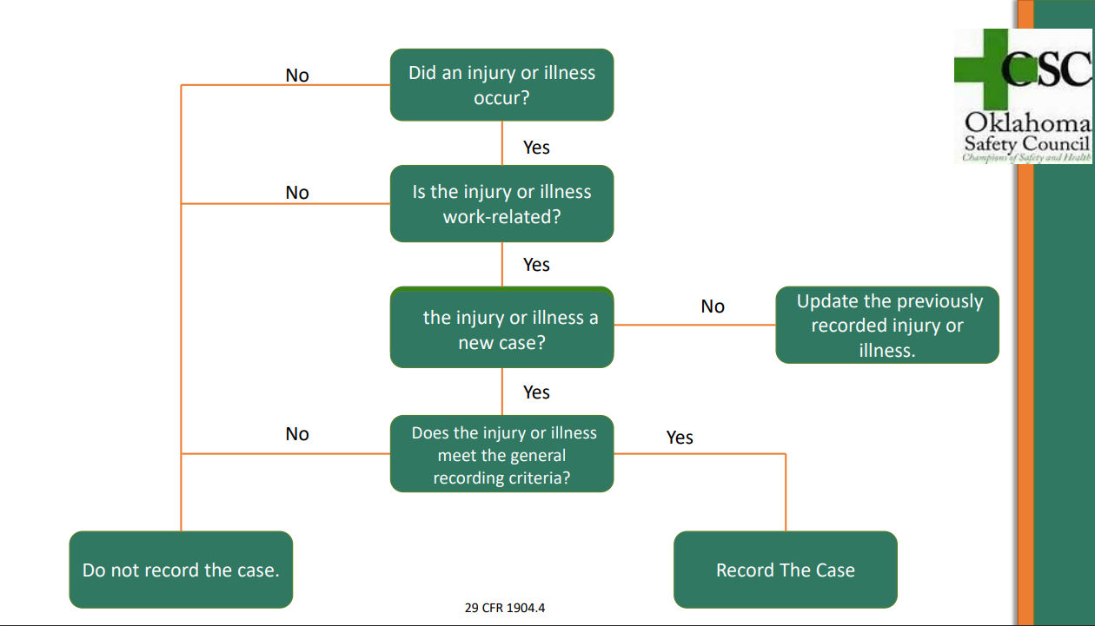

Slide 34

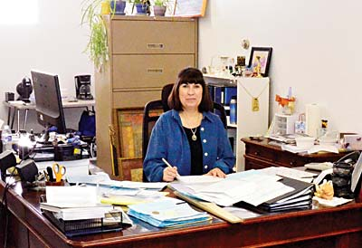
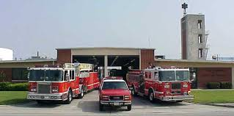
The Work Environment
The work environment is considered to include:
  The establishment or other locations where one or more employees are working or are present as a condition of their employment.

Slide 35

What is Medical Treatment?
According to 1904.7(b)(5)(i): Means the management and care of a patient to combat disease or disorder
Includes:
  Wound closing devices such as sutures, staples, etc.,
  Devices with rigid stays or other systems designed to immobilize parts of the body
  physical therapy or chiropractic treatment for a work-related injury
Does not include:
  Visits to a physician or other licensed health care professional (PLHCP) solely for observation or counseling
  Diagnostic procedures, such as x-rays and blood tests
  First aid

Slide 36

First Aid
According to 1904.7(b)(5)(ii)
  Using non-prescription medication at non-prescription strength.
  Tetanus immunizations.
  Cleaning, flushing, or soaking surface wounds on the skin.
  Wound coverings, butterfly bandages, steristrips.
  Hot or cold therapy (regardless of the number of treatments.)
  Non-rigid means of support.
  Temporary immobilization devices used to transport an accident victim.

Slide 37
First Aid (continued)
Drilling of a fingernail or toenail, draining fluid from a blister
Eye patches
Removing splinters or foreign material
  From areas other than the eye by irrigation, tweezers, cotton swabs or other simple means
  Removing foreign material from the eye by simple irrigation is considered first aid
    Note: Surgical removal, or other methods of removal of foreign material from the eye outside of irrigation, are considered medical treatment and RECORDABLE.
Finger guards
Massage (except for chiropractic or physical therapy)
Drinking fluids to relieve heat stress

Slide 38
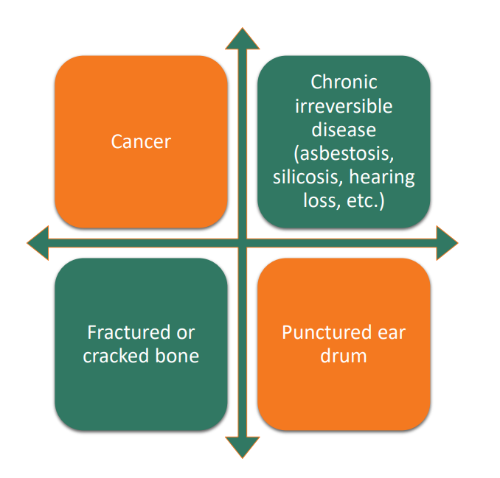
What Is a “Significant" Diagnosed Injury or Illness
Work-related cases involving:
  cancer
  chronic irreversible disease
  a fractured or cracked bone
  a punctured eardrum
Must always be recorded under the general criteria at the time of diagnosis by a physician or other licensed health care professional.

Slide 39
Tuberculosis
1904.11
  The standard includes separate provisions describing the recording criteria for cases involving work-related transmission of tuberculosis or medical removal under the standards.
  If and employee has been exposed to anyone with a known case of active tuberculosis (TB) at work, and that employee subsequently develops a tuberculosis infection, as evidenced by a positive skin test or diagnosis by a physician or other licensed health care professional.
  You must record the case on the OK 300 Log by checking the “respiratory condition” column.
  Record the case as a “privacy case”.

Slide 40
Medical Removal Cases
1904.9
You must record a case when an employee is medically removed under the medical surveillance requirements of an OSHA standard
  Chemicals
  Dusts
  Etc.
When the employer removes the employee prior to the over-exposure, such cases are not recordable.

Slide 41
Recording a Hearing Loss
1904.10
If an employee’s hearing test (audiogram) revelas that the employee has experienced a work-related Standard Threshold Shift (STS) in hearing in:
  One or both ears, and
  The employee’s total hearing level is 25 dB or more above audiometric zero (averaged at 2000, 3000, and 4000 Hz) in the same ear(s) as the STS.
    Need 24 hours of tested rest until the test in performed. No concerts, truck rally’s, loud noise exposure during this time. Cannot perform the test with hearing protection.
    You must be responsible for getting test results as soon as possible.
  You must record the case on the OK 300 Log.

Slide 42
Recording a Hearing Loss (Cont.)
If you retest the employee’s hearing within 30 days of the first test, and the retest does not confirm the recordable STS, you are not required to record the hearing loss case.
If the retest confirms the recordable STS, you must record the hearing loss within seven (7) calendar days of the retest.
Check the “hearing loss” column on the log.

Slide 43
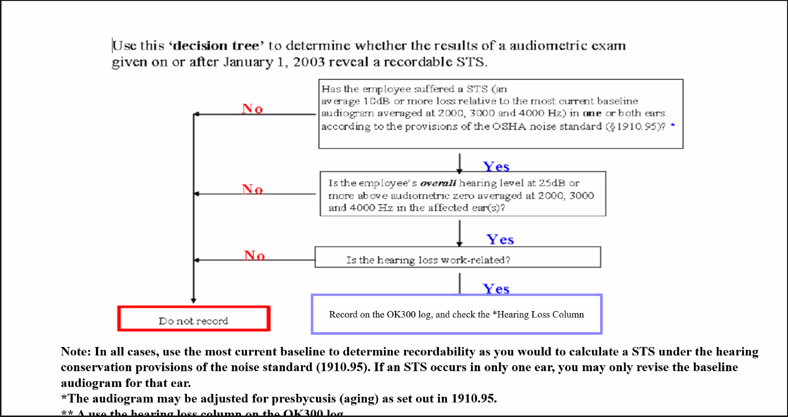
Recording a Hearing Loss (Cont.)

Slide 44
Needlestick and Sharps Injuries
1904.8
  Employers are required to record all needlestick and “sharps” (including box knives, scalpels, broken glass, metal, etc.) injuries involving contamination by another person’s blood or other potentially infectious materials.
  You must enter the case as a “Privacy Case”
  If an employee received a needle stick, you record it as an injury, however, if they later develop an infection, you go back and reclassify it as an illness and update any other data, such as days away, restricted or transferred.
    Note: It’s vital each employee reports an exposure to a needlestick or sharps injury as soon as possible, due to treatments available within the first 24 that can prevent the affects of some bloodborne pathogens, like Hepatitis B.
  A “sharps injury log” must be kept per the bloodborne pathogens standard requirements.

Slide 45
What Constitutes a Privacy Case?
Under 1904.29(b)(6)-(10):
An injury or illness to an intimate body part or the reproductive system
An injury or illness resulting from a sexual assault
Mental illnesses
HIV infection, hepatitis, or tuberculosis
Needlestick injuries and cuts from sharp objects that are contaminated with another person's blood or other potentially infectious
Other illnesses, if the employee voluntarily requests that his or her name not be entered on the log
You must keep and maintain a separate privacy log!

Slide 46
Employee Involvement (1904.35)
Your employees and their representatives must be involved in the record keeping system in several ways:
  You must establish a reasonable procedure for employees to report work-related injuries and illnesses promptly and accurately.
    Note: A procedure is not reasonable if it would deter or discourage a reasonable employee from accurately reporting a workplace injury or illness;
  You must inform each employee of how he or she is to report a work-related injury or illness to you
  You must provide access to your injury and illness records for your employees and their representatives

Slide 47
Employee Involvement (Cont.)
You must inform each employee that:
  Employees have the right to report work-related injuries and illnesses; and
  Employers are prohibited from discharging or in any manner discriminating against employees for reporting work-related injuries or illnesses; and
  You must not discharge or in any manner discriminate against any employee for reporting a work-related injury or illness.

Slide 48
Recording A Case
You must, within 7 days of the incident being reported:
  Determine if the case meets the recording criteria and
    Enter it on the OK 300 log and
    Complete an OK 301 form
  Your entry must be complete and in detail, and in accordance with the instructions provided in the packet and the standards.

Slide 49
What Constitutes a New Case?
You must consider an injury or illness to be a "new case" if:
  The employee has not previously experienced a recorded injury or illness of the same type that affects the same part of the body, or
  The employee previously experienced a recorded injury or illness of the same type that affected the same part of the body but had recovered completely (all signs and symptoms had disappeared) from the previous injury or illness and an event or exposure in the work environment caused the signs or symptoms to reappear

Slide 50
COVID Reporting Requirements
COVID-19 is still considered a recordable illness, and thus employers are responsible for recording cases of COVID-19 only if:
  The case is a confirmed case of COVID-19, as defined by the CDC.
  The case is 100% confirmed work-related, as defined by 29 CFR § 1904.5, or it’s determined very likely work-related based on the employee’s job duties.
  The case involves one or more of the general recording criteria set forth in 29 CFR § 1904.7.
As COVID cases fall under the requirements of HIPAA, all cases should be treated as a Privacy Case and follow the requirements found under OSHA 1904.29(b)(6)-(10).
Industries under Healthcare and Healthcare support services must follow the recordkeeping requirements under the Healthcare ETS.
  Covid-19 log and all reporting provisions remain in effect.
  All information for Healthcare industries can be found at https://www.osha.gov/coronavirus/ets.
Additional resources:
  https://www.osha.gov/coronavirus
  https://www.osha.gov/coronavirus/standards
  https://www.osha.gov/laws-regs/standardinterpretations/2020-05-19

Slide 51
If Changes Are Needed to Public Sector Survey
If you have a new facility, or consolidate with another entity, you need to notify the Public Sector Survey prior to the start of the survey year so your Survey can be updated.
  Under 380:40-1-5: “Employers shall notify the Department of Labor Statistical Research Unit within ninety (90) days of the closing, merging, or opening of a new facility”
Also notify the Public Sector Survey if your facilities are not properly broken down into individual facilities.
Note: Changes cannot be made while the survey is active.

Slide 52
Key Points To Remember
Forms must be filled out completely and in detail.
You must maintain your OK 300 and OK 300A each year, even if you did not have any recordable cases during the year. (You must also physically post your OK300A.)
You must count all calendar days away, restricted and transferred, including weekends and holidays, even if the employee is not scheduled to work.
  Each injury or illness case caps at 180 days between days away, job transfer or restriction.
Recordkeeping and Workers’ Compensation forms do not serve the same purpose and the two systems are not interactive. One has no bearing upon the other.
These records are required for a purpose. Utilize your records to look for trends, identify hazards and improve your safety and health management system.

Slide 53
If You Need Help, Please Reach Out!
For help with your OK300 forms or the Public Sector Survey, please contact:
  Eric.Williams@labor.ok.gov
  Or (405)-521-6568
New interactive Excel version of the OK300 forms available from ODOL. Please contact our Agency for a copy. (not currently available on our website)

Slide 54
Recordkeeping Resources
OSHA’s website
  Regulatory Text
  www.osha.gov/pls/oshaweb/owastand.display_standard_group?p_toc_level=1&p_part_number=1904
  OSHA Small Business Handbook
  https://www.ok.gov/odol/documents/OSHAFederalSmallBusinessHandbook.pdf
  OSHA Recordkeeping https://www.osha.gov/recordkeeping/index.html
Training Video
  https://www.youtube.com/watch?v=lhJdLRUXz8s
  May also email Eric Williams at ODOL to receive this video: Eric.Williams@labor.ok.gov

Slide 55
Recordkeeping Forms
Forms
  Located on our website at Safety and Health>Workplace Safety>Public Employees Occupational Safety and Health.
    https://oklahoma.gov/labor/safety-and-health/workplace-safety/peosh.html
  OK 300 Series Forms- Request the latest Excel version by emailing peosh@labor.ok.gov or Eric.Williams@labor.ok.gov
  A pdf version is available on our website and includes an instruction packet (very useful!):
    https://oklahoma.gov/labor/safety-and-health/workplace-safety/peosh/public-sector-ok300-forms.html

Slide 56
PEOSH’s Use of Public Sector Records
Identifies the “State Average” incidence rate
Utilizes data to identify public sector locations with higher-than-average incidence rates
Conducts site-specific inspections of high-incidence rate facilities
Inspects all “non-responders”
Can provide statistical analysis of user’s data, trends by various sectors, etc.

Slide 57


Any questions on Recordkeeping?

Slide 58
Workplace Safety In The Public Sector
PEOSH has jurisdiction over all public sector employees in Oklahoma, including city, county, state, schools, public hospitals, career techs, public universities, and municipal trusts. Oklahoma public sector employees are not within the jurisdiction of federal OSHA.
PEOSH is responsible for:
  Inspection
  Compliance
  Rule Making
  Consultation & Training

Slide 59

Inspection Prioritization
Imminent Danger Situations
Fatalities & catastrophes
Formal Employee Complaints
Referrals
“Scheduled” Inspections: Site-Specific Target List
Non-responders
High Incident Rates

Slide 60
Inspection Types
Involuntary
  Enforcement
  Complaints
  Fatalities & Catastrophes
Voluntary
  Consultations

Slide 61
Citations
380:40-1-16. Citations
  (e) Violations of the Act shall be classified as follows:
    (1) Serious: a condition creating substantial probability that death or serious physical harm could result. The condition is the result of one or more practices, means, methods, operations, or processes that have been adopted or are in use, unless the employer did not, and could not with the exercise of reasonable diligence, know of the condition that is the basis of the violation.
    (2) Other than serious: the most serious injury or illness that would be the likely result of the violation cannot reasonably be predicted to cause death or serious physical harm to exposed employees but does have a direct and immediate relationship to the employees' safety and health

Slide 62
Citations (continued)
    (3) Willful: a violation in which the employer either knowingly failed to comply with a legal requirement (purposeful disregard) or acted with plain indifference to employee safety.
    (4) Repeated: the employer has been cited previously for the same or a substantially similar condition within the past five years.
    (5) Regulatory: the violation involves posting requirements or injury and illness recordkeeping requirements.

Slide 63
Rules on Fines
380:40-1-24. Fines
(a) the Commissioner of Labor, or his or her designee, may issue an administrative fine for any and all violations of the Oklahoma Occupational Health and Safety Standards Act. All monies collected for violations of the Oklahoma Occupational Health and Safety Standards Act shall be deposited to the Department of Labor Administrative Penalty Revolving Fund for transfer to the General Revenue Fund. The following schedule of fines shall apply on a per-violation, per-day basis:
  (1) Serious: $1,000.00
  (2) Other Than Serious: $500.00
  (3) Willful: $5,000.00
  (4) Repeated: $5,000.00
  (5) Regulatory: $500.00

Slide 64
Rules on Fines (Continued)
380:40-1-24. Fines
(c) Employers who voluntarily request an onsite inspection shall not be subject to monetary penalties for hazards identified during the course of the voluntary inspection, provided that such hazards are corrected within the timeframes established during the consultation visit

Slide 65
Rules on Fines (Continued)
380:40-1-24. Fines
(d) Funds collected as payment from a violator for administrative fines imposed for violation of the Oklahoma Occupational Health and Safety Standards Act shall not be retained by the Department of Labor, but shall be deposited to the Department of Labor Administrative Penalty Revolving Fund for transfer to the General Revenue Fund.

Slide 66
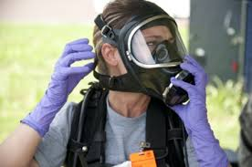
Enforcement
Inspection(s) conducted pursuant to authority granted in Oklahoma Occupational Health and Safety Standards Act of 1970 (OOHSSA).
  380:40-1-8. Authority for inspection
Non-Voluntary
Unannounced
Safety Coordinator or other official
Mandate to fix and abate all Hazards Identified
Timelines set by ODOL to abate all Identified Hazards

Slide 67
Formal vs. Informal Complaints
Any employee or representative of an employee who believes that a violation of the Act exists in any workplace, may file a complaint.
The complaint must be submitted in writing, signed by the employee. (Under development, will be posted on ODOL’s website when available.)
Any complaint we receive that is unsigned or in a manner other than in writing (phone, verbal, email) will be addressed as an “informal complaint”.

Slide 68
Complaints
Example of the most common complaints include:
  Mold
  Indoor Air Quality
  Inadequate personal protective equipment
  Chemical exposures
  Electrical hazards
  Proper personal protective equipment not provided
  Brakes not working on city vehicles or other mechanical failures
  Rodents, insects, snakes and other vermin in the workplace
  Unsafe Trenching & Excavations
  Retaliation for reporting hazards or filing a complaint or refusing unsafe work

Slide 69
Fatalities & Catastrophes
Work-related fatalities and catastrophes must be reported to the Department of Labor, in writing within 48 hours:
Fatality: One or more workers
Catastrophe: The hospitalization of five or more workers for medical treatment.

Slide 70
Consultation
380:40-1-24.
  (c) Employers who voluntarily request an onsite inspection shall not be subject to monetary penalties for hazards identified during the course of the voluntary inspection, provided that such hazards are corrected within the timeframes established during the consultation visit.

Slide 71
The Written Report
Following an inspection, a written report is submitted to the Facility.
The report outlines
  Rights & Responsibilities of the Employer
  List of Hazards
  Abatement timelines
  Certificate of Hazard Abatement

Slide 72
Common Program Deficiencies
Programs not reviewed annually
Training not conducted regularly
Programs on paper, not implemented
Generic programs
Not site specific

Slide 73
Employee Education & Training
Quarterly safety & health training
Conducted through a variety of training methods, such as:
  Newsletters, Fact Sheets
  Informal “Tool Box” or “Tail Gate” talks
  Formal class room training

Slide 74
Employee Education & Training
Standards dictate the frequency and format of safety training, such as (but not limited to):
  Powered Industrial Truck Operators
  Lockout-Tagout
  Hazard Communications
  Bloodborne Pathogens
  1st Aid/CPR
  HAZWOPER
  Electrical Safety-Related Work-practices

Slide 75
Employee Education & Training
Training must be:
  Timely
    A general rule of thumb: Employees (including temps) must be trained on the hazards to which they may be exposed…BEFORE they are exposed.
  Effective
    Training should ensure employees have the knowledge and skills necessary to identify and avoid hazards in the workplace.
  Documented
    Records must be available for review at the workplace

Slide 76
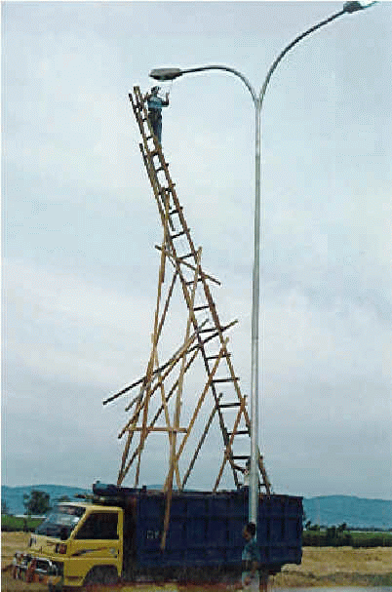
Common Hazards
Exit Signs
    Not in required places
    Not Illuminated
    Not visible
Ladders
    Improper type for job
Emergency Lighting
    Not inspected/Backup Battery Dead
    No emergency lighting

Slide 77
Common Hazards
Chemicals
  Improperly stored
  Not labeled
No Safety Data Sheets
Power Cords
  Plugged into surge protectors/Daisy Chained
  Home type extension cords
  Used for permanent wiring
Housekeeping
Fire extinguishers
  Annual inspections
  Monthly visual inspections
Alarm Panels & Sprinkler Systems

Slide 78
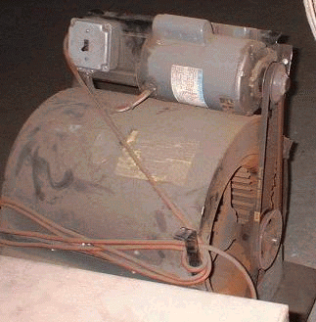
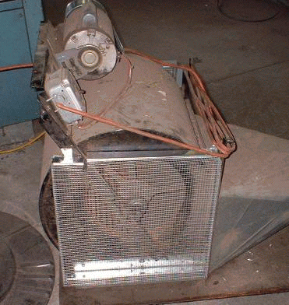
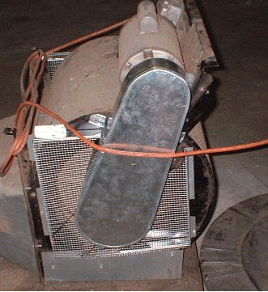
Common Physical Hazards
Properly Guarded
Machine Guarding
  No guards present
  Guards not secure
  Covers
General Requirements
Woodworking Machinery
Abrasive Wheel Machinery
Mechanical Power Presses
Forging Machines
Mechanical Power-Transmission Apparatus
Exposed Belt and Pulleys
Exposed Rotating Parts
You should never be able to go “about” a guard
Properly Guarded
Around
Behind
Over
Under
Through

Slide 79
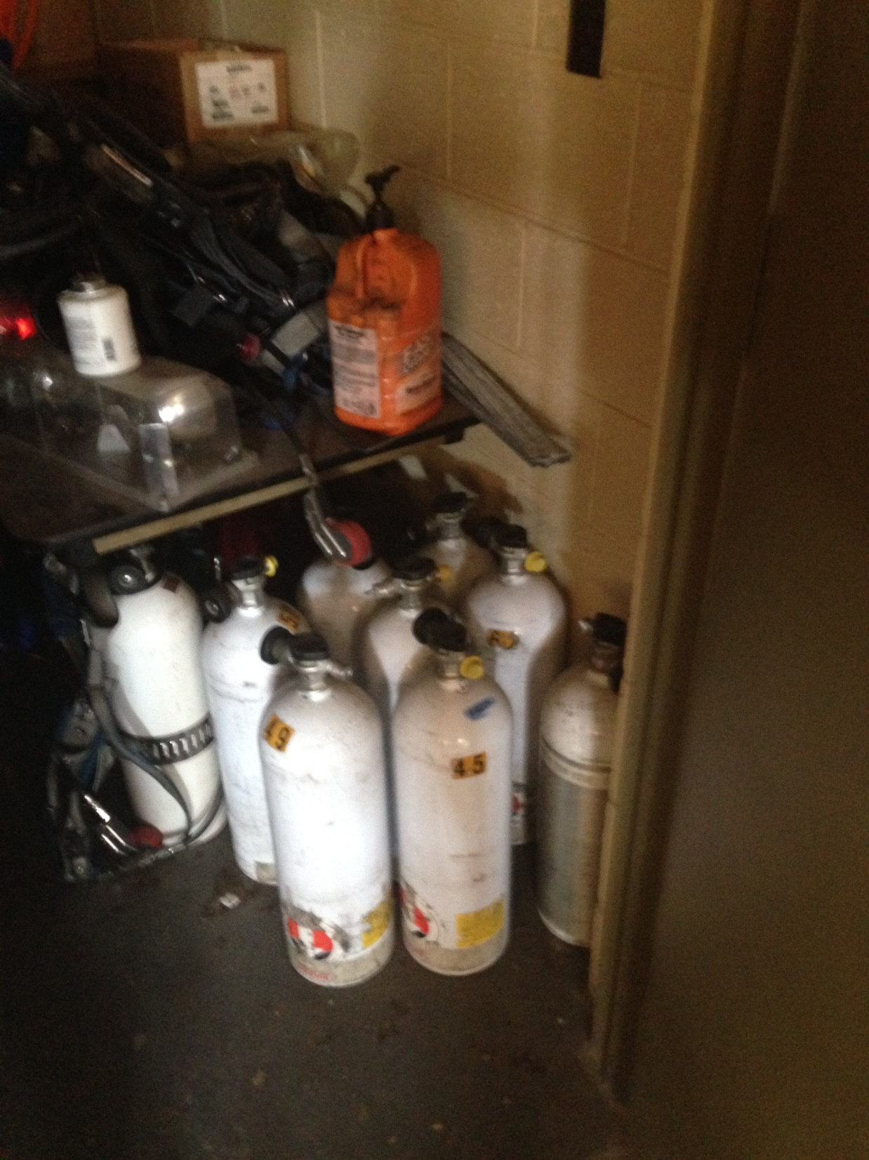
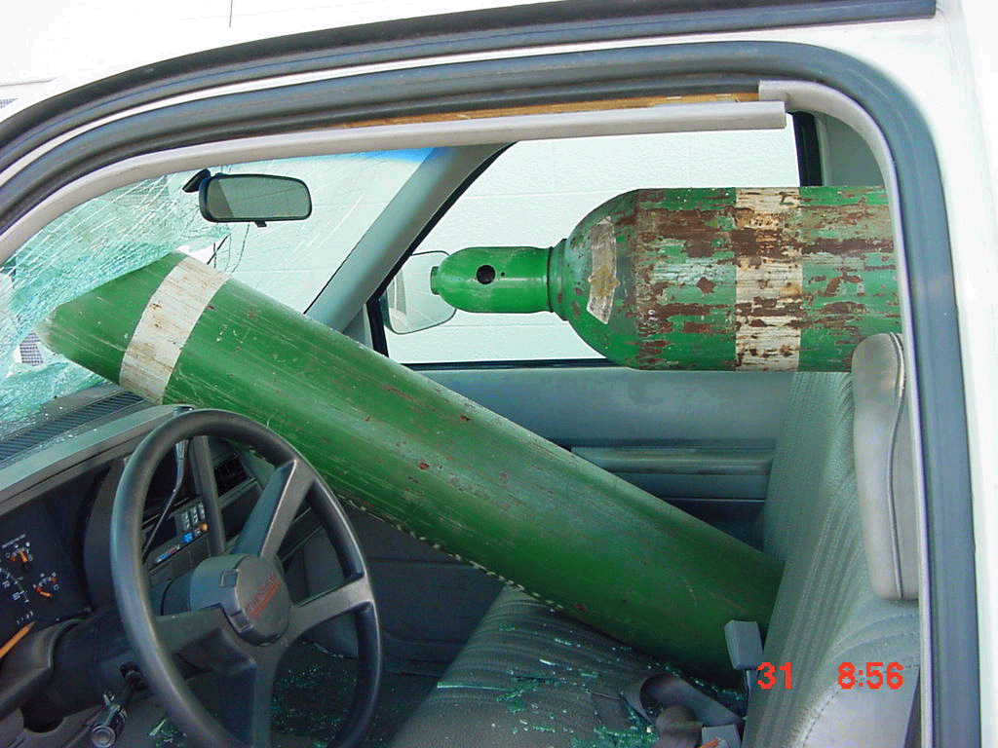
Common Physical Hazards
Cylinders
  Not secured
  Incompatible gases stored too close together

Slide 80
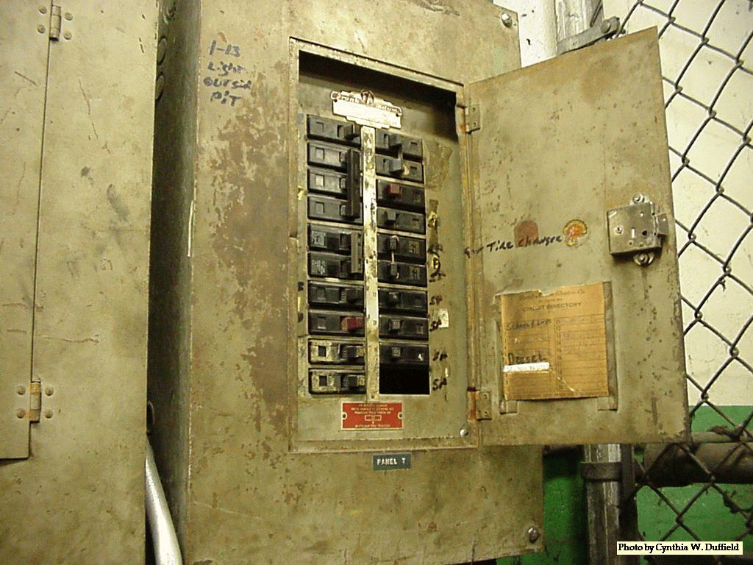
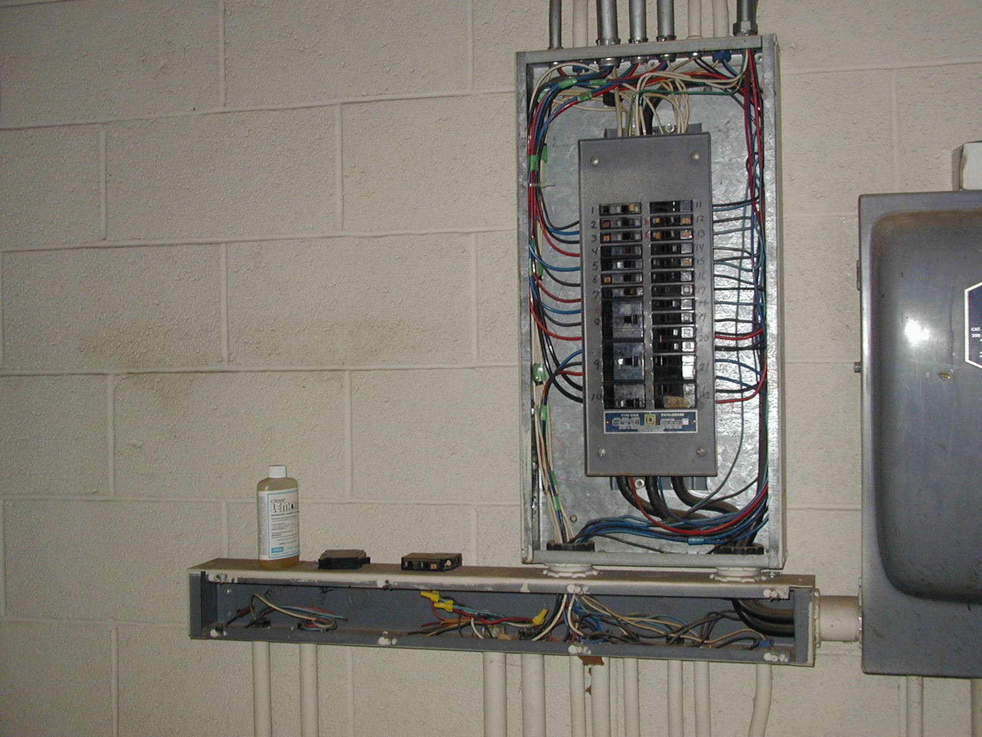
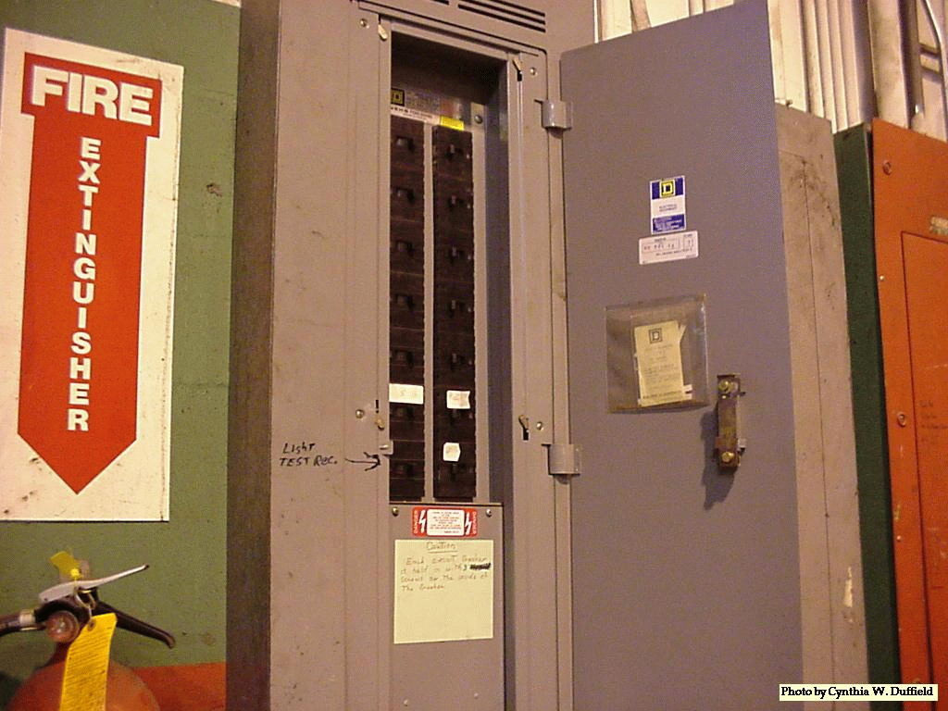
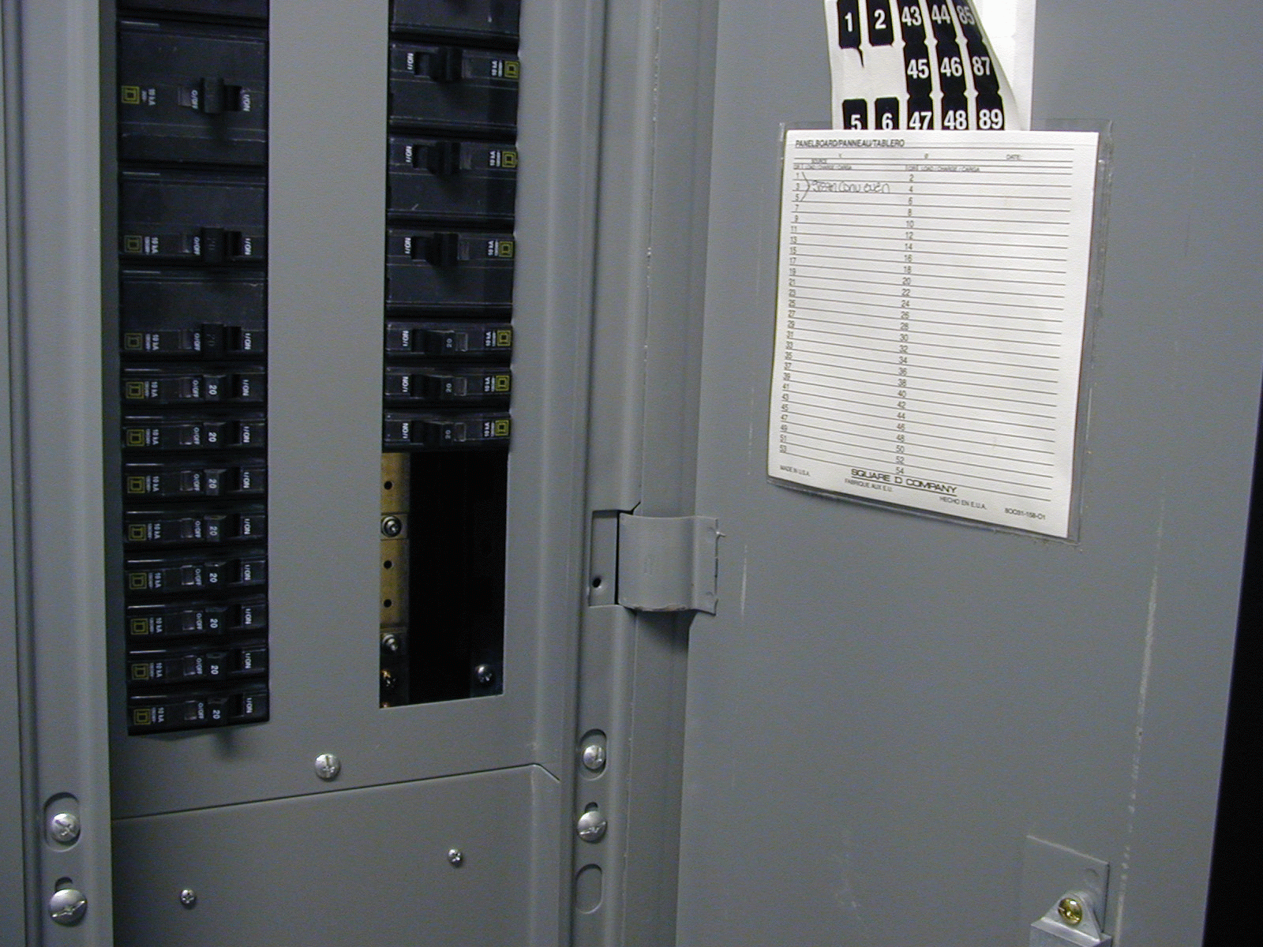
Common Electrical Hazards
Breaker Boxes
  Unlabeled
  Open knock-outs
Panel box not labeled

Slide 81
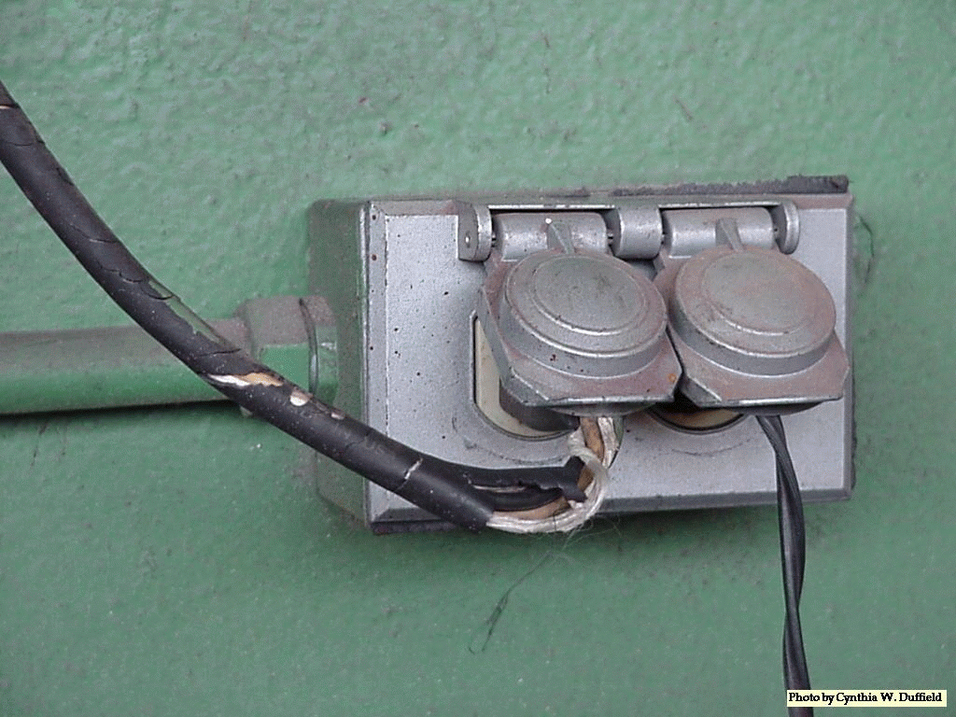
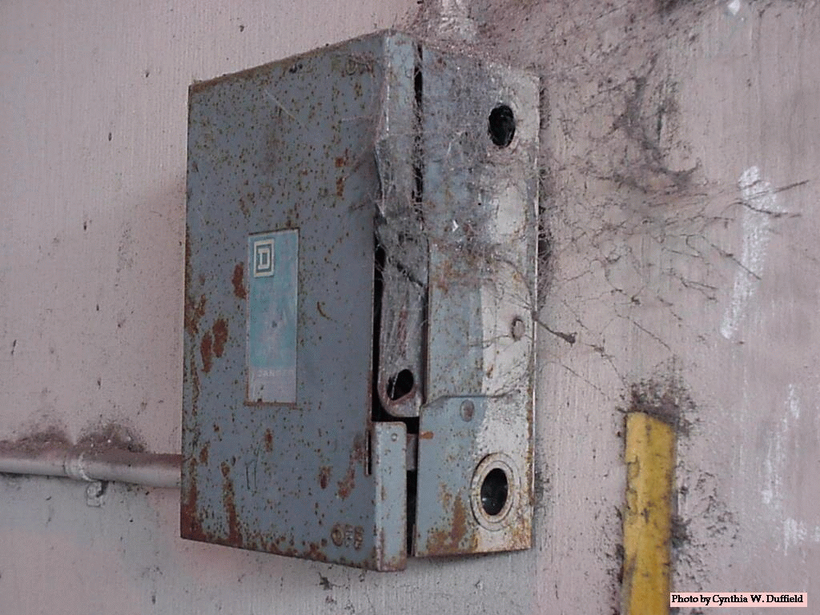

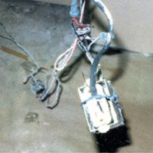
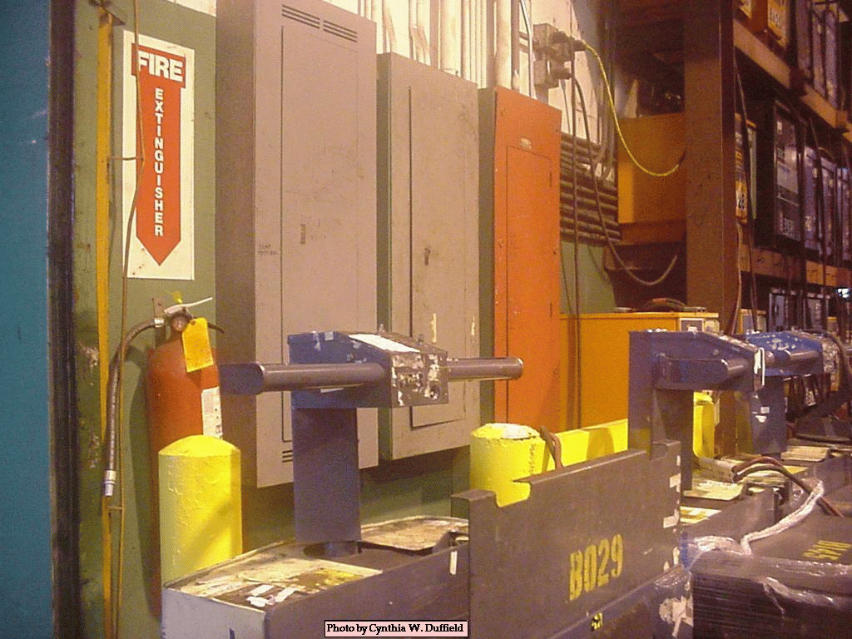
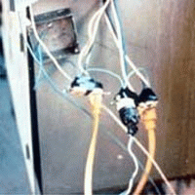
Common Electrical Hazards
Damaged Insulation On Cord
Open Knock-outs on panel box
Missing Ground Pin
“Home-made” Outlet box
Panel box blocked
Improper use of ext. cords

Slide 82
PEOSH Overview

Slide 83
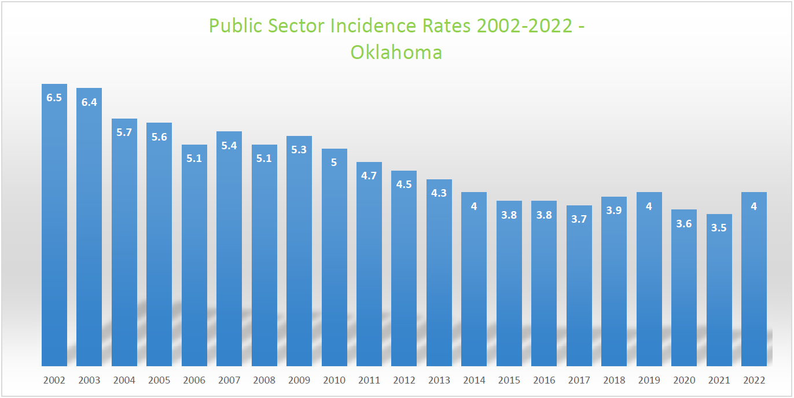
Injury and Illness Incidence Rate (IR) For Public Sector
Incidence Rate per 100 Full Time Equivalent (FTE) Public Sector Workers.
  IR = Total Number of Injuries & Illnesses x 200,000, Divided by Total No. of Hours Worked.

Slide 84
Oklahoma Public Sector Incidence Rates (IR)
YEAR |  | 2022 | 2021 | 2020 | 2019 | 2018 | 2017 | 2016 | 2015 | 2014 | 2013 | 2012 | 2011 | 2010 | 2009 | 2008 | 2007 | 2006
TOTAL | Incidence Rate | 4.0 | 3.5 | 3.6 | 4 | 3.9 | 3.7 | 3.8 | 3.8 | 4 | 4.3 | 4.5 | 4.7 | 5 | 5.3 | 5.1 | 5.4 | 5.1
 | STATE | 3.1 | 2.1 | 2.2 | 2.4 | 2.7 | 2.5 | 2.6 | 2.8 | 2.9 | 3.1 | 3.1 | 3.4 | 3.4 | 3.8 | 3.7 | 3.9 | 3.4
 | LOCAL | 4.5 | 4.3 | 4.5 | 5 | 4.6 | 4.6 | 4.6 | 4.5 | 4.7 | 5.1 | 5.5 | 5.6 | 6 | 6.2 | 6.1 | 6.3 | 6.3
 | CITY | 8.3 | 8.9 | 9.3 | 8.3 | 8.8 | 8.2 | 8.7 | 8.4 | 8.5 | 9.2 | 10.2 | 10.8 | 12.1 | 11.4 | 11.3 | 12.5 | 12.4
 | COUNTY | 4.5 | 4.1 | 4.2 | 4.2 | 3.9 | 4.7 | 4 | 3.6 | 4.4 | 4.3 | 4.4 | 4.7 | 5.2 | 5.6 | 5.9 | 5.8 | 5.7
 | SCHOOLS | 2.9 | 2.4 | 2.2 | 2.8 | 2.6 | 2.9 | 2.8 | 2.8 | 2.9 | 3.2 | 3.2 | 3.4 | 3.5 | 3.7 | 3.5 | 3.7 | 3.5
Source: Oklahoma Department of Labor, Statistical Research Division, Annual Public Sector Survey

Slide 85
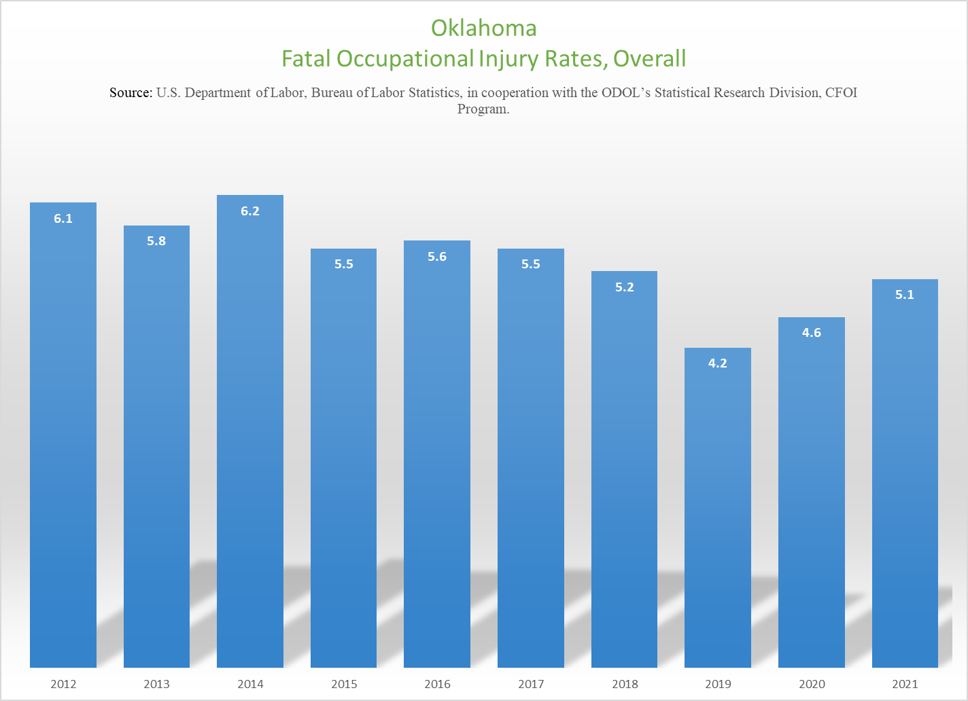
Fatal Injuries Incident Rate
Incident Rate per 100,000 Workers (Private and Public).

Slide 89
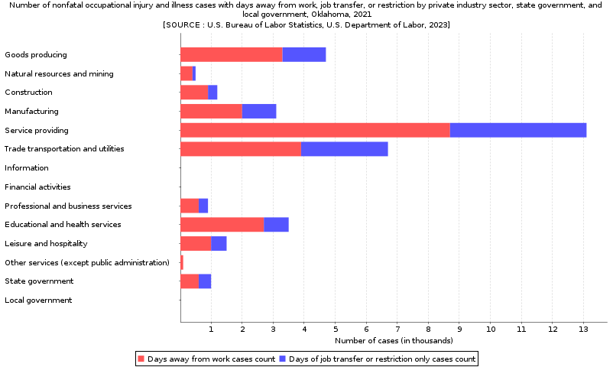

Slide 90
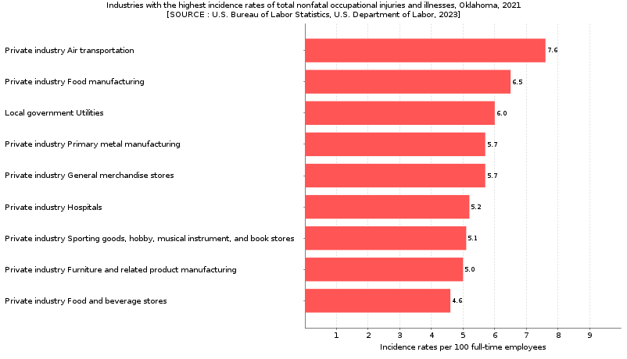

Slide 91
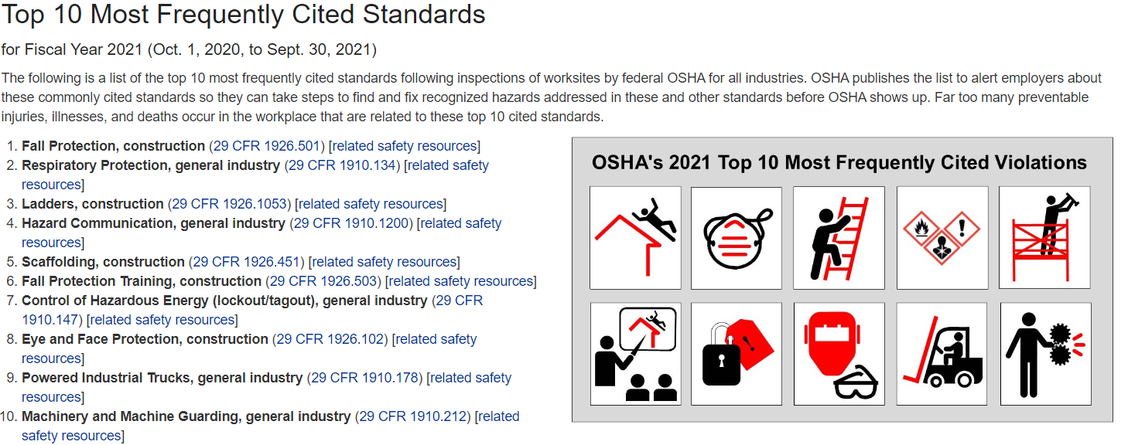

Slide 92
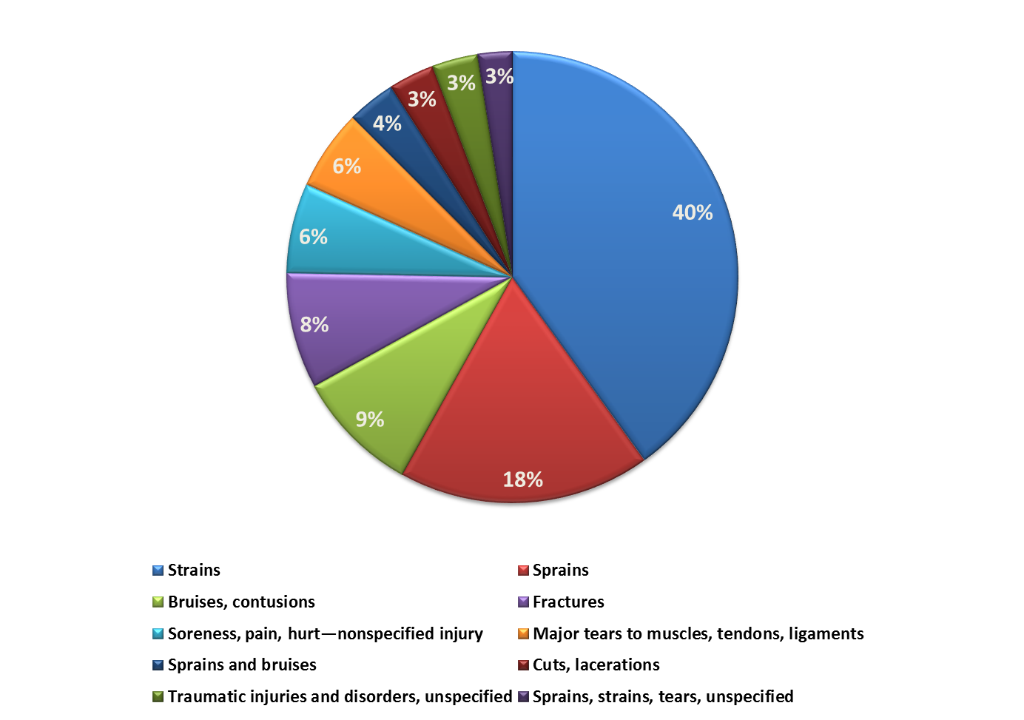
Top 10 Lost Workday Cases
All Public Sector by Nature of Injury

Slide 93
Top 5 Lost Workday Cases by Nature
Public Schools

Slide 94
Top 5 Lost Workday Cases by Nature
Counties

Slide 95
Top 5 Lost Workday Cases by Nature
Cities

Slide 96
Top 5 Lost Workday Cases by Nature
State Agencies

Slide 97
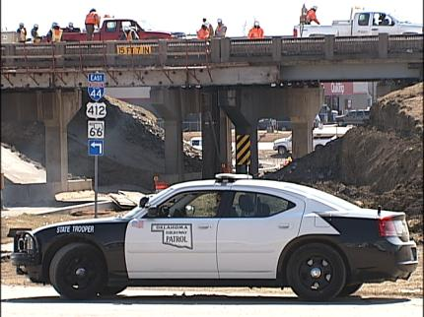
Final Questions

Slide 98
We Moved!
PEOSH and Oklahoma Department of Labor
Now located:
409 NE 28th Street, 3rd Floor
Oklahoma City, OK 73105
(888) 269-5353
www.oklahoma.gov/labor
www.facebook.com/OKDOL

Slide 99
For more information, contact:
John Dyer, M.S. I.H., CSHO
Safety and Health Director
Public Employees Occupational Safety & Health Division
409 NE 28th Street, 3rd Floor
Oklahoma City, OK 73105
(405) 521-6115
John.Dyer@labor.ok.gov
www.oklahoma.gov/labor
Eric Williams
Statistical Research Specialist and CFOI Program Manager
Public Employees Occupational Safety & Health Division
409 NE 28th Street, 3rd Floor
Oklahoma City, OK 73105
(405) 521-6568
Eric.Williams@labor.ok.gov

