Slide 1
CCTV Sewer Inspections
Results and data retention – AKA Would you look at this…

Slide 2
When should you worry?
When you have a blockage and the jetter can not remedy the situation.
Issue after issue in a certain area.
Constant Overflows
Visible Sink Holes Forming
Post Construction

Slide 4
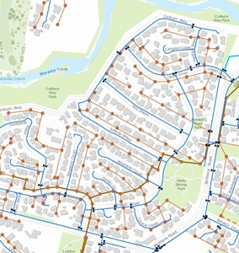
POP QUIZ!!
How many miles roughly of
sewer lines are in the
United States?

Slide 5
Over 800,000 miles of public and 500,000 of private laterals
There are 238,855 miles (384,400 km) between Earth and the moon on average.

Slide 6
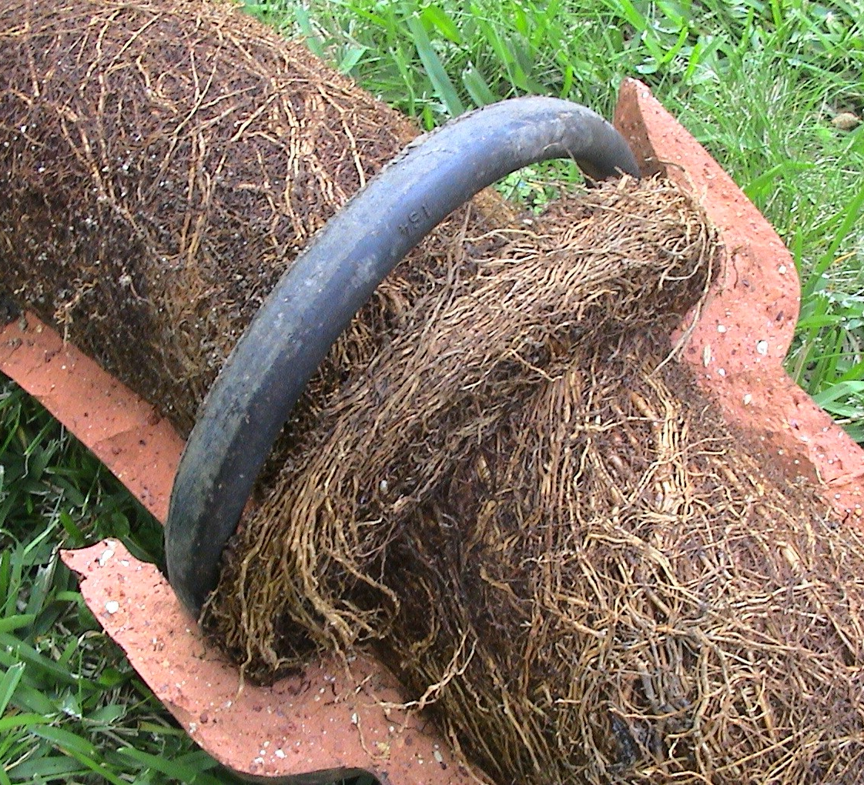
BLOCKAGES
Leading causes of blockages we mostly see are: ROOTS.

Slide 7
This was after jetting the line. You can see where the jetter made a “hole” for flow

Slide 8
This held back 100% of the flow in an 8 inch line for roughly 2 blocks.
This later required a point repair done as the line was collapsed behind the root mass.

Slide 10
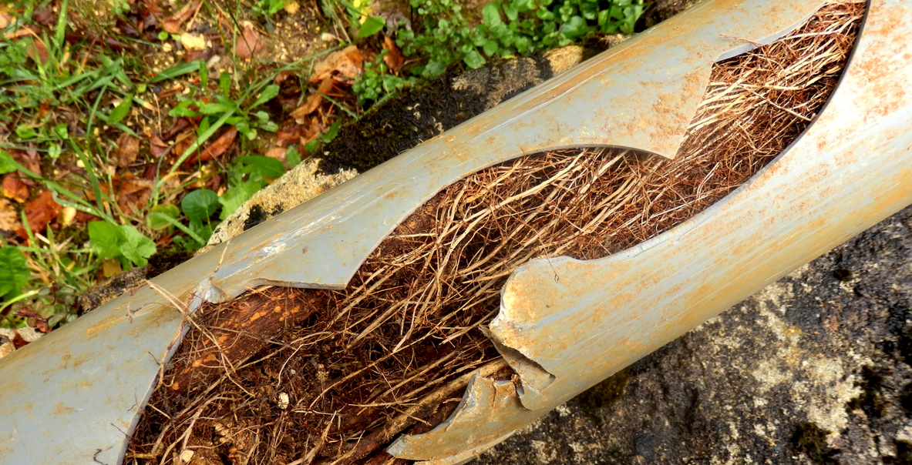

Slide 11
Another fine example of “its flowing for now”

Slide 12
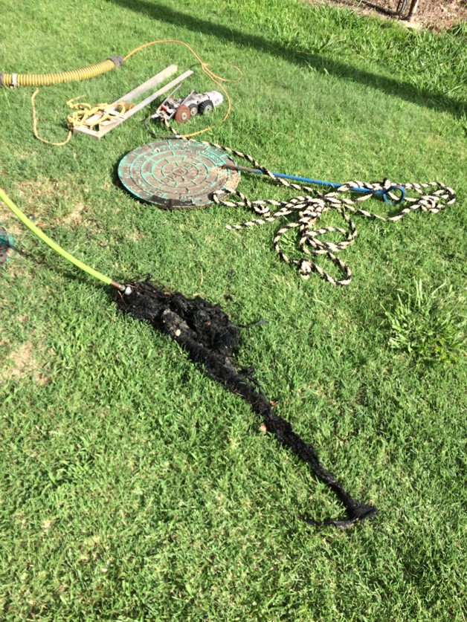
May I suggest…… Using Omag AND Dukes Program!

Slide 13
POP Quiz!!
How many gallons of wastewater does the city of New York treat on a daily basis?

Slide 14
On average the 14 wastewater facilities treat 1.3 billion gallons daily
So that’s around 8 billion 16oz water bottles. 12.5 million bathtubs or 1532 Olympic sized pools.

Slide 16
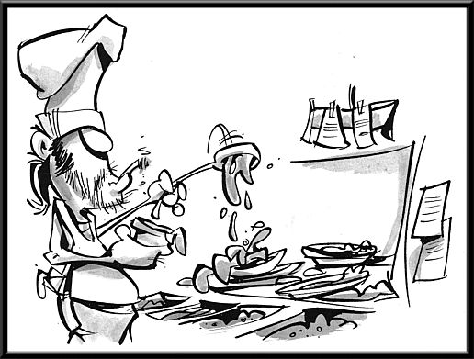
Fats, oils, and grease can solidify and accumulate around the insides of underground sewer pipes. This can lead to blockages, backups, pipe bursts, and overflows. The Environmental Protection Agency (EPA) reports that “grease from restaurants, homes, and industrial sources are the most common cause (47 %) of reported blockages.”

Slide 17
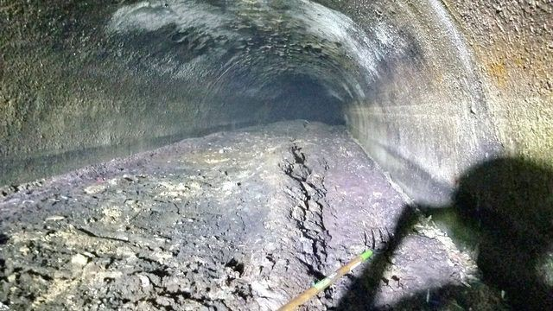

Slide 18
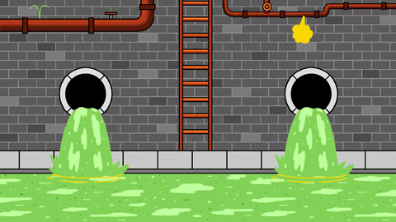
Suggestions:
When finding FOGS in the SS system make a note in a journal or such of when, how much and dates.
Contact the business owners, schools or whom ever. That is if you can pinpoint who is dumping.
Using a chemical treatment to “eat” away at the FOGs.

Slide 19
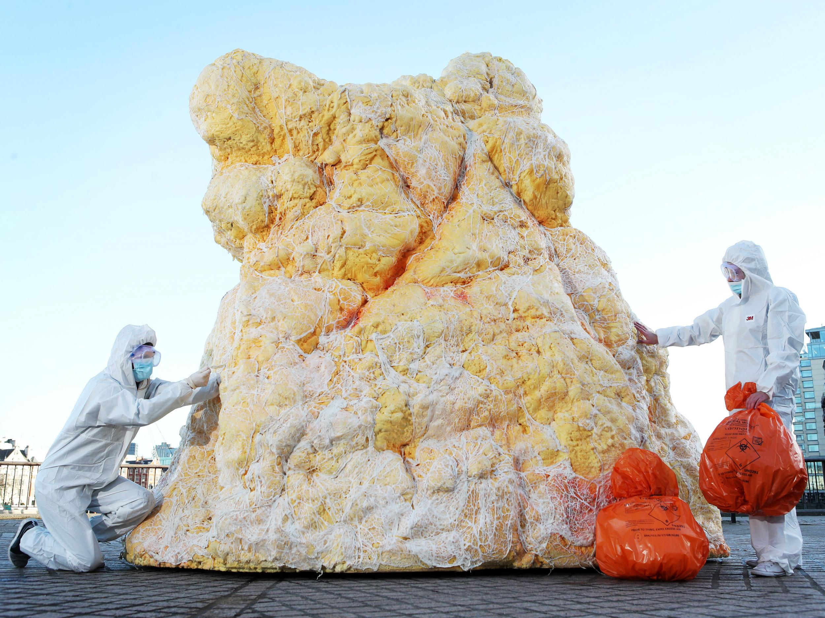

Slide 21
Sinkholes, CollapseS, Post Construction and Everything Else.
When using a camera system in sewers, storm drains and such we come across a lot of unknowns.
You NEVER know what you will find that is causing issues….seriously.

Slide 22
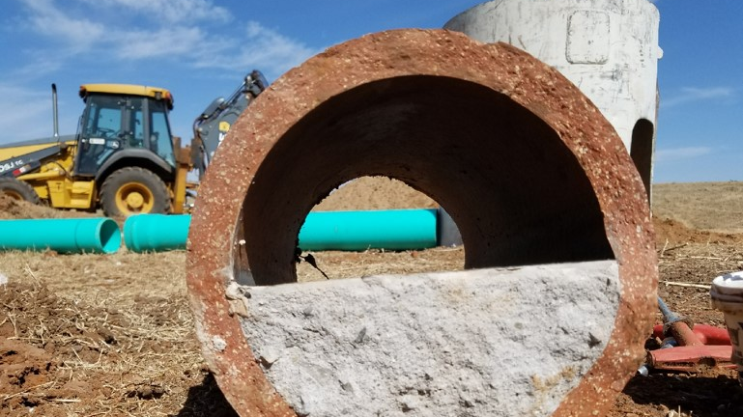

Slide 27
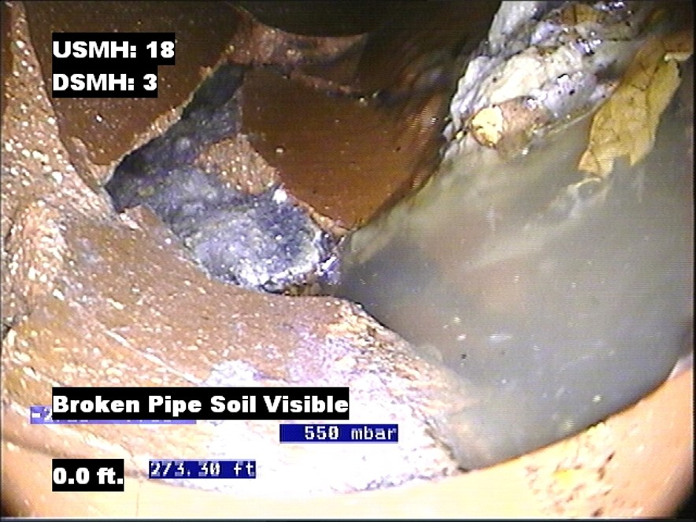

Slide 28
POST CONSTRUCTION

Slide 30
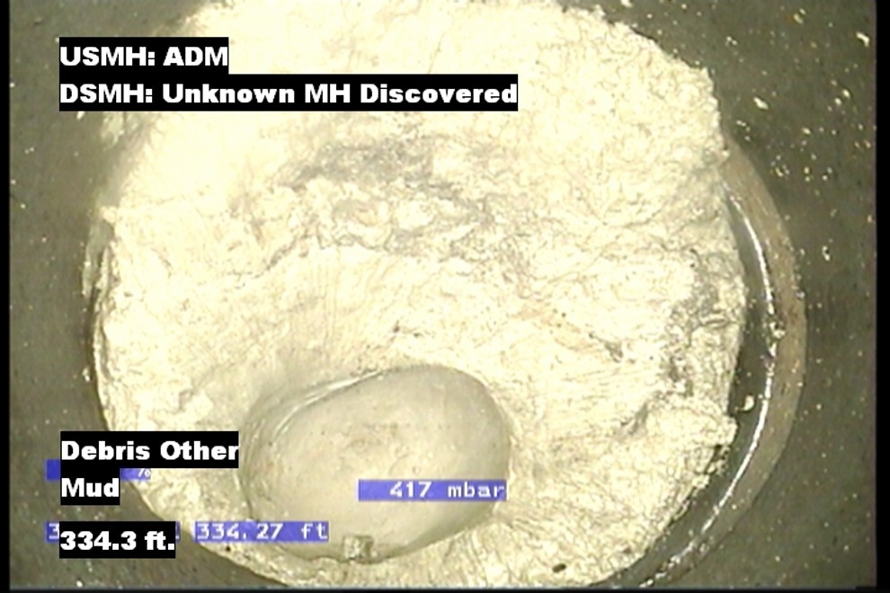
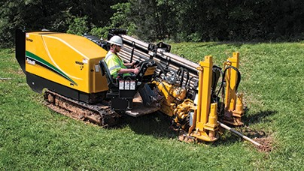
Mud from a boring machine. You can see where the warthog made an indention.

Slide 33
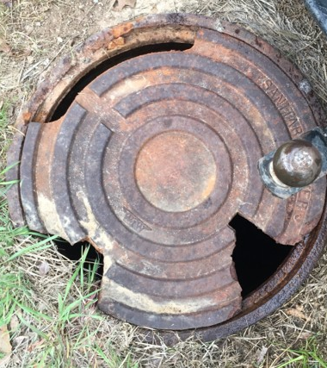
Don’t Forget to Check Manholes Lids also!!

